Slide 1



Lesson 3 Reading Guide - KC
Adaptation and Evolution
How does natural selection occur?
What is an adaptation?
Why do traits change over time?

Slide 2
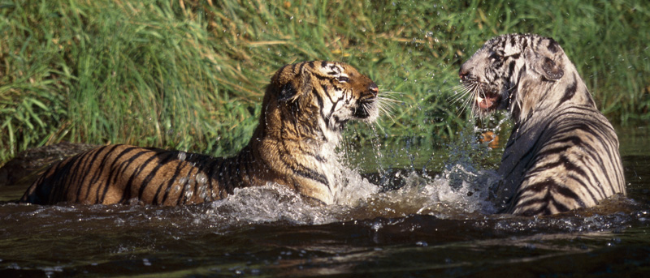
Lesson 3-1
Mutations, Variations, and Natural Selection
Slight differences in inherited traits among individuals in a population are called variations.
Creatas/PunchStock

Slide 3
Lesson 3-1
Mutations, Variations, and Natural Selection (cont.)
The process by which individuals with variations that help them survive in their environment live longer, compete better, and reproduce more than those individuals without these variations is called natural selection.

Slide 4
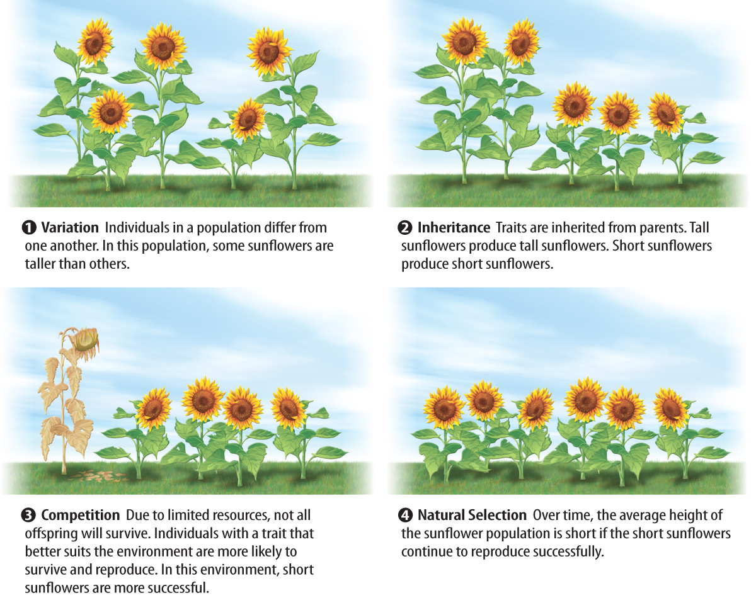
Lesson 3-1

Slide 5
Lesson 3-2
Adaptations
An adaptation is an inherited trait that increases an organism’s chance of surviving and reproducing in a particular environment.
Individuals CANNOT adapt!
Structural adaptations involve physical characteristics, such as color or shape.

Slide 6
Lesson 3-2
Adaptations (cont.)
Functional adaptations involve internal systems that affect an organism’s physiology or biochemistry.
Behavioral adaptations, such as migration, involve the ways an organism behaves or acts.

Slide 7
Lesson 3-3
Evolution of Populations—
Why Traits Change
Evolution is change in inherited characteristics over time.
Evolution by natural selection is a way that populations change over time.
As the environment changes, different inherited traits might enable survival, and the population can evolve again.

Slide 8
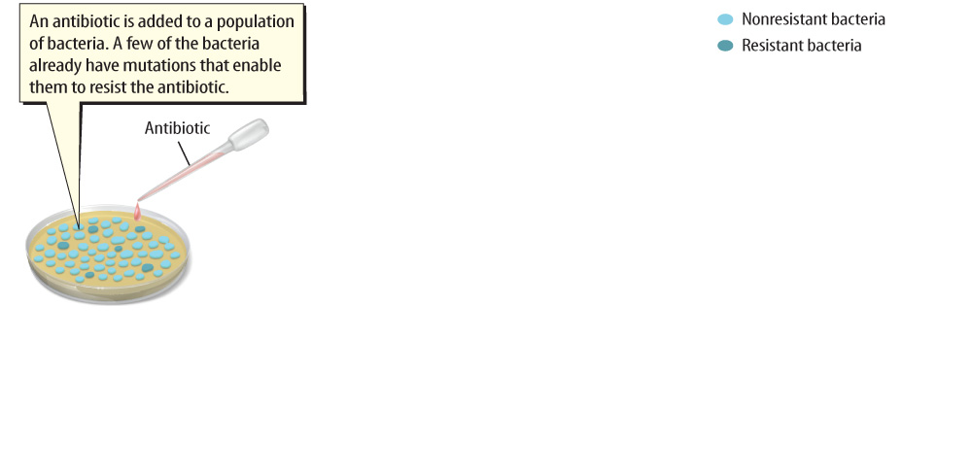
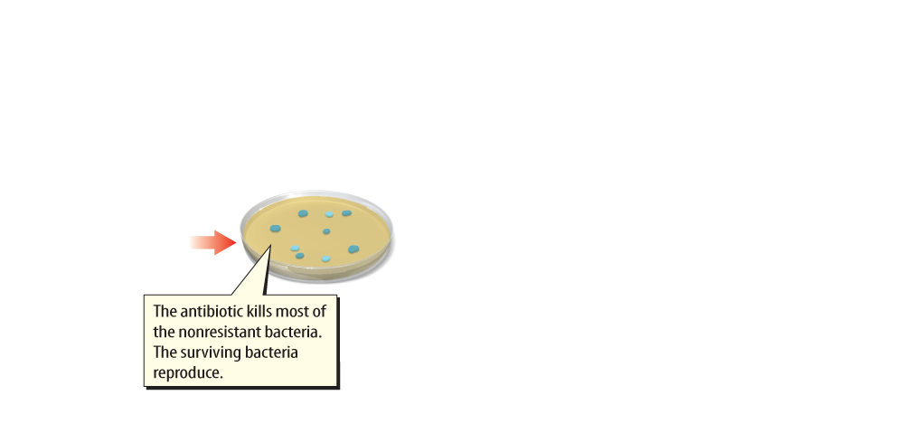
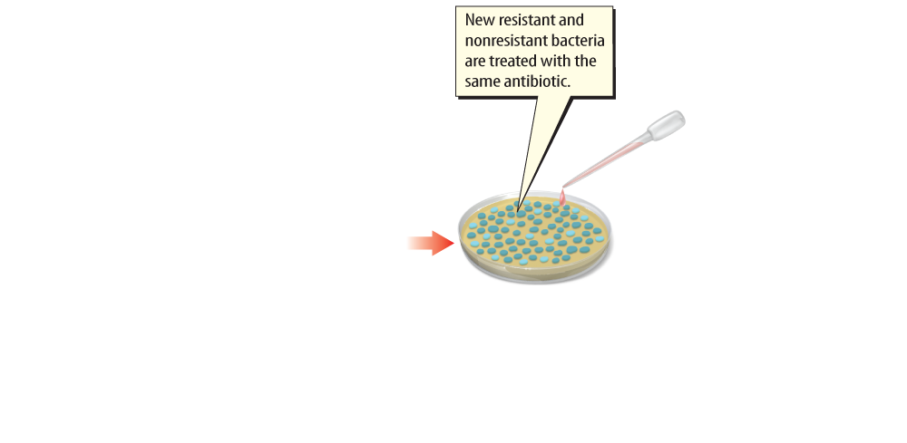
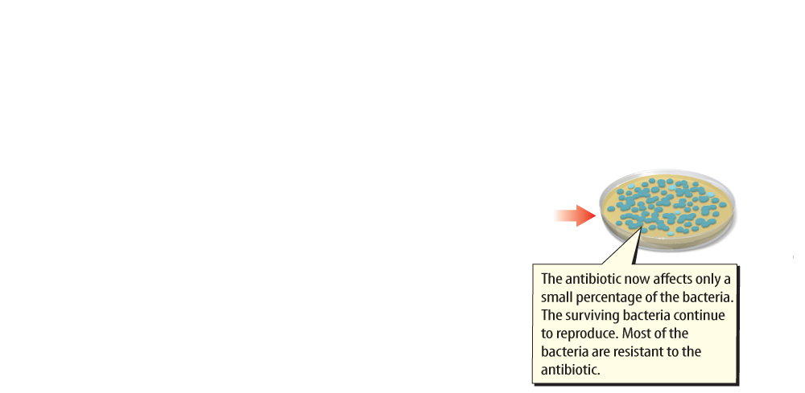
Lesson 3-3
A population of bacteria can evolve antibiotic resistance.

Slide 9
Lesson 3-4
Extinction and Conservation Biology
When the last individual of a species dies, the species has undergone extinction.
extinction
from Latin extinctus, means
“wipe out”

Slide 10
Lesson 3-4
Extinction and Conservation Biology (cont.)
Organisms called invasive species may be introduced into a habitat, making it difficult for some native species to survive and reproduce.
Conservation biology is a branch of biology that studies why many species are in trouble and what can be done to save them.

Slide 11

Lesson 3 - VS
Natural selection occurs when individuals with traits that better suit the environment survive longer and reproduce more successfully than individuals without the traits.

Slide 12
Lesson 3 - VS
An adaptation is an inherited trait that increases an organism’s chance of surviving and reproducing in an environment.
Conservation biologists work to save species from extinction.

Slide 13

Lesson 3 – LR1
What has a species undergone when the last individual of that species dies?
A. adaptation
B. evolution
C. extinction
D. variation

Slide 14
Lesson 3 – LR2
Migration is an example of which kind of adaptation?
A. behavioral
B. evolutionary
C. functional
D. structural

Slide 15
Lesson 3 – LR3
Which term refers to change over time?
A. adaptation
B. evolution
C. natural selection
D. variation

Slide 16

Lesson 3 - Now
Do you agree or disagree?
5. A population that lacks variation among its individuals might not be able to adapt to a changing environment.
6. Extinction occurs when the last individual of a species dies.

