Slide 1



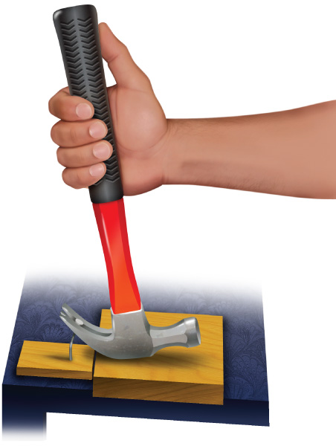




Chapter Menu
Chapter Introduction
Lesson 1 Types of
Energy
Lesson 2 Energy
Transformations
and Work
Lesson 3 Machines
Chapter Wrap-Up

Slide 2


Chapter Introduction
How does energy cause change?

Slide 3

Chapter Introduction
What do you think?
Before you begin, decide if you agree or disagree with each of these statements.
As you view this presentation, see if you change your mind about any of the statements.

Slide 4
Chapter Introduction
Do you agree or disagree?
1. Energy is the ability to produce motion.
2. Waves transfer energy from place to place.
3. Energy cannot be created or destroyed, but it can be transformed.

Slide 5
Chapter Introduction
Do you agree or disagree?
4. Work describes how much energy it takes for a force to push or to pull an object.
5. All machines are 100 percent efficient.
6. Simple machines do work using one motion.

Slide 6


Lesson 1 Reading Guide - KC
Types of Energy
What is energy?
What are the different forms of energy?
How is energy used?

Slide 7
Lesson 1-1
What is energy?
Energy is the ability to do work (physics definition)
Work is moving something
So ENERGY creates the ability to move something
Many sources of energy can be transformed into other forms of energy

Slide 8
Lesson 1-2
Kinetic Energy
Kinetic energy is the energy an object has because of motion.
Anything that is in motion has kinetic energy
  Including large objects that you can see as well as small particles, such as molecules, ions, atoms, and electrons.

Slide 9
Lesson 1-2
Kinetic Energy (cont.)
Electrons move around the nucleus of an atom, and they can move from one atom to another.
When electrons move, they have kinetic energy and create an electric current.
The energy that an electric current carries is a form of kinetic energy called electric energy.

Slide 10
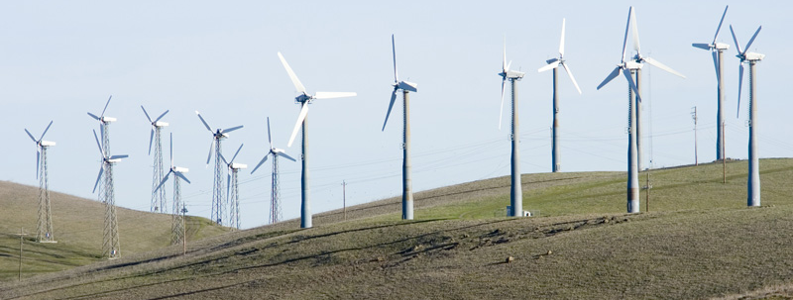
Lesson 1-2
When the blades of wind turbines rotate, they turn a generator that changes the kinetic energy of the moving blades into electric energy.
The McGraw-Hill Companies, Inc./John Flournoy, photographer

Slide 11
Lesson 1-2
Kinetic Energy (cont.)
electric
from Greek elektron, means “amber”; because electricity was
first generated by rubbing pieces
of amber with fur or straw

Slide 12
Lesson 1-3
Potential Energy
Potential energy is stored energy
Gravitational potential energy is a type of potential energy stored in an object due to its height above Earth’s surface.

Slide 13
Lesson 1-3
Potential Energy (cont.)
Gravitational potential energy depends on the mass of an object and its distance from Earth’s surface.
The more mass an object has and the greater its distance from Earth, the greater its gravitational potential energy.

Slide 14
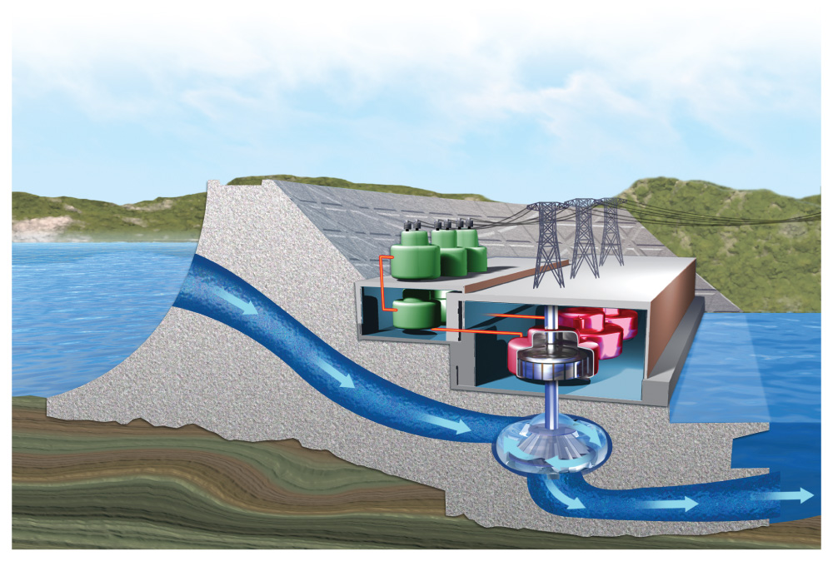
Lesson 1-3
Hydroelectric energy plants convert the gravitational potential energy of water into electric energy.

Slide 15
Lesson 1-3
Potential Energy (cont.)
Most electric energy in the United States comes from fossil fuels such as petroleum, natural gas, and coal.
The atoms that make up these fossil fuels are joined by chemical bonds.
Chemical energy is energy that is stored in and released from the bonds between atoms.

Slide 16
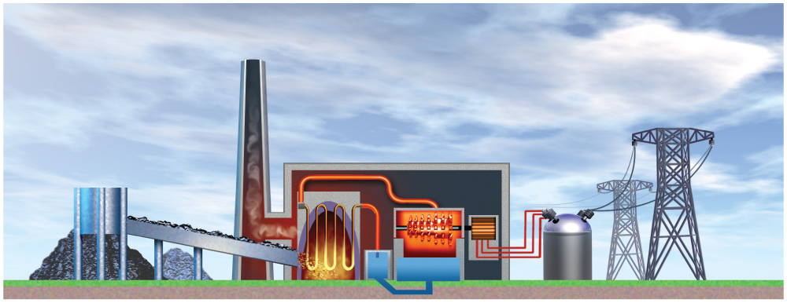
Lesson 1-3
When fossil fuels burn, the chemical bonds between the atoms that make up the fossil fuel break apart. When this happens, chemical energy transforms to thermal energy.

Slide 17
Lesson 1-3
This energy is used to heat water and form steam. The steam is used to turn a turbine, which is connected to a generator that generates electric energy.

Slide 18
Lesson 1-3
Potential Energy (cont.)
Chemical energy is stored in the foods you eat.
Your body converts the energy stored in chemical bonds in food into the kinetic energy of your moving muscles and into the electric energy that sends signals through your nerves to your brain.

Slide 19
Lesson 1-3
Potential Energy (cont.)
The majority of energy on Earth comes from the Sun.
Nuclear fusion, a process found in the Sun, joins the nuclei of atoms and releases large amounts of energy.

Slide 20
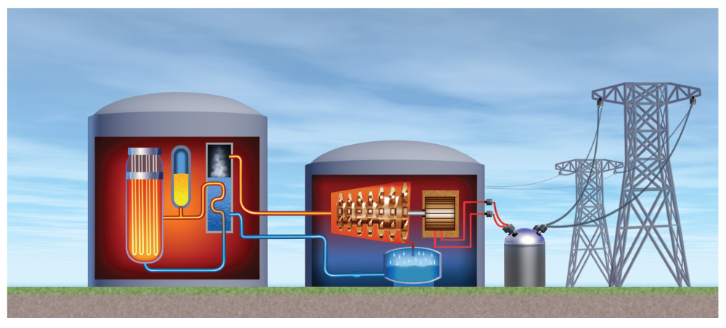
Lesson 1-3
Nuclear energy plants break apart the nuclei of certain atoms using a process called nuclear fission.

Slide 21
Lesson 1-3
Nuclear fission produces a large amount of energy from just a small amount of fuel.

Slide 22
Lesson 1-3
Potential Energy (cont.)
Both nuclear fusion and nuclear fission release nuclear energy—energy stored in and released from the nucleus of an atom.
Nuclear fission produces radioactive waste that is hazardous and difficult to dispose of safely.

Slide 23
Lesson 1-4
Kinetic and Potential Energies Combined (cont.)
The sum of potential energy and kinetic energy in a system of objects is mechanical energy.
Mechanical energy is the energy an
object has because of a combination
of the following:
  the movement of its parts (kinetic energy)
  the position of its parts (potential energy)

Slide 24
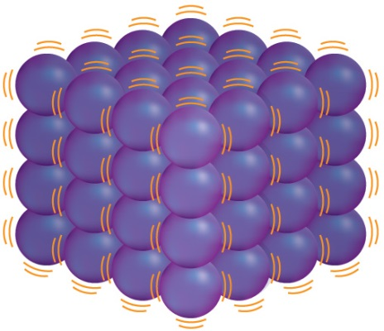
Lesson 1-4
Kinetic and Potential Energies Combined (cont.)
Thermal energy is the sum of the kinetic energy and potential energy of the particles that make up an object.
Individual particles vibrate
back and forth in place, giving
them kinetic energy.
The particles also have potential energy because of the distance between particles and the charge of the particles.

Slide 25
Lesson 1-4
Kinetic and Potential Energies Combined (cont.)
The particles in Earth’s interior contain great amounts of thermal energy.
This energy is called geothermal energy.

Slide 26
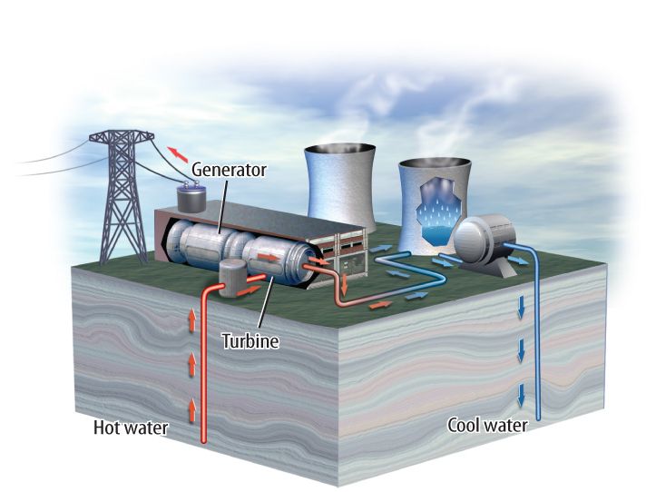
Lesson 1-3
Geothermal energy plants turn water into steam, which turns turbines in electric generators that covert the geothermal energy to electric energy.

Slide 27
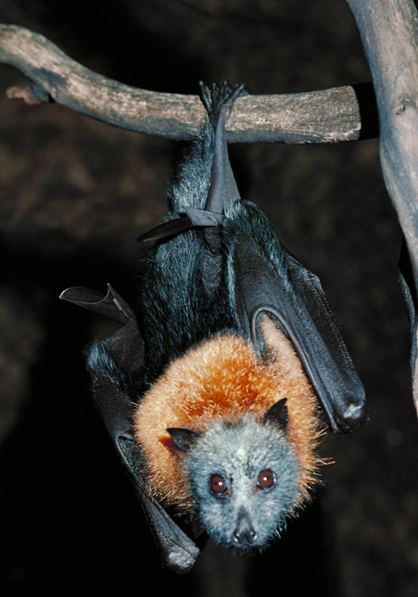
Lesson 1-5
Energy from Waves
Waves are disturbances that carry energy from one place to another.
Sound energy is energy
carried by sound waves.
Some animals, such as
bats, emit sound waves
to find prey
CORBIS

Slide 28
Lesson 1-5
Energy from Waves (cont.)
The kinetic energy of tectonic plate movement is carried through the ground by seismic waves.
Seismic energy is energy transferred by waves moving through the ground.

Slide 29
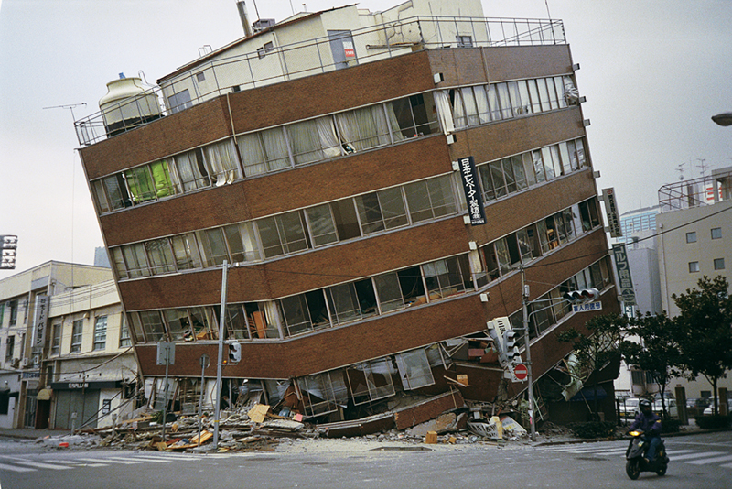
Lesson 1-5
Seismic energy can destroy buildings and roads.
Dr. Roger Hutchinson/NOAA

Slide 30
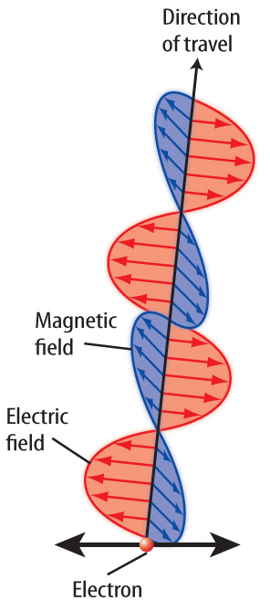
Lesson 1-6
Energy from Waves (cont.)
Electromagnetic waves are electric and magnetic waves that move perpendicular to each other.
Electromagnetic waves can travel through solids, liquids, gases, and vacuums.

Slide 31
Lesson 1-6
Energy from Waves (cont.)
vacuum
Science Use a space that contains no matter
Common Use to clean with a vacuum cleaner or sweeper

Slide 32
Lesson 1-6
Energy from Waves (cont.)
The energy carried by electromagnetic waves is radiant energy.
The Sun’s energy is transmitted to Earth by electromagnetic waves.

Slide 33
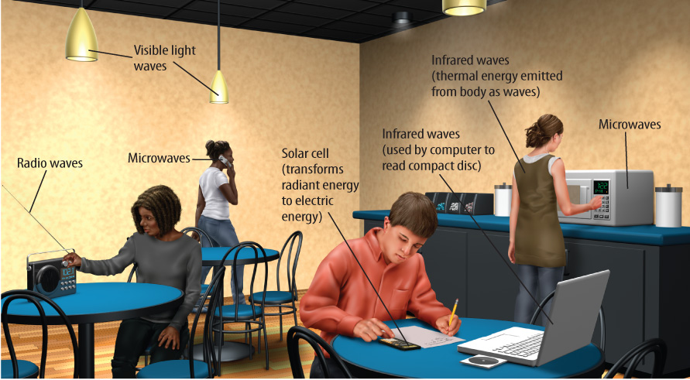
Lesson 1-6
Radio waves, light waves, and microwaves are all electromagnetic waves.

Slide 34

Lesson 1 – LR1
Which energy type is stored in and released from the bonds between atoms?
A. chemical
B. electrical
C. kinetic
D. potential

Slide 35
Lesson 1 – LR2
Which term refers to thermal energy that originates from particles in the Earth’s interior?
A. geothermal energy
B. nuclear fission
C. nuclear fusion
D. seismic energy

Slide 36
Lesson 1 – LR3
Which energy type is carried by electromagnetic waves?
A. mechanical
B. radiant
C. seismic
D. thermal

Slide 37

Lesson 1 - Now
Do you agree or disagree?
1. Energy is the ability to produce motion.
2. Waves transfer energy from place to place.

