Slide 1



Lesson 2 Reading Guide - KC
Energy Transformations and Work
What is the law of conservation of energy?
In what ways can energy be transformed?
How are energy and work related?

Slide 2

Lesson 2 Reading Guide - Vocab
Energy Transformations and Work
energy transformation
law of conservation of energy
work

Slide 3
Lesson 2-1
Energy Transformations
Energy transformation is the conversion of one form of energy to another.
When energy is transferred, the form of energy does not have to change.

Slide 4
Lesson 2-1
Energy Conservation
The law of conservation of energy says that energy can be transformed from one form to another, but it cannot be created or destroyed.
Even though energy can change forms, the total amount of energy in the universe does not change. It just changes form.

Slide 5

Lesson 2-1
Energy Conservation (cont.)
What is the law of conservation
of energy?

Slide 6
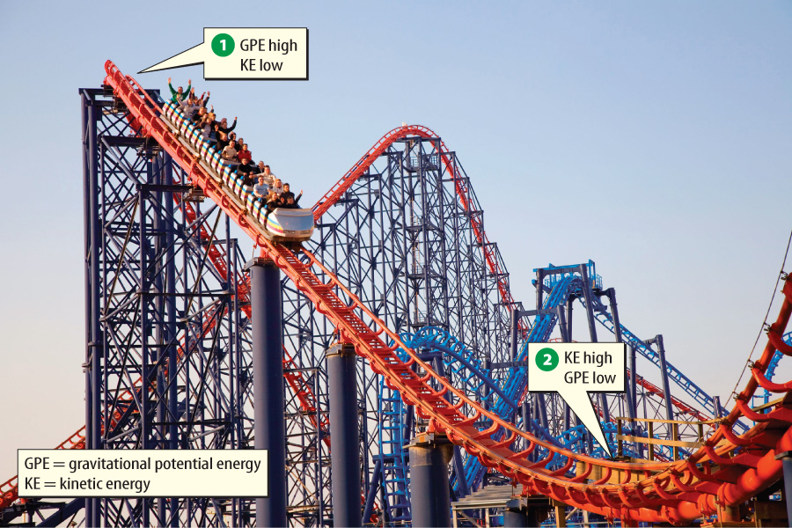
Lesson 2-1
When you ride a roller coaster, your gravitational potential energy is transformed to kinetic energy and back to gravitational potential energy.

Slide 7
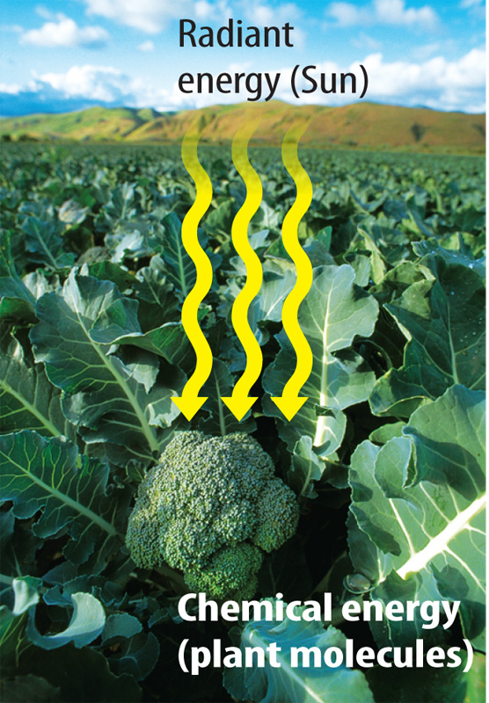
Lesson 2-1
Energy Conservation (cont.)
When a plant carries on photosynthesis, it transforms radiant energy from the Sun into chemical energy.
The chemical energy is stored in the bonds of the plant’s molecules.

Slide 8
Lesson 2-1
Energy Conservation (cont.)
When electric energy plants burn fossil fuels, they transform the chemical energy from the molecules that were made by plants that lived millions of years ago.
That chemical energy is transformed to the electric energy that you use in your home and school.

Slide 9
Lesson 2-1
Energy Conservation (cont.)
Identify three energy
transformations that occur
to make electric energy.

Slide 10
Lesson 2-3
Energy and Work
Work is the transfer of energy that occurs when a force makes an object move in the direction of the force while the force acts on the object.
Forces are pushes or pulls.

Slide 11
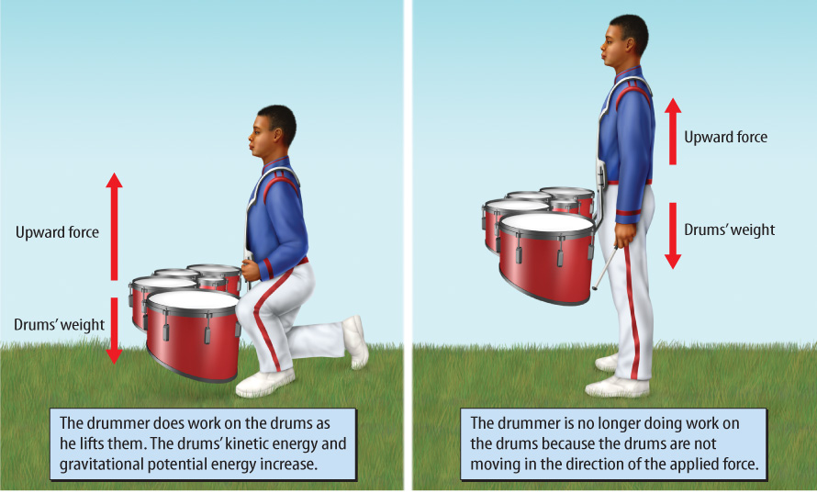
Lesson 2-3
The student does work on the drums when he lifts them. Once the drums are in place, no work is being done.

Slide 12
Lesson 2-3
Energy and Work (cont.)
If you do work on an object,
how will its energy change?

Slide 13
Lesson 2-3
Energy and Work (cont.)
To do work on an object, an object must move in the direction of the force.
Work is done only while the force is moving the object.

Slide 14
Lesson 2-3
Energy and Work (cont.)
work
from Greek ergon, means “activity”

Slide 15
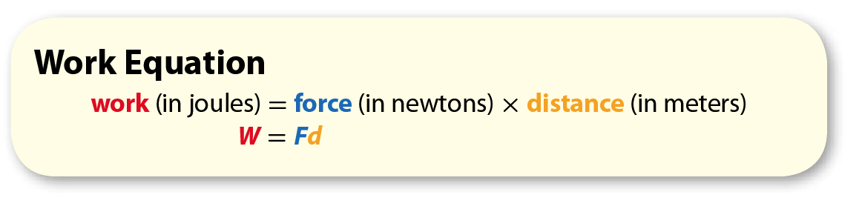
Lesson 2-3
Energy and Work (cont.)
Work also depends on the distance an object moves during the time the force is applied.
The equation for work is shown below.

Slide 16
Lesson 2-3
Energy and Work (cont.)
Force is the force applied to the object. Distance is the distance the object moves in the direction of the force while the force is acting on it.
The force in the equation is in newtons, and distance is in meters.
The product of newtons and meters is newton-meter.
A newton-meter is a joule.

Slide 17

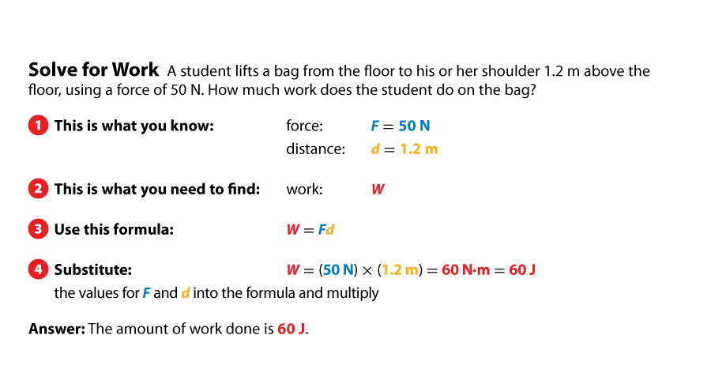
Lesson 2-3
Energy and Work (cont.)

Slide 18
Lesson 2-4
Energy and Heat
Friction is a force between two surfaces in contact with each other.
The direction of friction is in the opposite direction of the motion.
In every energy transformation and every energy transfer, some energy is transformed into thermal energy.

Slide 19
Lesson 2-4
Energy and Heat (cont.)
This thermal energy is transferred to the surroundings.
Thermal energy moving from a region of higher temperature to a region of lower temperature is called heat.
Scientists sometimes call this heat waste energy because it is not easily used to do useful work.

Slide 20

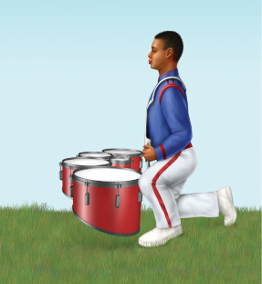
Lesson 2 - VS
Energy is always conserved.
Energy can be transformed into different kinds of energy.
Work and energy are
related.

Slide 21

Lesson 2 – LR1
Which energy type is radiant energy from the Sun transformed into during photosynthesis?
A. chemical
B. kinetic
C. mechanical
D. thermal

Slide 22
Lesson 2 – LR2
Which term refers to the conversion of one form of energy to another?
A. energy transfer
B. energy transformation
C. law of conservation of energy
D. work

Slide 23
Lesson 2 – LR3
In every energy transformation, some energy is transformed into what type of energy??
A. thermal
B. radiant
C. kinetic
D. chemical

Slide 24

Lesson 2 - Now
Do you agree or disagree?
3. Energy cannot be created or destroyed, but it can be transformed.
4. Work describes how much energy it takes for a force to push or to pull an object.

