Slide 1
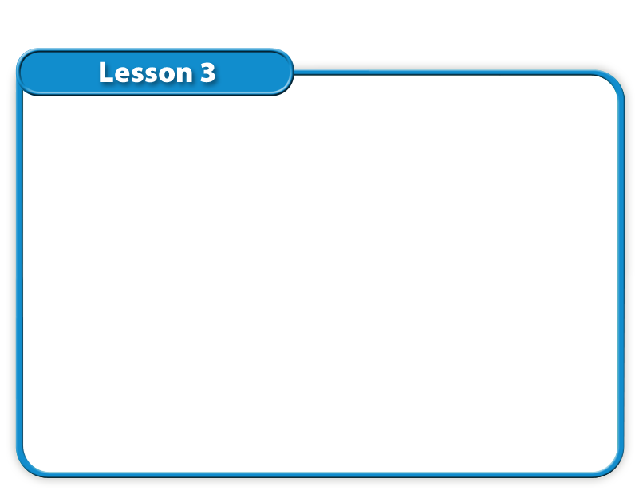


Lesson 3 Reading Guide - KC
Machines
What are simple machines?
In what ways can machines make work easier?

Slide 2

Lesson 3 Reading Guide - Vocab
Machines
simple machine
inclined plane
screw
wedge
lever
wheel and axle
pulley
complex machine
efficiency

Slide 3
Lesson 3-1
Machines Transfer Mechanical Energy
Many machines transfer mechanical energy from one object to another.
Simple machines are machines that do work using one movement.

Slide 4
Lesson 3-1
Machines Transfer Mechanical Energy (cont.)
Simple machines do not change the amount of work required to do a task; they only change the way work is done.
A simple machine can be an inclined plane, a screw, a wedge, a lever, a pulley, or a wheel and axle.

Slide 5
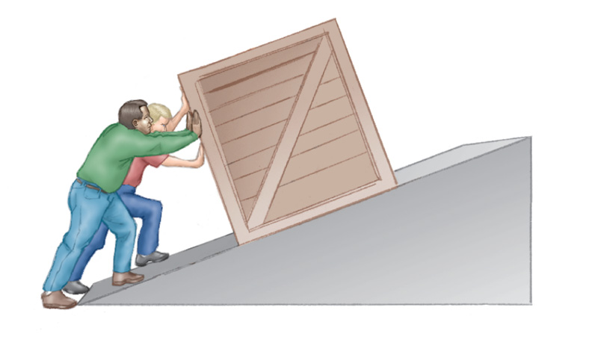

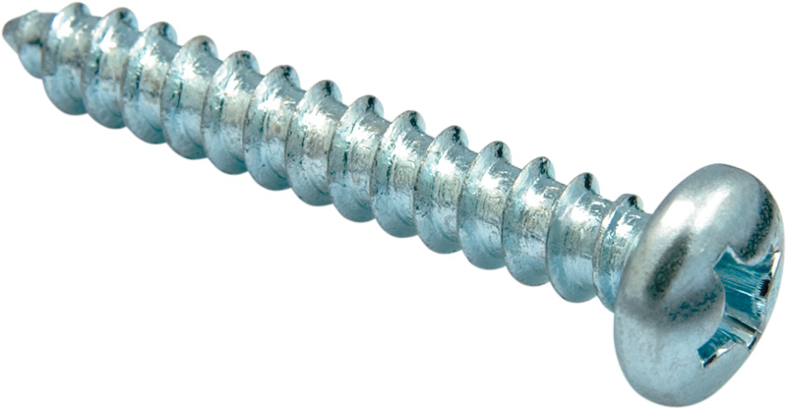
Lesson 3-1
An inclined plane
is a flat, sloped
surface.
A screw is an
inclined plane
wrapped around
a cylinder.
The McGraw-Hill Companies, Inc./Jacques Cornell photographer

Slide 6
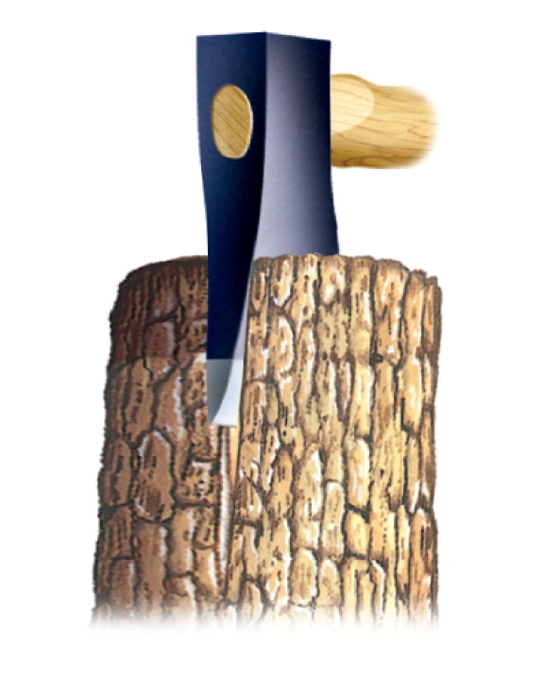
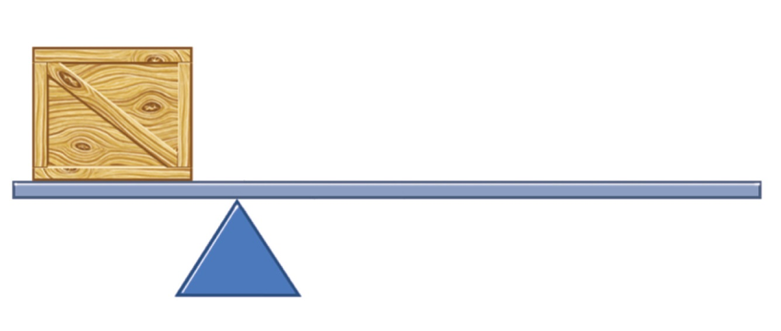
Lesson 3-1
A wedge is an inclined
plane that moves.
A lever is a simple
machine that pivots
around a fixed point.

Slide 7
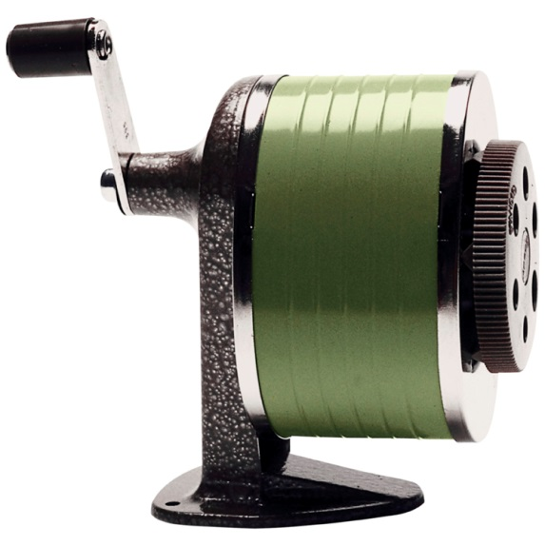
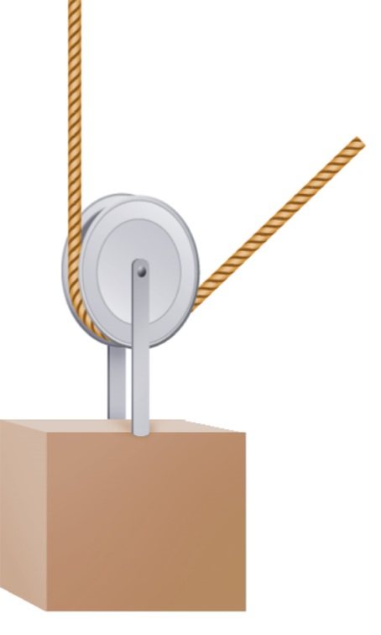
Lesson 3-1
A wheel and axle is a
simple machine that is a
shaft attached to a wheel
of a larger diameter so that
both rotate together.
A pulley is a grooved
wheel with a rope or cable
wrapped around it.
Dynamic Graphics/Jupiterimages

Slide 8

Lesson 3-1
Machines Transfer Mechanical Energy (cont.)
What are examples of simple
machines?

Slide 9
Lesson 3-1
Machines Transfer Mechanical Energy (cont.)
Two or more simple machines working together are a complex machine.
Complex machines use more than one motion to accomplish tasks.

Slide 10
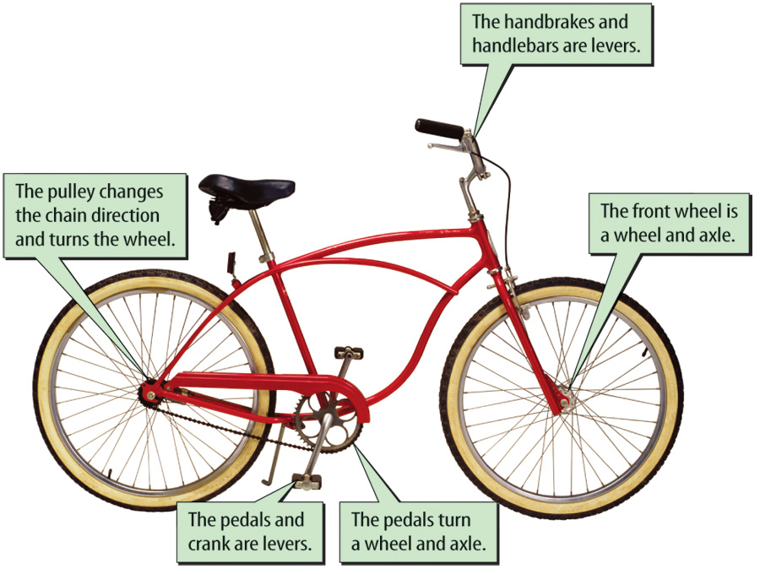
Lesson 3-1
A bicycle is an example of a complex machine.
Brand X Pictures

Slide 11
Lesson 3-2
Machines and Work
The work you do on a machine is called the input work.
The work the machine does on an object is the output work.
Machines make work easier by changing the distance the object moves or the force required to do work on an object.

Slide 12
Lesson 3-2
Machines and Work (cont.)
When the input distance of a machine is larger than the output distance, the output force is larger than the input force.
Machines also can change the direction of a force.

Slide 13
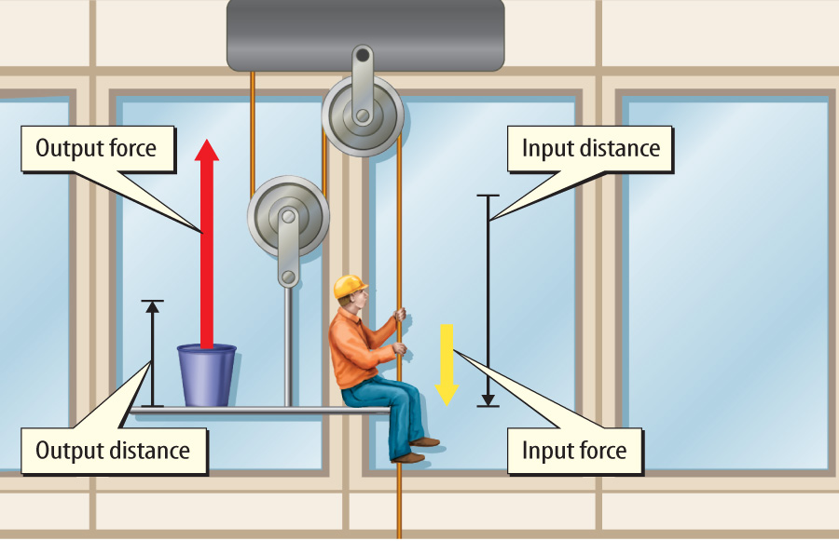
Lesson 3-2
The window washer’s pulley system makes the work of lifting easier.

Slide 14
Lesson 3-2
Machines and Work (cont.)
How can machines make
work easier?

Slide 15
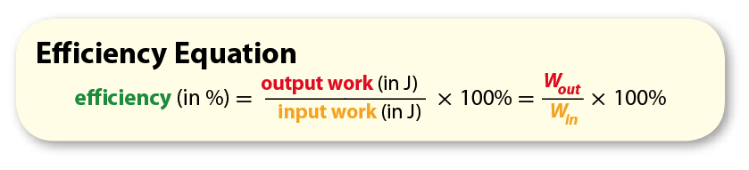
Lesson 3-3
Efficiency
Efficiency is the ratio of output work to input work.

Slide 16
Lesson 3-3
Efficiency (cont.)
Input and output work are measured in joules.
Efficiency is expressed as a percentage by multiplying the ratio by 100%.

Slide 17
Lesson 3-3
Efficiency (cont.)
The efficiency of a machine is never 100%—some work is always transformed into wasted thermal energy because of friction.
Lubricating the moving parts of a machine reduces the friction between the moving parts so that less input work is transformed to waste energy.

Slide 18
Lesson 3-3
Efficiency (cont.)
efficiency
from Latin efficere, means “work
out, accomplish”

Slide 19
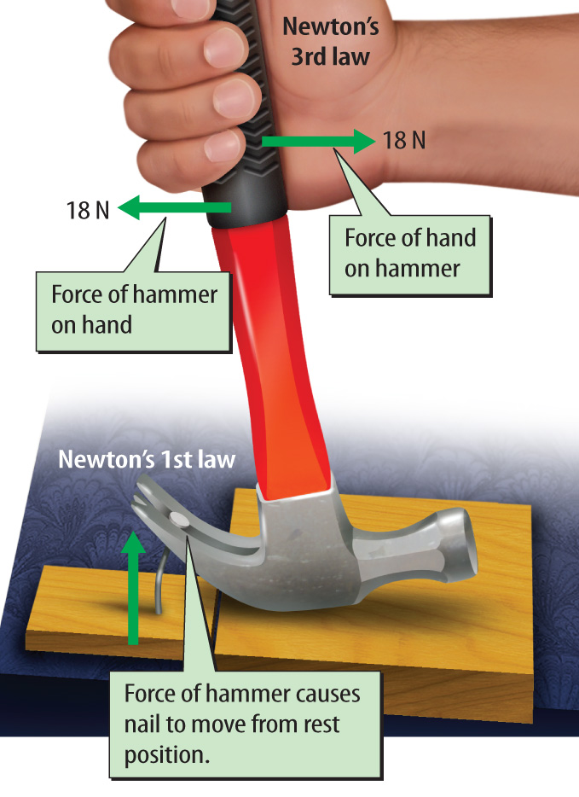
Lesson 3-3
Newton’s Laws and Simple Machines
Newton’s third law says that if one object applies a force on a second object, the second object applies an equal and opposite force on the first object.

Slide 20
Lesson 3-3
Newton’s Laws and Simple Machines (cont.)
According to Newton’s first law, the motion of an object changes when the forces that act on the object are unbalanced.

Slide 21
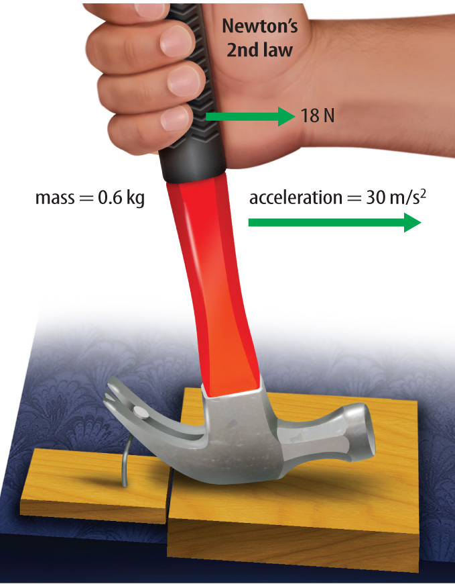
Lesson 3-3
Newton’s Laws and Simple Machines (cont.)
According to Newton’s second law of motion, the change in motion of an object is in the same direction as the total, or net.

Slide 22

Lesson 3 - VS
A bottle opener is a simple machine.
There are six types of simple machines, and a ramp is one example.
A bicycle is an example of a complex machine that is made up of different simple machines.

Slide 23
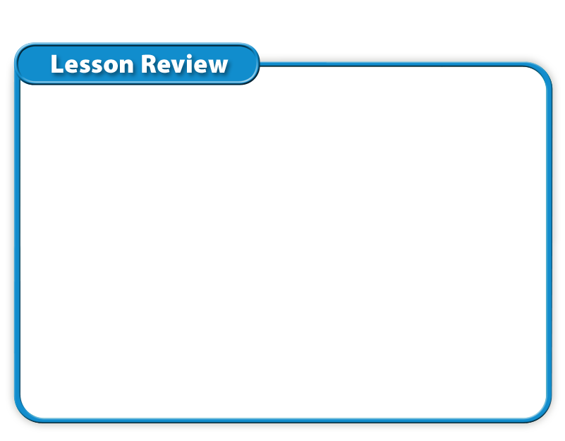
Lesson 3 – LR1
Which type of machine does work using one movement?
A. complex
B. efficient
C. mechanical
D. simple

Slide 24
Lesson 3 – LR2
Which term describes a grooved wheel with a rope or cable wrapped around it?
A. complex machine
B. inclined plane
C. pulley
D. wedge

Slide 25
Lesson 3 – LR3
What does lubricating the moving parts of a machine reduce?
A. efficiency
B. force
C. friction
D. work

Slide 26

Lesson 3 - Now
Do you agree or disagree?
5. All machines are 100 percent efficient.
6. Simple machines do work using one motion.

