Slide 1








Chapter Menu
Chapter Introduction
Lesson 1 Sound
Lesson 2 Light
Lesson 3 Mirrors, Lenses,
and the Eye
Chapter Wrap-Up

Slide 2

Chapter Introduction
What do you think?
Before you begin, decide if you agree or disagree with each of these statements.
As you view this presentation, see if you change your mind about any of the statements.

Slide 3
Chapter Introduction
Do you agree or disagree?
1. Vibrating objects make sound waves.
2. Human ears are sensitive to more sound frequencies than any other animal’s ears.
3. Unlike sound waves, light waves can travel through a vacuum.

Slide 4
Chapter Introduction
Do you agree or disagree?
4. Light waves always travel at the same speed.
5. All mirrors form images that appear identical to the object itself.
6. Lenses always magnify objects.

Slide 5



Lesson 1 Reading Guide - KC
Sound
How are sound waves produced?
Why does the speed of sound waves vary in different materials?
How do your ears enable you to hear sounds?

Slide 6
Lesson 1-1
What is sound?
A sound wave is a longitudinal wave that can travel only in matter.
Vibrations produce sound waves.

Slide 7
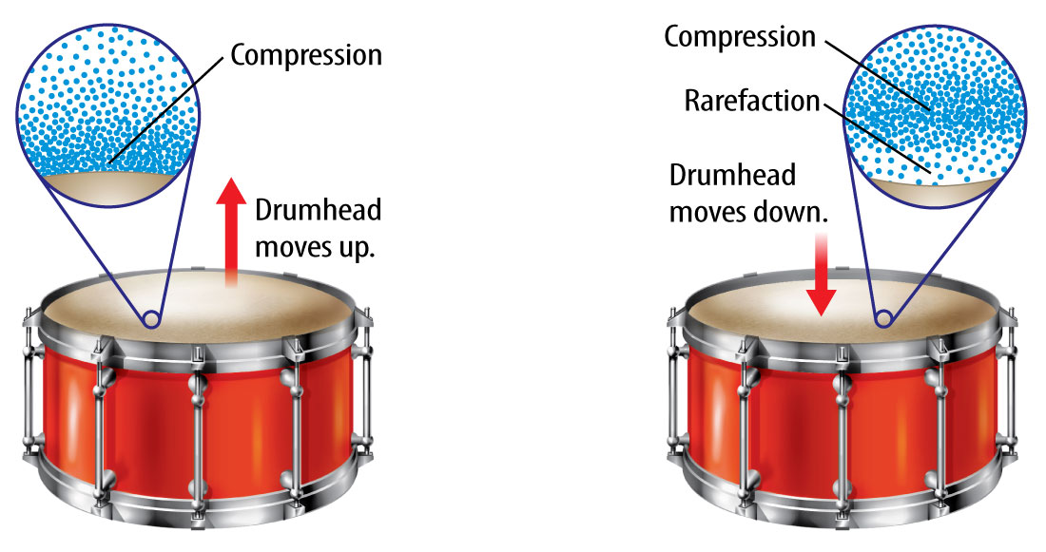
Lesson 1-1
What is sound? (cont.)
The region where molecules are closer together is a compression.

Slide 8

Lesson 1-1
What is sound? (cont.)
The region where molecules are farther apart is a rarefaction.
How do vibrating objects produce sound waves?

Slide 9
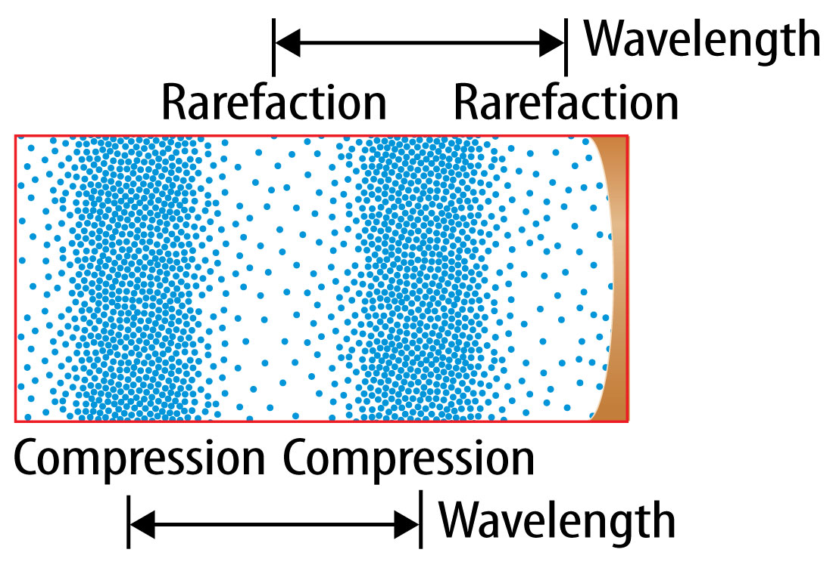
Lesson 1-1
What is sound? (cont.)
Wavelength is the distance between a point on a wave and the nearest point just like it.

Slide 10
Lesson 1-1
What is sound? (cont.)
A sound wave’s frequency is the number of wavelengths that pass a given point in one second.

Slide 11
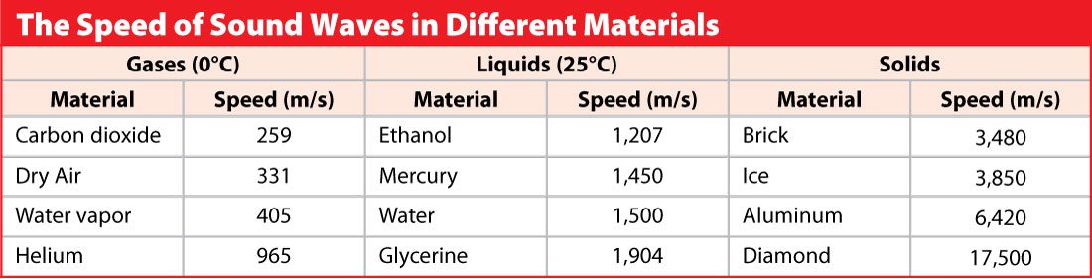

Lesson 1-2
Speeds of Sound Waves
The speed of a sound wave depends on the material in which it travels.
Sound waves usually travel faster in solids than in liquids or gases.

Slide 12
Lesson 1-2
Speeds of Sound Waves (cont.)
The speed of a sound wave depends mainly on the strength of the forces between the particles in the material.
Sound waves travel faster in a material as the temperature of the material increases.

Slide 13
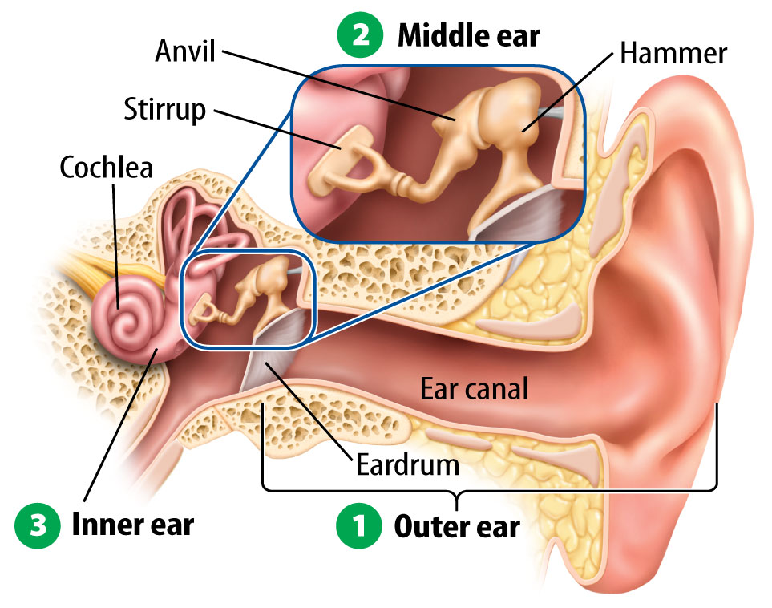
Lesson 1-3
The Human Ear

Slide 14
Lesson 1-3
The Human Ear (cont.)
The outer ear collects sound waves.
The middle ear includes a thin membrane called the eardrum and three tiny bones which amplify sound waves.
The inner ear converts vibrations to nerve signals that travel to the brain.
Balance is also controlled by the inner ear!

Slide 15
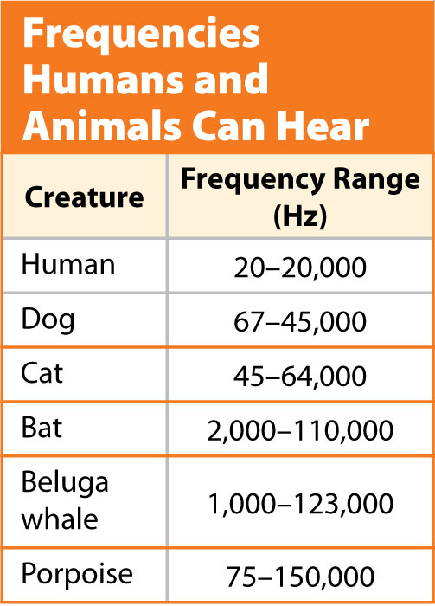
Lesson 1-1
The Human Ear (cont.)
Humans hear sounds with frequencies between about 20 and 20,000 Hz. Some animals can hear sounds with frequencies greater than 100,000 Hz.

Slide 16
Lesson 1-4
Sound and Pitch
The pitch of a sound is the human sensation of how high or low the sound seems to be.
A sound wave with a higher frequency has a higher pitch. A sound wave with lower frequency has a lower pitch.

Slide 17
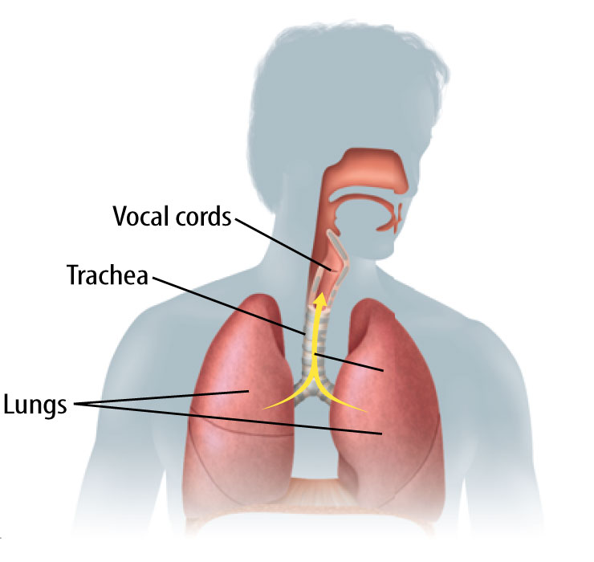
Lesson 1-4
Sound and Pitch (cont.)
The vocal cords—two membranes in your neck above your windpipe, or trachea—allow you to produce sounds of different pitches.

Slide 18
Lesson 1-5
Sound and Loudness
Loudness is the human sensation of how much energy a sound wave carries.
The amount of energy a sound wave carries depends on its amplitude.

Slide 19
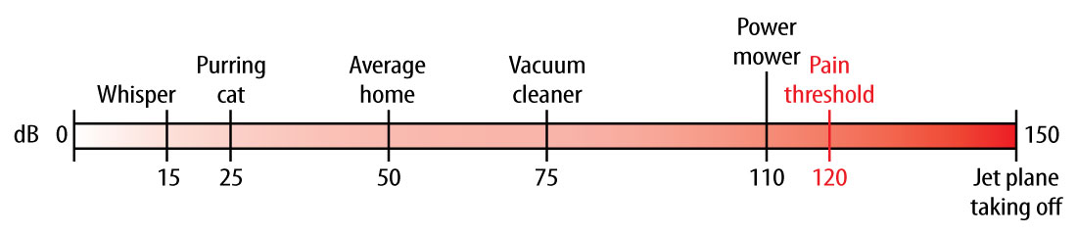
Lesson 1-5
Sound and Loudness (cont.)
The decibel scale is one way to compare the loudness of sounds.

Slide 20
Lesson 1-6
Using Sound Waves
An echo is a reflected sound wave.
echo
from Greek ekhe, means “sound”

Slide 21
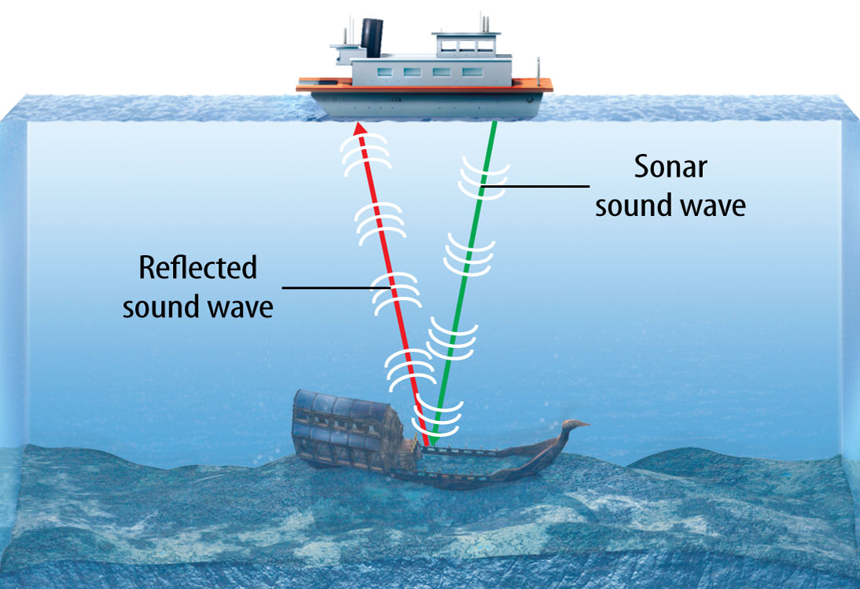
Lesson 1-6
Using Sound Waves (cont.)
Sonar systems use reflected sound waves to locate objects under water.

Slide 22
Lesson 1-6
Using Sound Waves (cont.)
Some animals, such as bats and dolphins, use a method called echolocation to navigate and hunt.
Ultrasound scanners convert high-frequency sound waves to images of internal body parts.
The scanner analyzes the reflected waves and produces images, called sonograms, of the body structures.

Slide 23

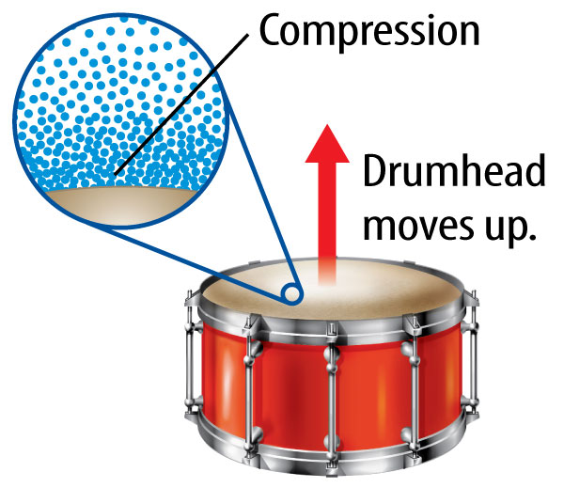
Lesson 1 - VS
A sound wave is a longitudinal wave that can travel only through matter.

Slide 24
Lesson 1 - VS
The pitch is how high or low the frequency of a sound wave is. You create different
pitches using
your vocal cords.

Slide 25
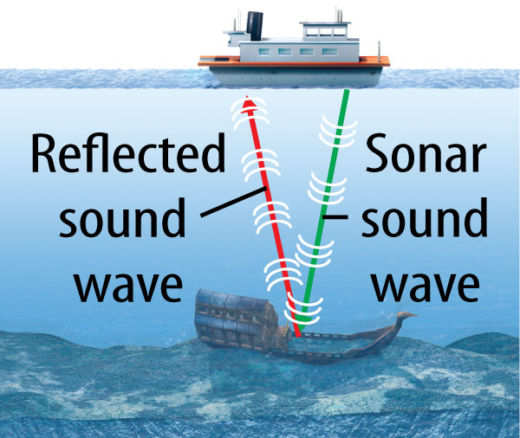
Lesson 1 - VS
An echo is a reflected sound wave. Ships use sonar to find underwater objects.

Slide 26

Lesson 1 – LR1
Which refers to the human sensation of how high or low a sound seems to be?
A. echo
B. loudness
C. pitch
D. sound waves

Slide 27
Lesson 1 – LR2
Which describes the two membranes in your neck that produce different pitches?
A. windpipe
B. vocal cords
C. stirrup
D. pitch

Slide 28
Lesson 1 – LR3
Which is a reflected sound wave?
A. sound
B. pitch
C. loudness
D. echo

Slide 29

Lesson 1 - Now
Do you agree or disagree?
1. Vibrating objects make sound waves.
2. Human ears are sensitive to more sound frequencies than any other animal’s ears.

