Slide 1



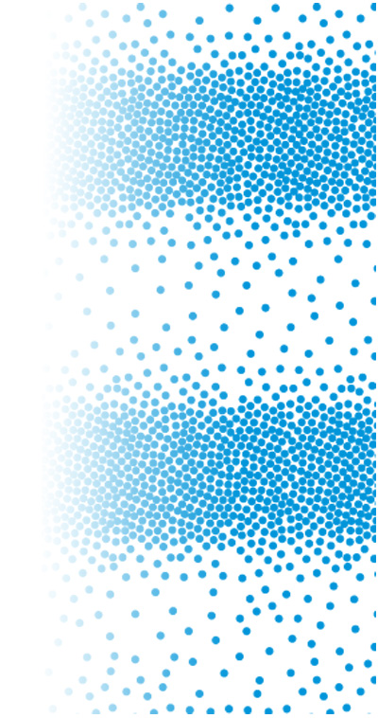




Chapter Menu
Chapter Introduction
Lesson 1 Sound
Lesson 2 Light
Lesson 3 Mirrors, Lenses,
and the Eye
Chapter Wrap-Up

Slide 2



Lesson 2 Reading Guide - KC
Light
How are light waves different from sound waves?
How do waves in the electromagnetic spectrum differ?
What happens to light waves when they interact with matter?

Slide 3
Lesson 2-1
What is light?
Light is an electromagnetic wave that can travel through matter.
Unlike sound waves, light can also travel through a vacuum, where no matter is present.
Light waves travel much faster than sound waves.

Slide 4
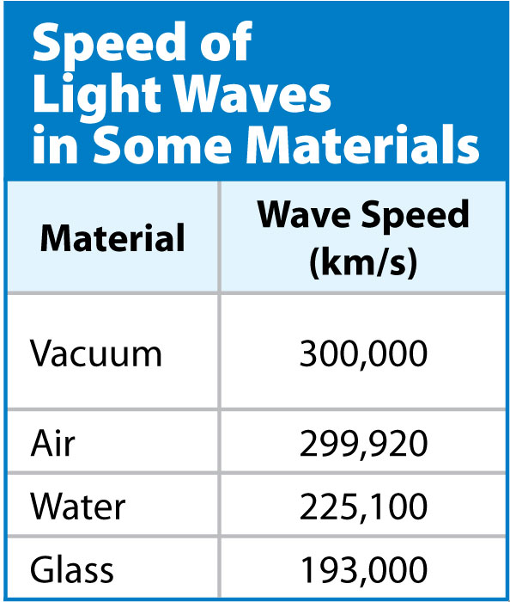
Lesson 2-1
What is light? (cont.)
Light waves slow
down when they
travel through matter.

Slide 5

Lesson 2-1
What is light? (cont.)
How are light waves different from sound waves?

Slide 6
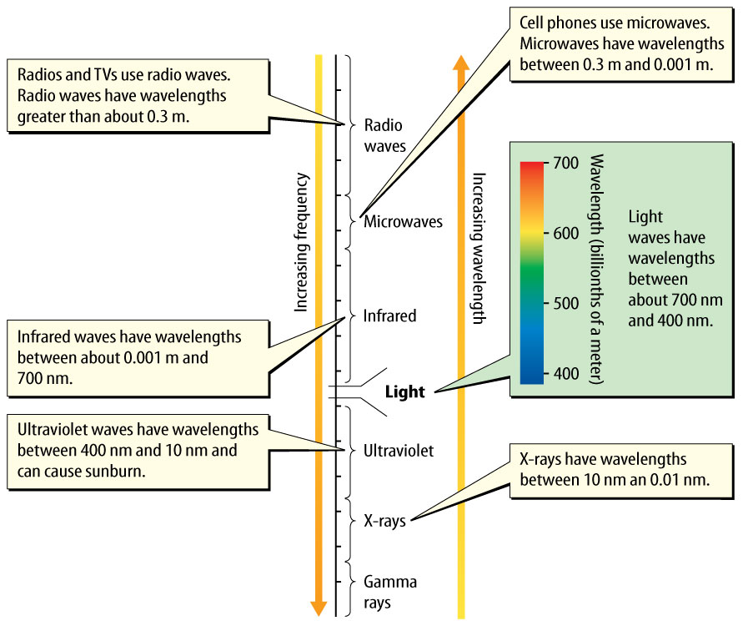
Lesson 2-1
What is light? (cont.)
X-rays and radio waves are some of the other types of electromagnetic waves.
Scientists classify
electromagnetic
waves into groups
based on their
wavelengths
and frequencies.

Slide 7
Lesson 2-1
What is light? (cont.)
How are waves in the electromagnetic spectrum different?

Slide 8
Lesson 2-1
What is light? (cont.)
A light source is something that emits light.
A light ray is a narrow beam of light that travels in a straight line.

Slide 9
Lesson 2-1
What is light? (cont.)
Unless light rays come in contact with a surface or pass through a different material, they travel in straight lines.
In order to see an object that is not a light source, light waves must reflect from an object and enter your eyes.

Slide 10
Lesson 2-2
The Interaction of Light and Matter
Like all waves, when light waves interact with matter they can be transmitted, absorbed, or reflected.
Transmission occurs when light waves travel through a material.
Absorption occurs when a material absorbs energy from light waves that are traveling in the material.

Slide 11
Lesson 2-2
The Interaction of Light and Matter
(cont.)
Reflection occurs when light waves come in contact with the surface of a material and bounce off.
What can happen to light waves when they interact with matter?

Slide 12
Lesson 2-2
The Interaction of Light and Matter
(cont.)
Depending on how they interact with light, materials can be classified as transparent, translucent, or opaque.
A material is transparent if it transmits light waves, and objects can be seen clearly through the material.

Slide 13
Lesson 2-2
The Interaction of Light and Matter
(cont.)
A material is translucent if it transmits light waves, but objects cannot be seen clearly through the material.
A material is opaque if light waves cannot travel through the material.

Slide 14
Lesson 2-2
The Interaction of Light and Matter
(cont.)
opaque
from Latin opacus, means “shady, dark”

Slide 15
Lesson 2-2
The Interaction of Light and Matter
(cont.)
All waves, including light waves, obey the law of reflection.
According to the law of reflection, the angle of incidence always equals the angle of reflection.

Slide 16
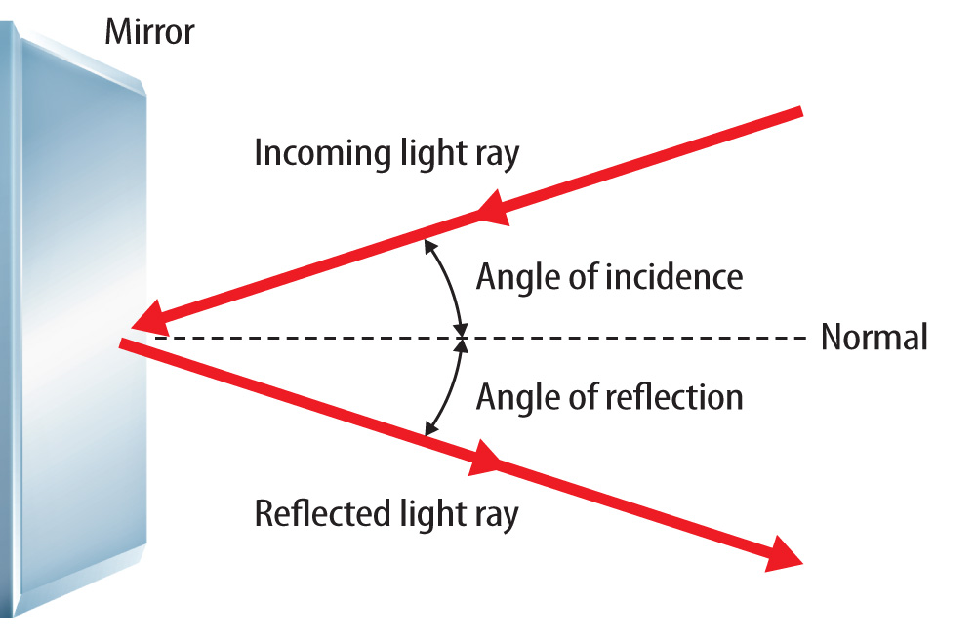
Lesson 2-2
When a surface reflects a light ray, the angle of incidence equals the angle of reflection.

Slide 17
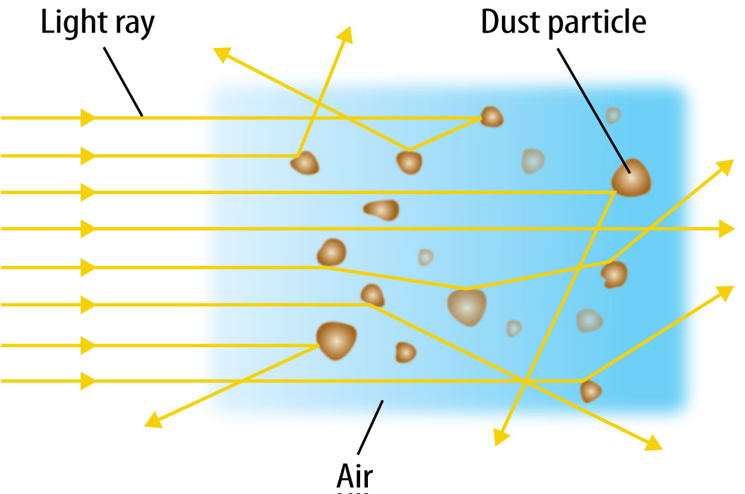
Lesson 2-2
The Interaction of Light and Matter
(cont.)
Scattering occurs when light waves traveling in one direction are made to travel in many directions.

Slide 18
Lesson 2-2
The Interaction of Light and Matter
(cont.)
A wave that changes direction as it travels from one material to another is refracting.
Refraction occurs when a wave changes speed.
The greater the change in speed, the more the light wave refracts or changes direction.

Slide 19

Lesson 2 - VS
An object is seen when light waves emitted by the object or reflected by the object enter the eye.
The electromagnetic
spectrum includes
electromagnetic
waves of different
wavelengths,
such as X-rays.

Slide 20
Lesson 2 - VS
When light waves interact with matter, they can be absorbed, reflected, or transmitted.

Slide 21

Lesson 2 – LR1
What word describes a material that transmits light waves so that objects can be seen clearly through the material?
A. transparent
B. translucent
C. reflection
D. opaque

Slide 22
Lesson 2 – LR2
Which term describes a wave that changes direction as it travels from one material to another?
A. scattering
B. reflecting
C. refracting
D. absorbing

Slide 23
Lesson 2 – LR3
Which is a narrow beam of light that travels in a straight line?
A. light wave
B. light source
C. light reflection
D. light ray

Slide 24

Lesson 2 - Now
Do you agree or disagree?
3. Unlike sound waves, light waves can travel through a vacuum.
4. Light waves always travel at the same speed.

