Slide 1



Lesson 3 Reading Guide - KC
Mirrors, Lenses, and the Eye
What is the difference between regular and diffuse reflection?
What types of images are formed by mirrors and lenses?
How does the human eye enable a person to see?

Slide 2
Lesson 3-1
Why are some surfaces mirrors?
Regular reflection occurs when a smooth surface reflects light rays traveling in the same direction at the same angle.
Because the light rays travel the same way relative to each other before and after reflection, the reflected light rays form a sharp image.

Slide 3
Lesson 3-1
Why are some surfaces mirrors? (cont.)
Diffuse reflection occurs when light rays traveling in the same direction hit a rough surface at different angles, reflecting light rays in many different directions.
You don’t see a clear image when diffuse reflection occurs.

Slide 4
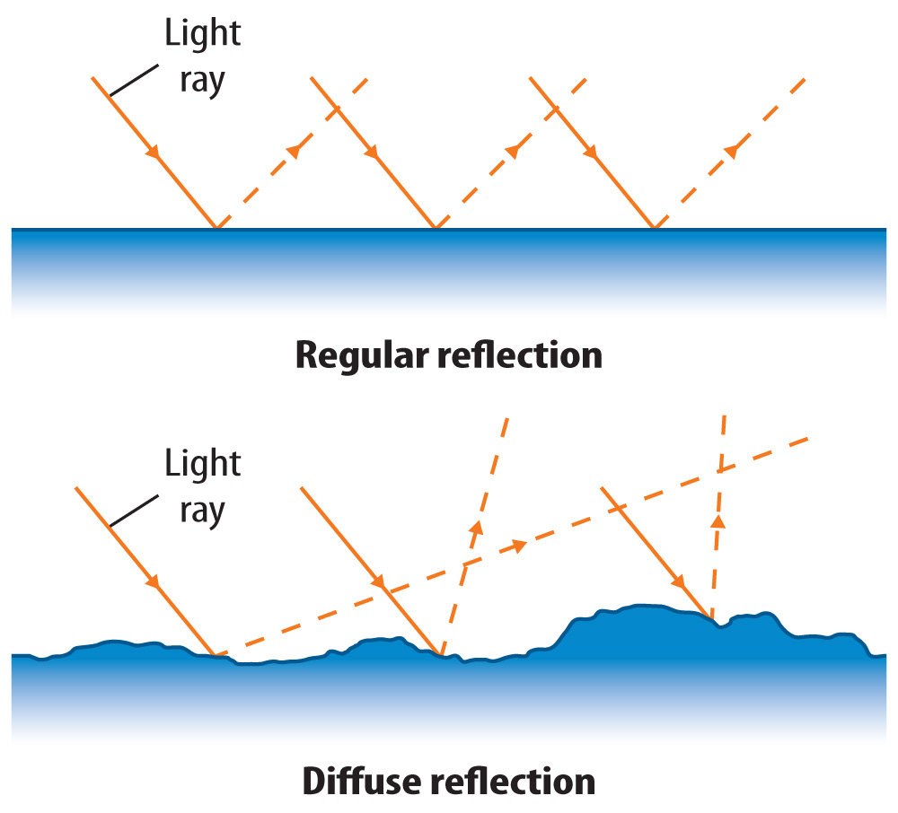
Lesson 3-1
Light waves always obey the law of reflection, whether the surface is smooth or rough.

Slide 5

Lesson 3-1
Why are some surfaces mirrors? (cont.)
Contrast regular and diffuse reflection.

Slide 6
Lesson 3-2
Types of Mirrors
A mirror is any reflecting surface that forms an image by regular reflection.
The image formed by a mirror depends on the shape of the mirror’s surface.

Slide 7
Lesson 3-2
Types of Mirrors (cont.)
A plane mirror is a mirror that has a flat reflecting surface.
The image formed by the mirror looks like a photograph of the object except that the image is reversed left to right.
The size of the image in the mirror depends on how far the object is from the mirror. The image gets smaller as the object gets farther from the mirror.

Slide 8
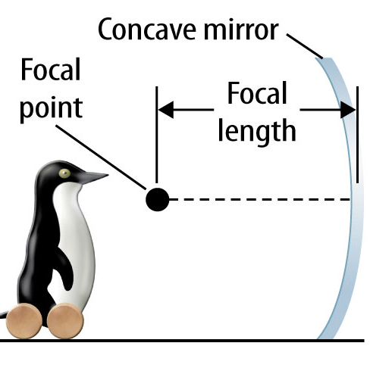
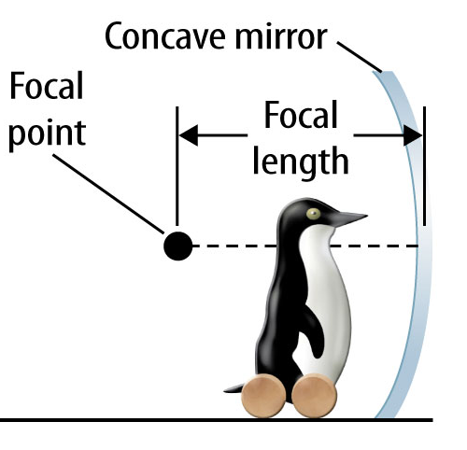
Lesson 3-2
Types of Mirrors (cont.)
Concave mirrors are reflecting surfaces that are curved inward.

Slide 9
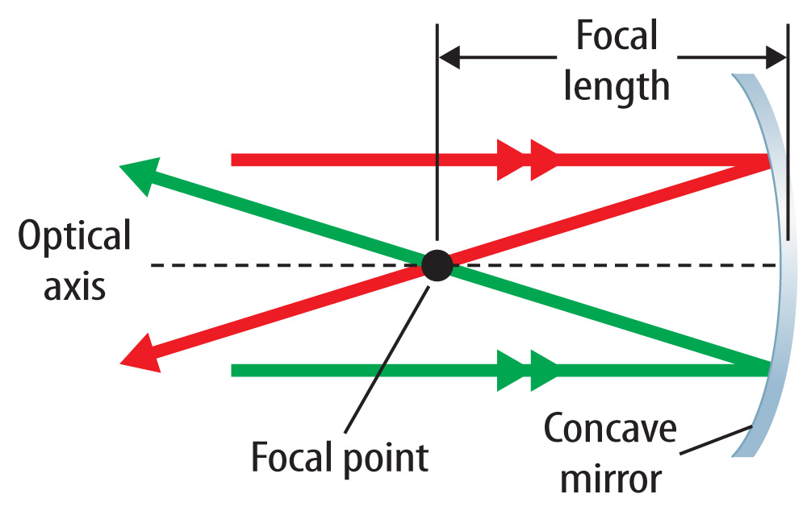
Lesson 3-2
Light rays that are parallel to the optical axis are reflected through the focal point.
The distance from the mirror to the focal point is called
the focal length.

Slide 10
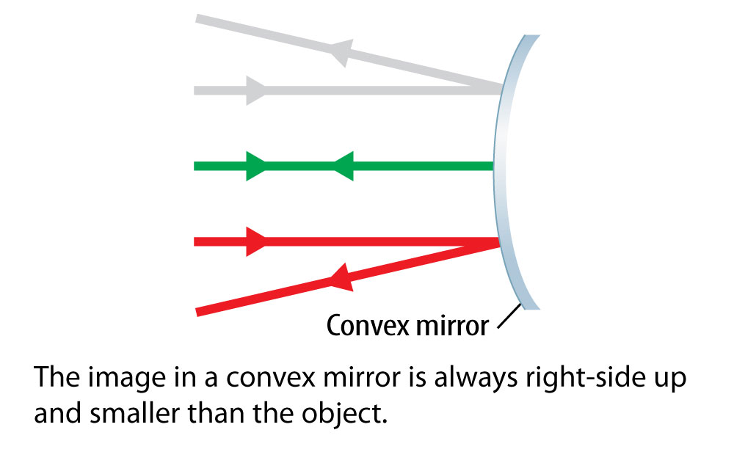
Lesson 3-2
Types of Mirrors (cont.)
A convex mirror has a reflecting surface that is curved outward.

Slide 11
Lesson 3-2
Types of Mirrors (cont.)
How do the images formed by plane mirrors, concave mirrors, and convex mirrors depend on the distance of an object from the mirror?

Slide 12
Lesson 3-3
Types of Lenses
A lens is a transparent object with at least one curved side that causes light to change direction.
The more curved the sides of a lens, the more the light changes direction as it passes through the lens.
A convex lens is curved outward on at least one side so it is thicker in the middle.

Slide 13
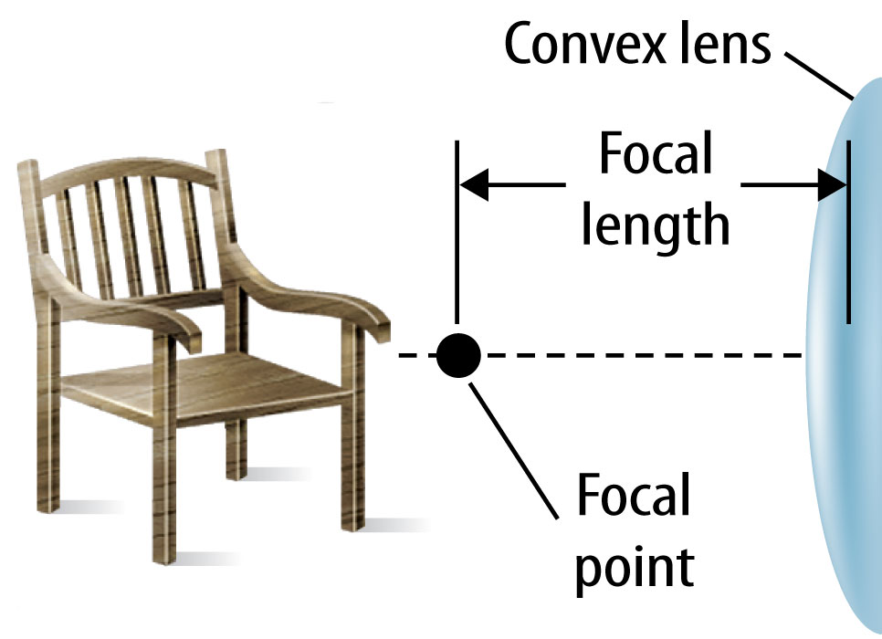
Lesson 3-3
Types of Lenses (cont.)
The image formed by a convex lens depends on where the object is, just like it does for a concave mirror.
When an object is
farther than one
focal length from
a convex lens, the
image is upside
down.

Slide 14
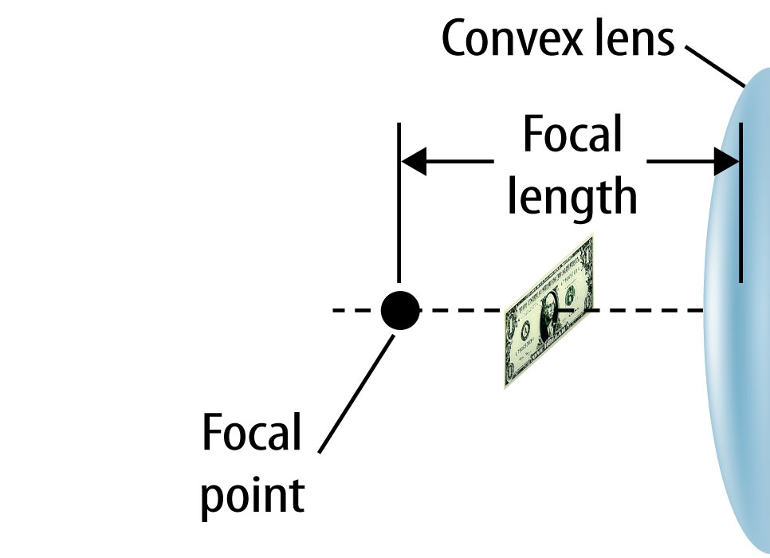
Lesson 3-3
Types of Lenses (cont.)
When an object is less than one focal length from a convex lens, the image is larger and right
side up.

Slide 15
Lesson 3-2
Types of Lenses (cont.)
How does the image formed by a convex lens depend on the distance of the object from the lens?

Slide 16
Lesson 3-3
Types of Lenses (cont.)
A concave lens is curved inward on at least one side and thicker at the edges.
The image formed by a concave lens is upright and smaller than the object
Concave lenses are usually used in combinations with other lenses in instruments such as telescopes and microscopes.

Slide 17
Lesson 3-4
Light and the Human Eye
To see an object, light waves from an object travel through two convex lenses in the eye—the cornea and the lens.

Slide 18
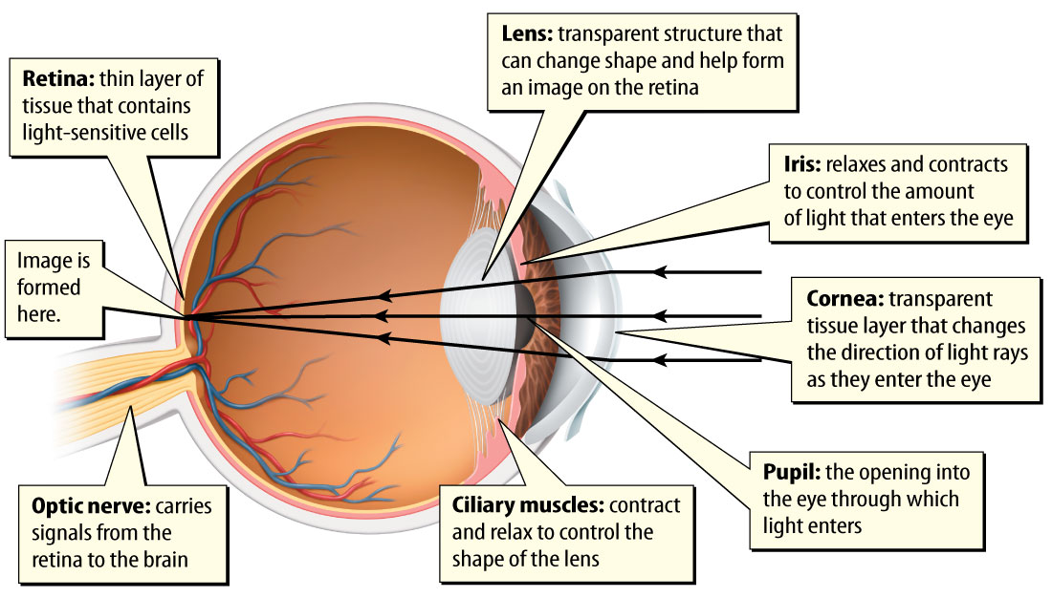
Lesson 3-4
The eye is made of a number of parts that have different functions.

Slide 19
Lesson 3-4
Light and the Human Eye (cont.)
The cornea is a convex lens made of transparent tissue located on the outside of the eye.
The pupil is the dark opening into the interior of the eye.
The iris is the colored part of the eye.

Slide 20
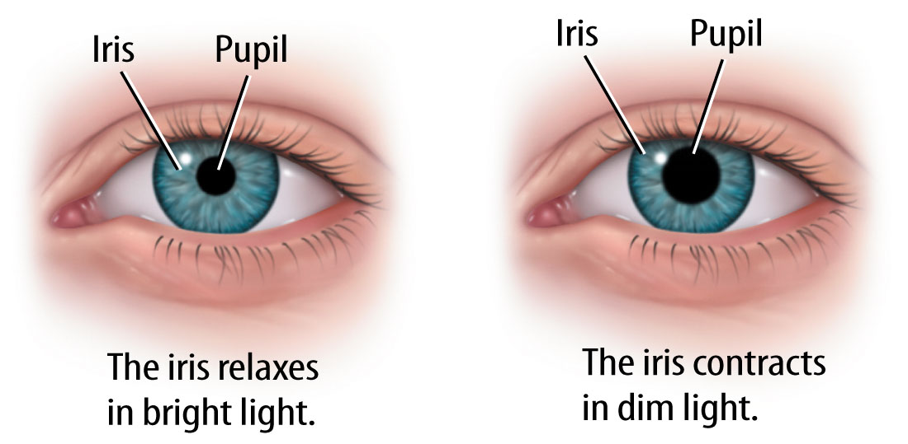
Lesson 3-4
Light and the Human Eye (cont.)
When the iris changes size, the amount of light that enters the eye changes.

Slide 21
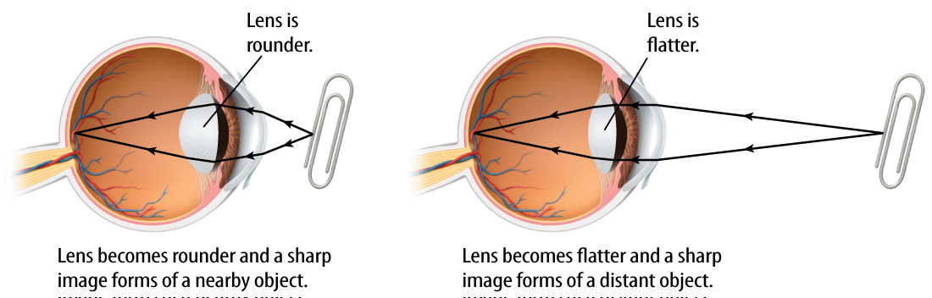

Lesson 3-4
Light and the Human Eye (cont.)
The lens enables the eye to form a sharp image of nearby and distant objects. The muscles surrounding the lens change the lens’s shape.

Slide 22
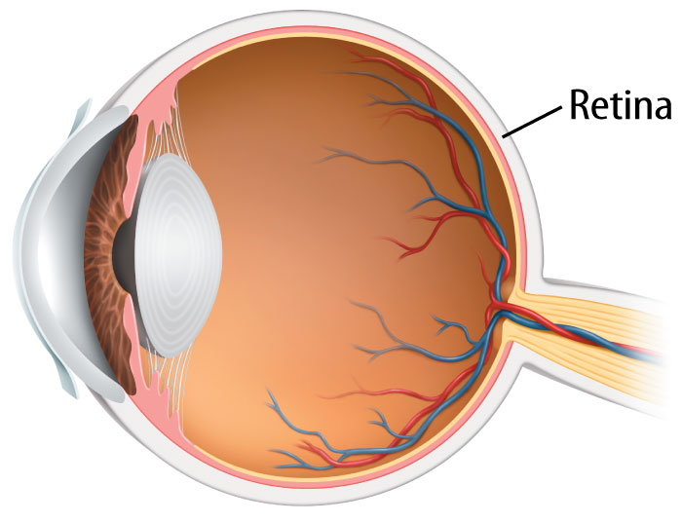
Lesson 3-4
Light and the Human Eye (cont.)
The retina is a layer of special light-sensitive cells in the back of the eye.

Slide 23
Lesson 3-4
Light and the Human Eye (cont.)
In the retina, chemical reactions produce nerve signals that the optic nerve sends to your brain.
Rod cells and cone cells are two types
of light-sensitive cells in your retina.
Rod cells enable people to see objects
in dim light.

Slide 24
Lesson 3-4
Light and the Human Eye (cont.)
Cone cells enable people to see colors. The retina has three types of cone cells, which respond to a different range of wavelengths.
retina
from Latin rete, means “net”

Slide 25
Lesson 3-4
Light and the Human Eye (cont.)
Identify the parts of the eye that form a sharp image of an object and the parts that convert an image into electrical signals.

Slide 26
Lesson 3-5
The Colors of Objects
The color of an object depends on the wavelengths of the light waves it reflects.
An object absorbs some light waves and reflects others.
When light waves enter your eye, they cause the cone cells in your retina to send certain nerve signals to your brain.
These signals cause you to see colors.

Slide 27
Lesson 3-5
The Colors of Objects (cont.)
A red rose reflects light waves with wavelengths that you see as red. It absorbs all other wavelengths of light.
A banana reflects light waves with wavelengths that you see as yellow. It absorbs all other wavelengths of light.

Slide 28
Lesson 3-5
The Colors of Objects (cont.)
Why do you experience the sensation of color?

Slide 29
Lesson 3-5
The Colors of Objects (cont.)
The color of an object that emits light depends on the wavelengths of the light waves it emits.
Light that you see as white is actually a combination of light waves of many different wavelengths.
The appearance of an object changes under different colors of light.

Slide 30

Lesson 3 - VS
A mirror is a surface that causes a regular reflection. The shape of the reflecting surface and the position of the object
determine
what the image
looks like.

Slide 31
Lesson 3 - VS
A lens is a transparent object with at least on curved side that causes light waves to change
direction. The
shape of the lens
and the position
of the object
determine how
the image
appears.

Slide 32
Lesson 3 - VS
The eye has different parts with different functions. The iris is the colored part of your eye. The iris opens and closes
to control the
amount of light
that enters the
eye.

Slide 33

Lesson 3 – LR1
Which is a convex lens of transparent tissue located on the outside of the eye?
A. retina
B. pupil
C. iris
D. cornea

Slide 34
Lesson 3 – LR2
Which term refers to any reflecting surface that forms an image by regular reflection?
A. mirror
B. light ray
C. lens
D. iris

Slide 35
Lesson 3 – LR3
Which describes the image formed by a concave lens if an object is more than one focal length away?
A. It is upside down.
B. It is right-side up.
C. It is smaller than the object.
D. There is no image.

Slide 36

Lesson 3 - Now
Do you agree or disagree?
5. All mirrors form images that appear identical to the object itself.
6. Lenses always magnify objects.

