Slide 1








Chapter Menu
Chapter Introduction
Lesson 1 Thermal Energy,
Temperature,
and Heat
Lesson 2 Thermal Energy
Transfers
Lesson 3 Using Thermal
Energy
Chapter Wrap-Up

Slide 2

Chapter Introduction
What do you think?
Before you begin, decide if you agree or disagree with each of these statements.
As you view this presentation, see if you change your mind about any of the statements.

Slide 3
Chapter Introduction
Do you agree or disagree?
1. Temperature is the same as thermal energy.
2. Heat is the movement of thermal energy from a hotter object to a cooler object.
3. It takes a large amount of energy to significantly change the temperature of an object with a low specific heat.

Slide 4
Chapter Introduction
Do you agree or disagree?
4. The thermal energy of an object can never be increased or decreased.
5. Car engines create energy.
6. Refrigerators cool food by moving thermal energy from inside the refrigerator to the outside.

Slide 5



Lesson 1 Reading Guide - KC
Thermal Energy, Temperature, and Heat
How are temperature and kinetic energy related?
How do heat and thermal energy differ?

Slide 6
Lesson 1-1
Kinetic and Potential Energy
Potential energy is stored energy due to the interaction between two objects.
Kinetic energy is the energy objects have due to motion.
  Equation:
The potential energy plus the kinetic energy of an object is the mechanical energy of the object.

Slide 7
Kinetic Theory of Matter
Kinetic Theory of Matter
All matter made of small particles
Particles of matter in motion
Collisions between particles transmit energy
Faster motion has more kinetic energy
Temperature is average kinetic energy of the particles of a substance
SI units for temperature are Kelvins (K)

Slide 8
Lesson 1-2
What is thermal energy? (cont.)
The greater the average distance between particles, the greater the potential energy of the particles.
Thermal energy is the sum of the kinetic energy and the potential energy of the particles that make up a material.

Slide 9
Lesson 1-3
What is temperature?
Temperature represents the average kinetic energy of the particles that make up a material.

Slide 10
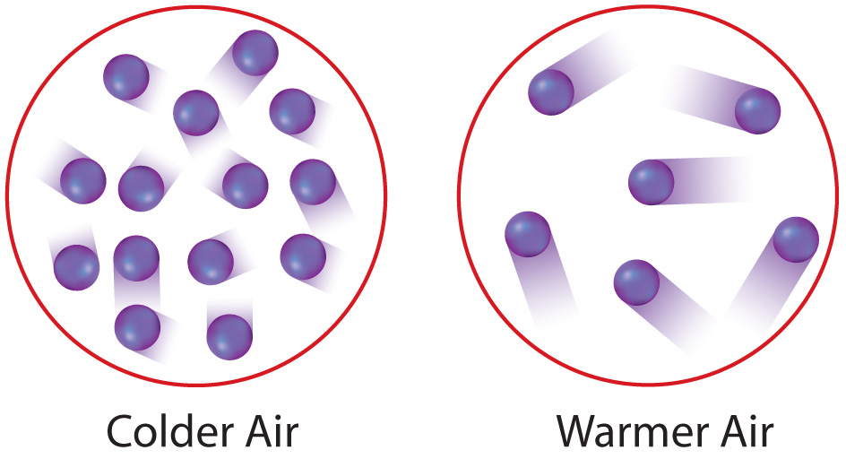
Lesson 1-3
What is temperature? (cont.)
The greater the average kinetic energy of particles, the greater the temperature.
The particles in warmer air move at a greater average speed than the particles in colder air.

Slide 11
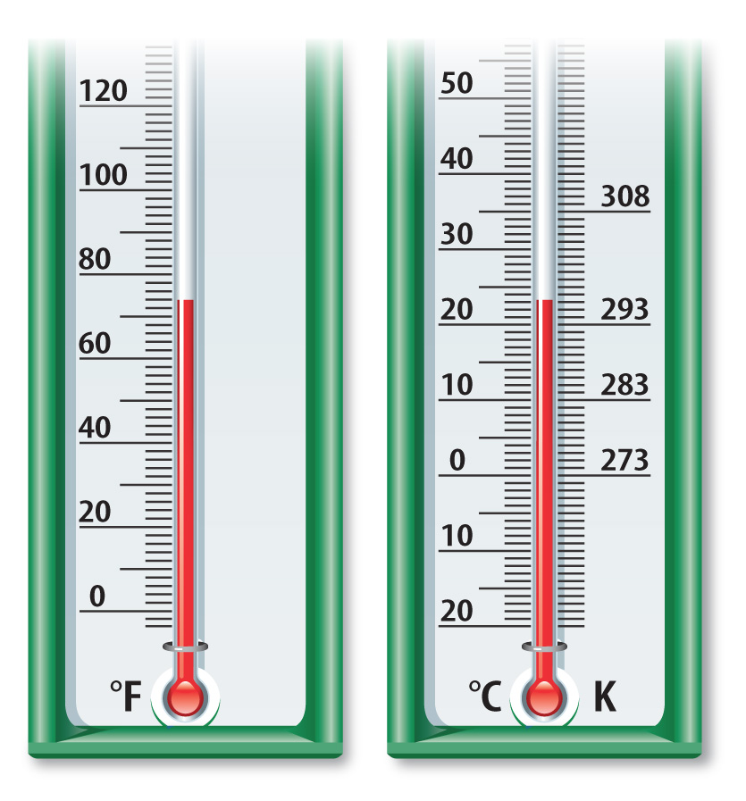
Lesson 1-3
What is temperature? (cont.)
Thermometers are used to measure temperature.
Common
temperature
scales are
Celsius (°C),
Kelvin (K),
and Fahrenheit (°F).

Slide 12
Lesson 1-4
What is heat?
The movement of thermal energy from a warmer object to a cooler object is called heat.
All objects have thermal energy; however, you heat something when thermal energy transfers from one object to another.
The rate at which heating occurs depends on the difference in temperatures between the objects.

Slide 13


Lesson 1 - VS
The greater the
distance between
two particles or two
objects, the greater
the potential energy.
Heat is the movement
of thermal energy from
a warmer object to a cooler object.

Slide 14
Lesson 1 - VS
When thermal energy moves between a material and its environment, the material’s temperature changes.

Slide 15

Lesson 1 – LR1
Because particles are in motion, what type of energy do they have?
A. thermal energy
B. potential energy
C. mechanical energy
D. kinetic energy

Slide 16
Lesson 1 – LR2
Particles that make up liquid and solid water have different potential energies, and therefore also have which of the following?
A. different thermal energies
B. different temperatures
C. different kinetic energies
D. the same thermal energy

Slide 17
Lesson 1 – LR3
Which term refers to the average kinetic energy of the particles that make up a material?
A. heat
B. temperature
C. potential energy
D. thermal energy

Slide 18

Lesson 1 - Now
Do you agree or disagree?
1. Temperature is the same as thermal energy.
2. Heat is the movement of thermal energy from a hotter object to a cooler object.

