Slide 1



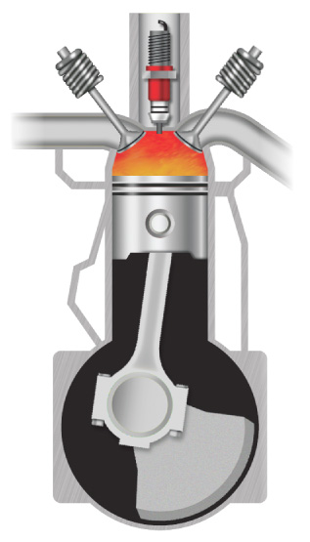




Chapter Menu
Chapter Introduction
Lesson 1 Thermal Energy,
Temperature,
and Heat
Lesson 2 Thermal Energy
Transfers
Lesson 3 Using Thermal
Energy
Chapter Wrap-Up

Slide 2



Lesson 2 Reading Guide - KC
Thermal Energy Transfers
What is the effect of having a small specific heat?
What happens to a material when it is heated?
In what ways can thermal energy be transferred?

Slide 3
Specific Heat Capacity
Compares how easily the kinetic energy of particles is changed for different materials
Smaller specific heat -- easier to change the temperature
Symbol is c
Definition:
  Amount of heat needed to raise the temperature of 1 kg of a material 1ºC or 1K

Slide 4
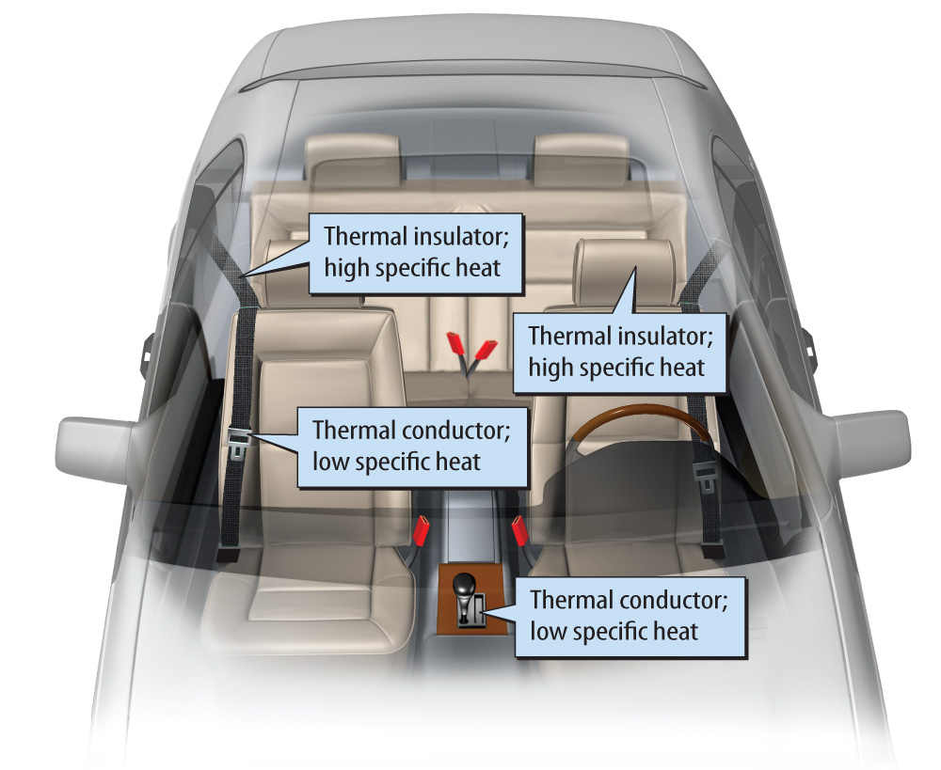
Lesson 2-3
In a hot car, the temperature of thermal conductors, such as the safety-belt buckles, increases more
quickly than the
temperature of
thermal insulators,
such as the
seat material.

Slide 5
Lesson 2-1
How is thermal energy transferred?
Thermal energy is transferred in three ways.
  by radiation
  by conduction
  by convection

Slide 6
Lesson 2-2
Radiation
The transfer of thermal energy from one material to another by electromagnetic waves is called radiation.
Radiation is the only way thermal energy can travel from the Sun to Earth, because space is a vacuum.
Radiation also transfers thermal energy through solids, liquids, and gases.

Slide 7
Lesson 2-3
Conduction
When particles with different kinetic energies collide, the particles with higher kinetic energy transfer energy to particles with lower kinetic energy.
The transfer of thermal energy between materials by the collisions of particles is called conduction.
Conduction continues until the thermal energy of all particles in contact is equal.

Slide 8
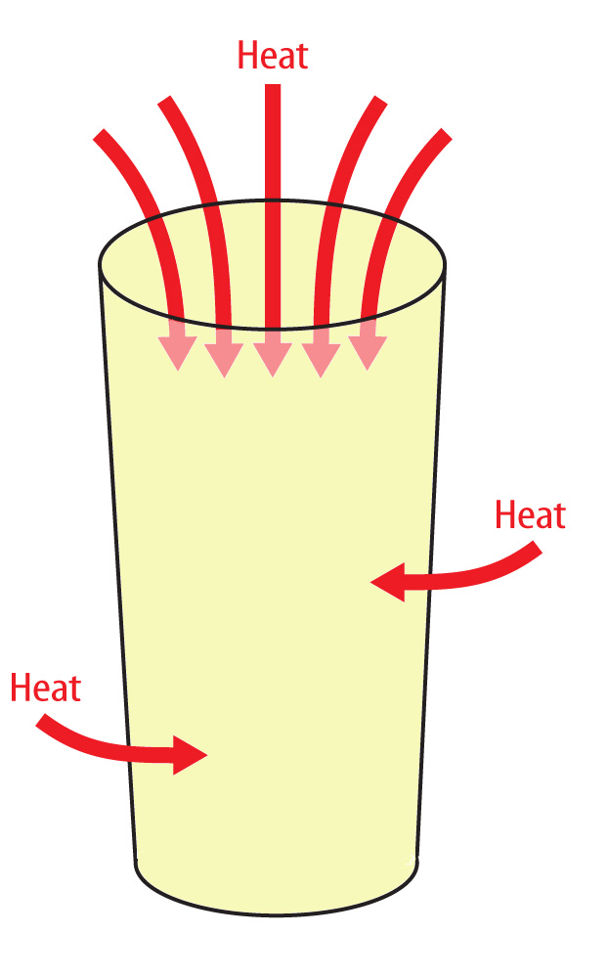

Lesson 2-3
Conduction (cont.)
The hot air transfers thermal energy to,
or heats, the cool lemonade by conduction.
Eventually the kinetic thermal energy and temperature of the air and the lemonade will be equal.

Slide 9
Lesson 2-3
Conduction (cont.)
A thermal conductor is a material through which thermal energy flows easily.
A thermal insulator is a material through which thermal energy does not flow easily.

Slide 10
Lesson 2-5
Convection
Convection is the transfer of thermal energy by the movement of particles from one part of a material to another.
Convection only occurs in fluids.
convection
from Greek convectionem, means “the act of carrying”

Slide 11
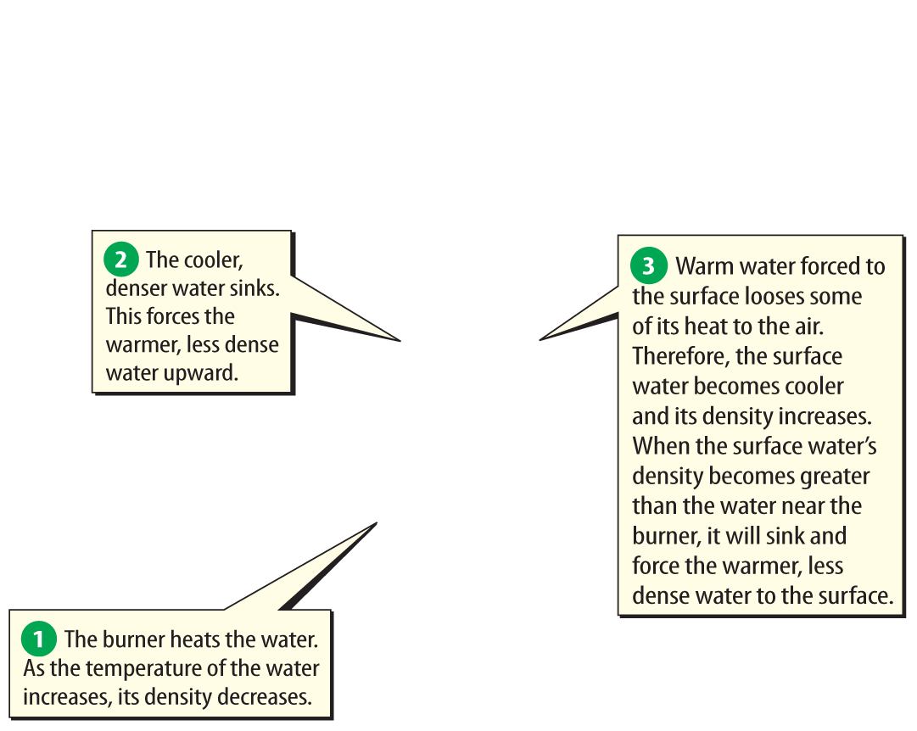
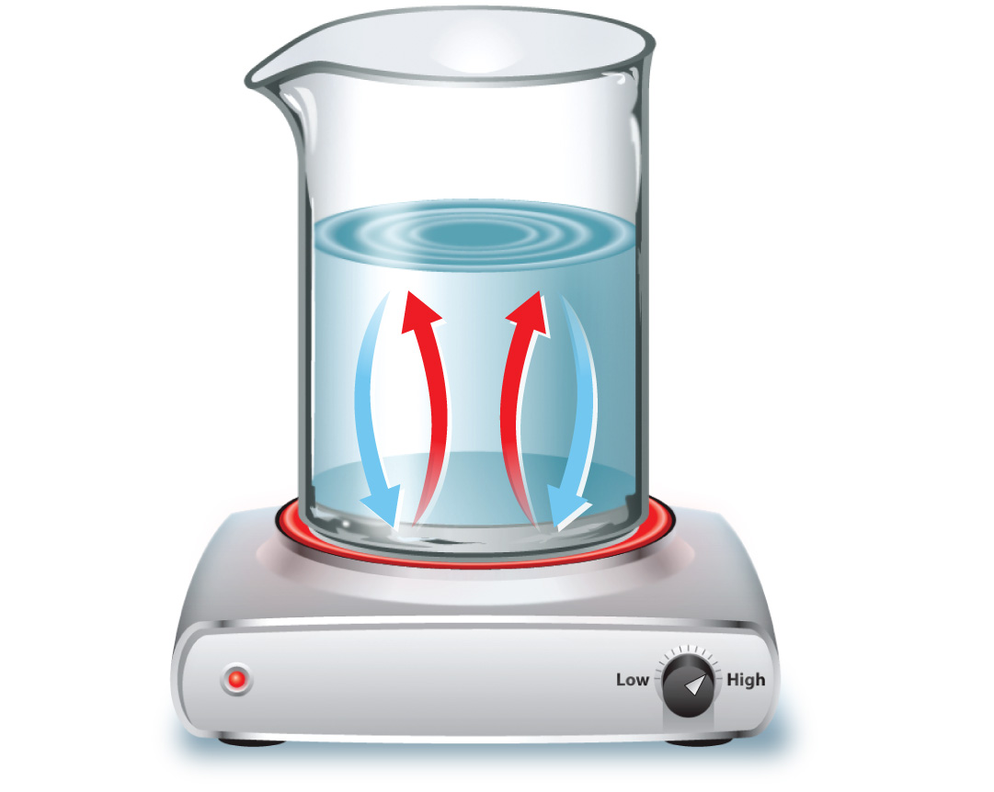
Lesson 2-5
This cycle of cooler water sinking and forcing warmer water upward is an example of convection.

Slide 12
Lesson 2-5
Convection (cont.)
The movement of fluids in a cycle because of convection is a convection current.
Convection currents circulate the water in Earth’s mantle, atmosphere and bodies of water.

Slide 13
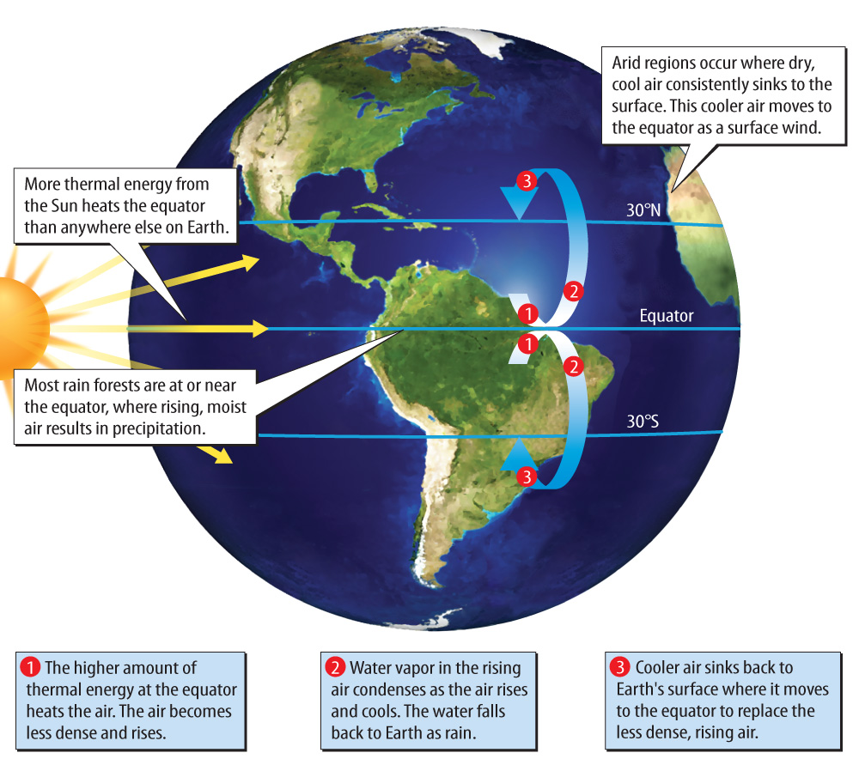
Lesson 2-5
Convection Currents in Earth’s Atmosphere

Slide 14
Lesson 2-4
Thermal Expansion and Contraction
Thermal contraction is a decrease in a material’s volume when its temperature decreases.
Thermal expansion is an increase in a material’s volume when its temperature increases.
Thermal expansion and contraction are most noticeable in gases, less noticeable in liquids, and the least noticeable in solids.

Slide 15

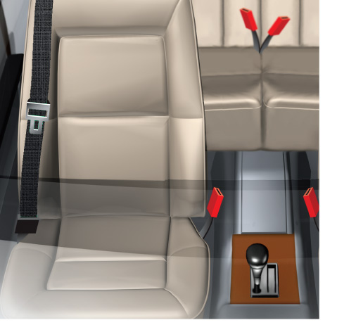
Lesson 2 - VS
When a material has a low specific heat, transferring a small amount of energy to the material increases its temperature
significantly.

Slide 16
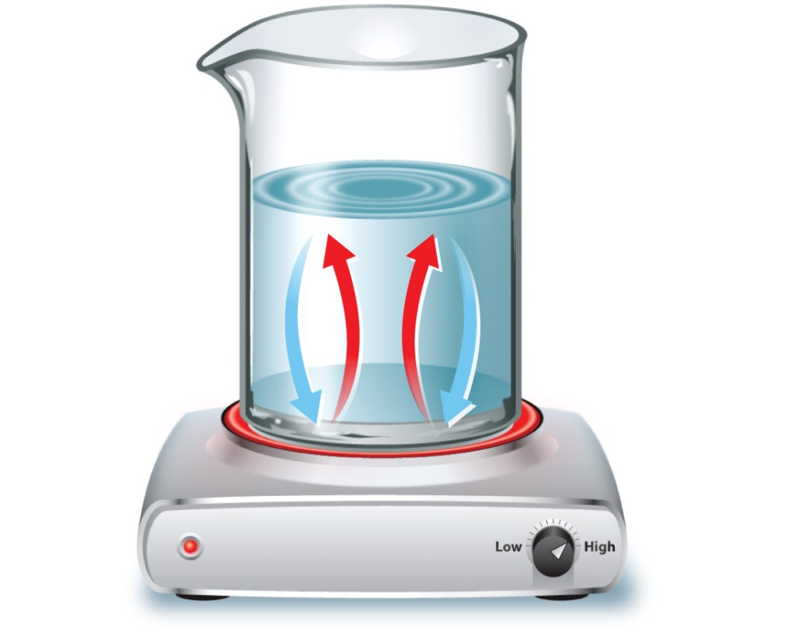
Lesson 2 - VS
Thermal energy can be transferred through radiation, conduction, or convection.

Slide 17
Lesson 2 - VS
When a material is heated, the thermal energy of the material increases and the material expands.

Slide 18

Lesson 2 – LR1
Which term refers to a material through which thermal energy flows easily?
A. convection current
B. specific heat
C. thermal conductor
D. thermal insulator

Slide 19
Lesson 2 – LR2
Which describes an increase in
a material’s volume when its temperature increases?
A. conduction
B. thermal expansion
C. thermal conductor
D. thermal contraction

Slide 20
Lesson 2 – LR3
What term describes the transfer of thermal energy by the movement of particles from one part of a material to another?
A. convection
B. conduction
C. thermal contraction
D. thermal expansion

Slide 21

Lesson 2 - Now
Do you agree or disagree?
3. It takes a large amount of energy to significantly change the temperature of an object with a low specific heat.
4. The thermal energy of an object can never be increased or decreased.

