Slide 1



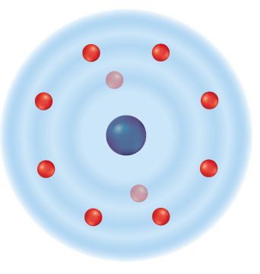




Chapter Menu
Chapter Introduction
Lesson 1 Electrons and
Energy Levels
Lesson 2 Compounds,
Chemical
Formulas, and
Covalent Bonds
Lesson 3 Ionic and Metallic Bonds
Chapter Wrap-Up

Slide 2



Lesson 1 Reading Guide - KC
Electrons and Energy Levels
How is an electron’s energy related to its distance from the nucleus?
Why do atoms gain, lose, or share electrons?

Slide 3
Lesson 1-1
The Periodic Table
Elements on the periodic table are organized in periods (rows) and groups (columns).
The periodic table lists elements in order of atomic number, which increases from left to right as you move across a period.

Slide 4
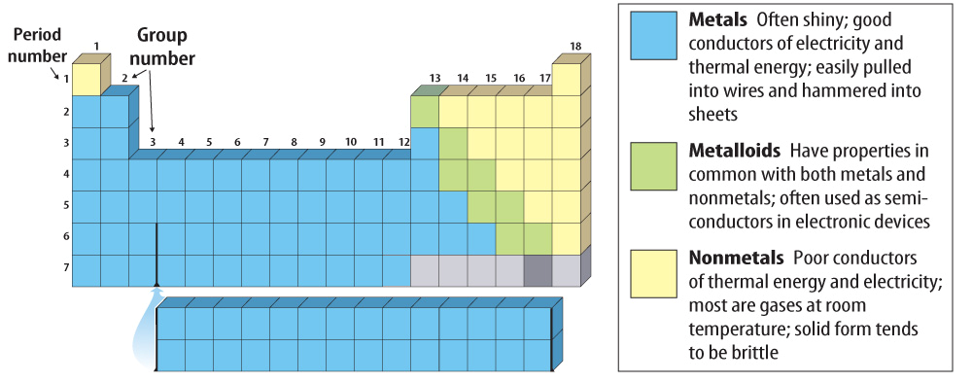
Lesson 1-1
The three main regions of elements on the periodic table classify elements as metals, nonmetals, or metalloids.

Slide 5
Lesson 1-1
The Periodic Table (cont.)
Elements on the left side of the table are metals.
Nonmetals are on the right side of the table.
Metalloids form the narrow stair-step region between metals and nonmetals.

Slide 6
Lesson 1-2
Atoms Bond
A chemical bond is a force that holds two or more atoms together in a compound.
Bonding involves outer shell (valence) electrons

Slide 7
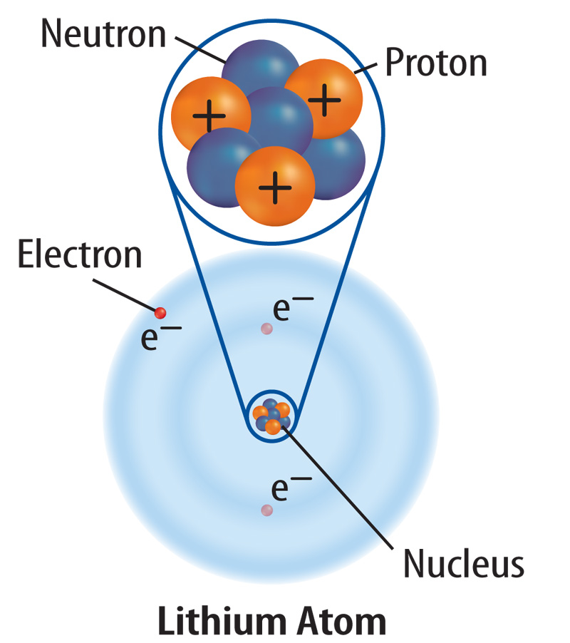
Lesson 1-2
Protons and neutrons are in an atom’s nucleus. Electrons move around the nucleus.

Slide 8
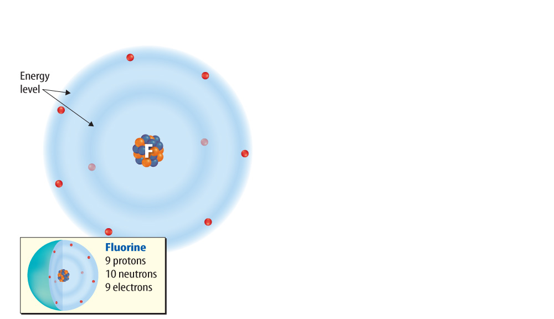
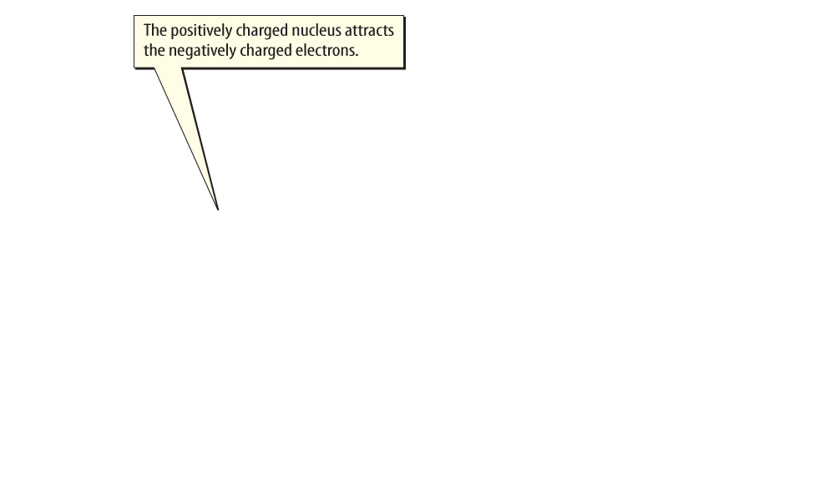
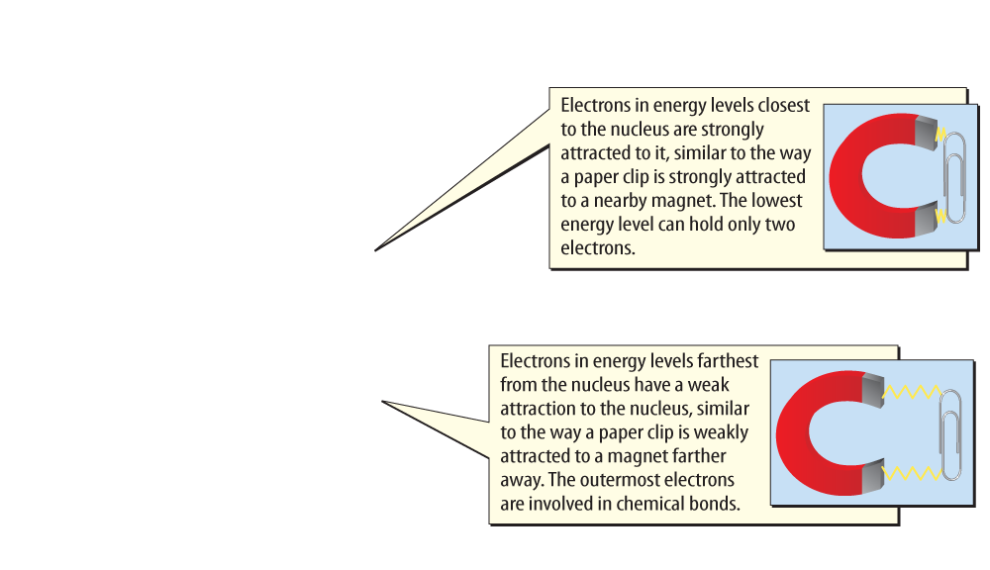
Lesson 1-2
Electron Energy Levels

Slide 9
Lesson 1-2
Atoms Bond (cont.)
The attraction between the positive nucleus of one atom and the negative electrons of another atom is what creates a chemical bond.
A valence electron is an outermost electron of an atom that participates in chemical bonding.

Slide 10
Lesson 1-2
Atoms Bond (cont.)
valence
from Latin valentia, means “strength, capacity”
The number of valence electrons in each atom of an element can help determine the type and number of bonds that an atom can form.

Slide 11
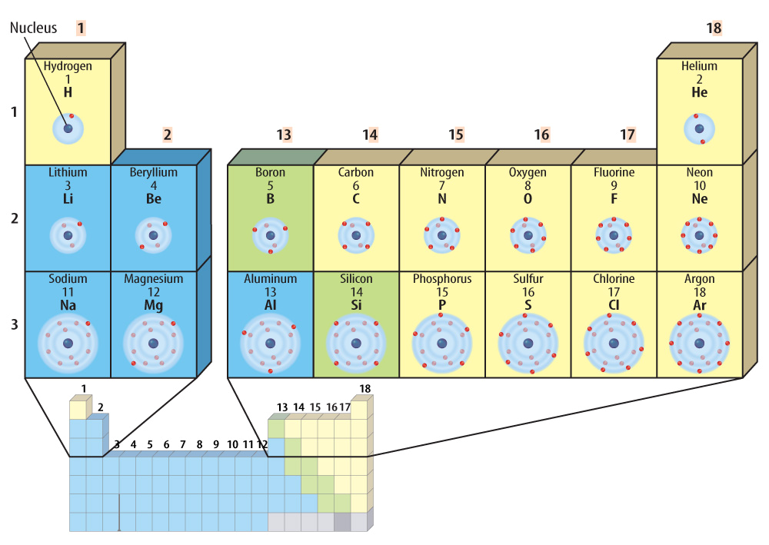
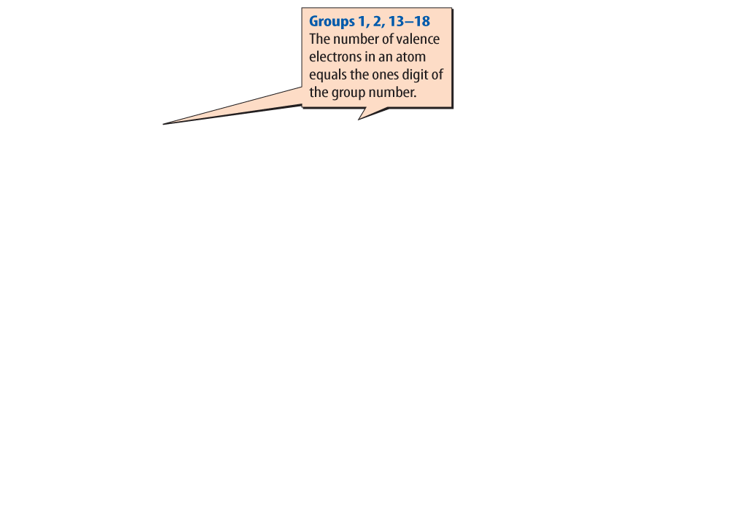
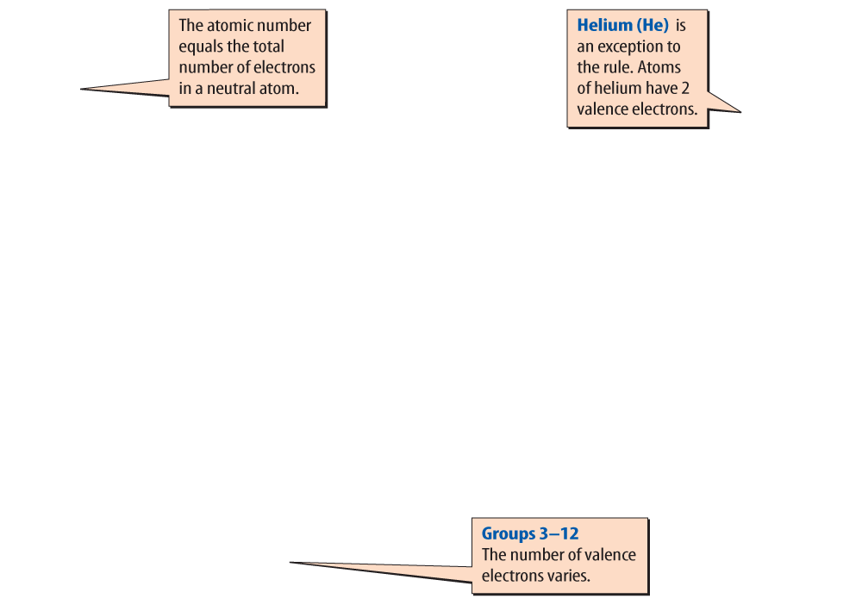
Lesson 1-2
The periodic table can tell you how many valence electrons an atom has.

Slide 12
Lesson 1-2
Atoms Bond (cont.)
In 1916 an American chemist named Gilbert Lewis developed the electron dot diagram, a model that represents valence electrons in an atom as dots around the element’s chemical symbol.

Slide 13
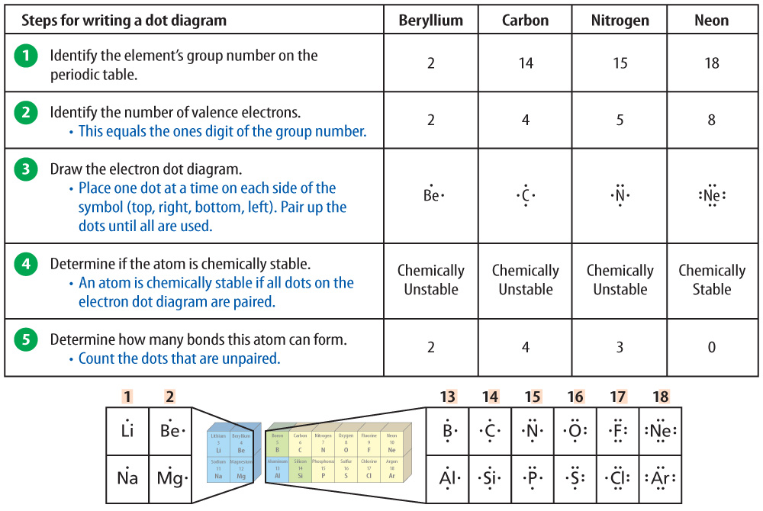
Lesson 1-3

Slide 14
Lesson 1-2
Atoms Bond (cont.)
Atoms with eight valence electrons are chemically stable and do not easily react with other atoms.
Atoms that have between one and seven valence electrons are reactive or chemically unstable and easily bond with other atoms to form chemically stable compounds.

Slide 15
Lesson 1-2
Atoms Bond (cont.)
The elements in group 18 are called noble gases.
With the exception of helium, noble gases have eight valence electrons and are chemically stable.
All noble gases have a FULL valence shell

Slide 16
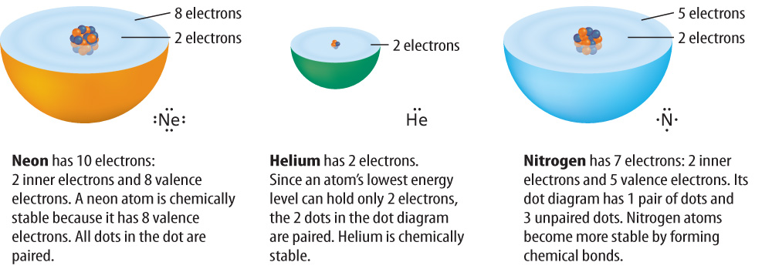
Lesson 1-2
Atoms gain, lose, or share valence electrons and become chemically stable.

Slide 17

Lesson 1 - VS
Electrons are less strongly attracted to a nucleus the farther they are from it, similar to the way a magnet attracts a paper clip.

Slide 18
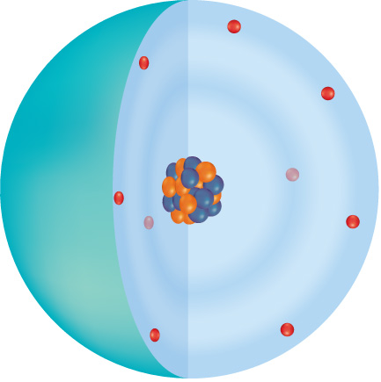
Lesson 1 - VS
Electrons in atoms are in energy levels around the nucleus. Valence electrons are involved in chemical bonding.

Slide 19

Lesson 1 - VS
All noble gases, except He, have four pairs of dots in their electron dot diagrams. Noble gases are chemically stable.

Slide 20

Lesson 1 – LR1
Where on the periodic table are nonmetals located?
A. the left side
B. the right side
C. the middle
D. all of the above

Slide 21
Lesson 1 – LR2
Which term refers to areas of space in which electrons move around the nucleus?
A. electron dot diagram
B. periodic table
C. neutron
D. energy levels

Slide 22
Lesson 1 – LR3
All of the elements in group 18 are called what?
A. metalloids
B. valence electrons
C. noble gases
D. metals

Slide 23

Lesson 1 - Now
Do you agree or disagree?
1. Elements rarely exist in pure form. Instead, combinations of elements make up most of the matter around you.
2. Chemical bonds that form between atoms involve electrons.

