Slide 1



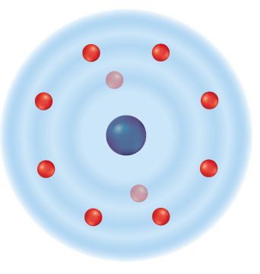




Chapter Menu
Chapter Introduction
Lesson 1 Electrons and
Energy Levels
Lesson 2 Compounds,
Chemical
Formulas, and
Covalent Bonds
Lesson 3 Ionic and Metallic Bonds
Chapter Wrap-Up

Slide 2



Lesson 2 Reading Guide - KC
Compounds, Chemical Formulas, and Covalent Bonds
How do elements differ from the compounds they form?
What are some common properties of a covalent compound?
Why is water a polar compound?

Slide 3
Lesson 2-1
From Elements to Compounds
Compounds are chemical combinations of different types of atoms.
Chemical bonds join atoms together.

Slide 4
Lesson 2-2
Covalent Bonds—Electron Sharing
A covalent bond is a chemical bond formed when two atoms share one or more pairs of valence electrons.
  Normally this is two (or more) nonmetals
A compound formed from many covalent bonds is called a covalent compound.
The smallest part of this compound is a molecule.

Slide 5
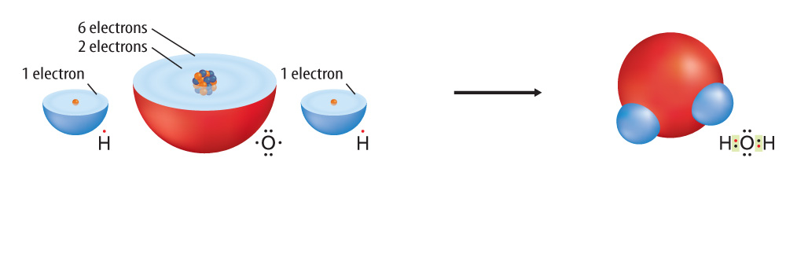
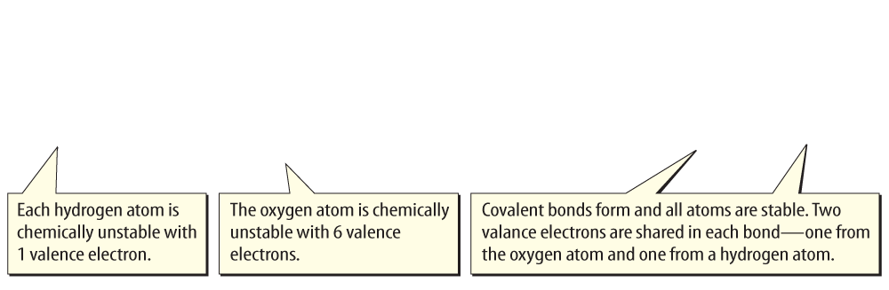
Lesson 2-2
Atoms with less than eight valence electrons become chemically stable by forming a chemical bond.

Slide 6
Lesson 2-2
Covalent Bonds—Electron Sharing
(cont.)
A single covalent bond exists
when two atoms share one pair of valence electrons.
A double covalent bond exists when
two atoms share two pairs of valence electrons
A triple covalent bond exists when two atoms share three pairs of valence electrons.

Slide 7
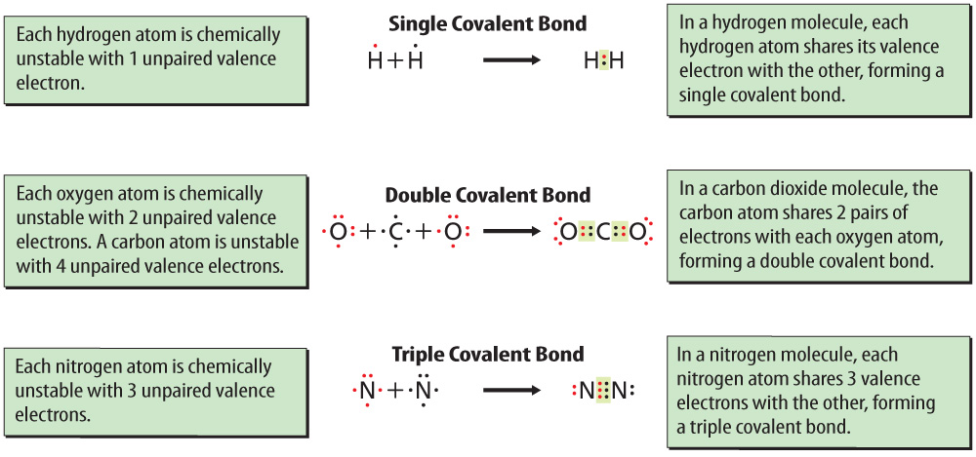
Lesson 2-2
The more valence electrons that two atoms share, the stronger the covalent bond is between the atoms.

Slide 8
Lesson 2-3
Covalent Compounds
Covalent compounds usually have low melting points and low boiling points.
They are usually gases or liquids at room temperature.
Covalent compounds are poor conductors of thermal energy and electricity.

Slide 9
Lesson 2-3
Covalent Compounds (cont.)
A molecule is a group of atoms held together by covalent bonding that acts as an independent unit.
A molecule that has a partial positive end and a partial negative end because of unequal sharing of electrons is a polar molecule.

Slide 10
Lesson 2-3
Covalent Compounds (cont.)
polar
from Latin polus, means “pole”

Slide 11
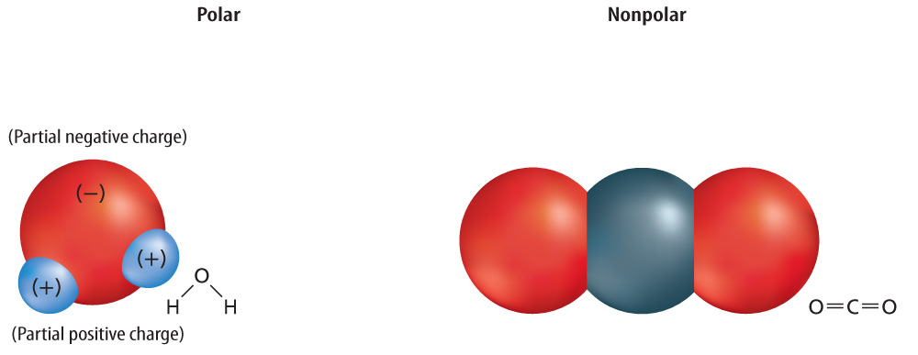
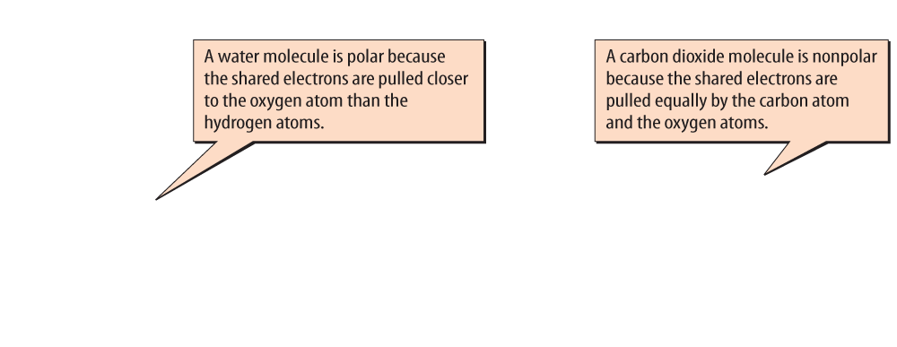
Lesson 2-4
Atoms of a polar molecule share their valence electrons unequally.

Slide 12
Lesson 2-4
Atoms of a nonpolar molecule share their valence electrons equally.

Slide 13
Lesson 2-3
Covalent Compounds (cont.)
A chemical formula is a group of chemical symbols and numbers that represent the elements and the number of atoms of each element that make up a compound.
A chemical formula describes the types of atoms in a compound or a molecule

Slide 14
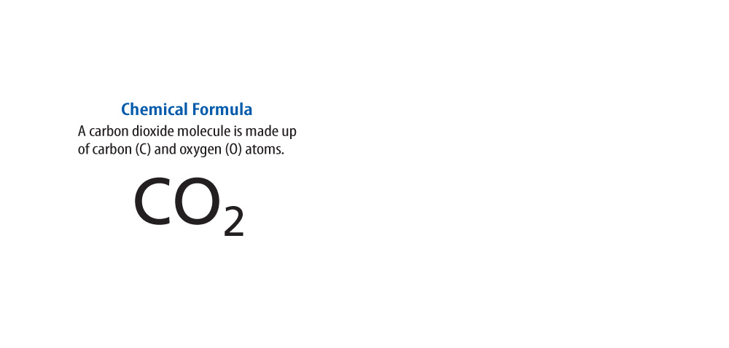
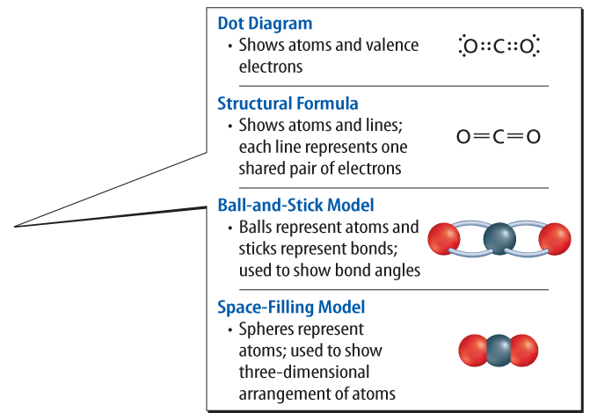
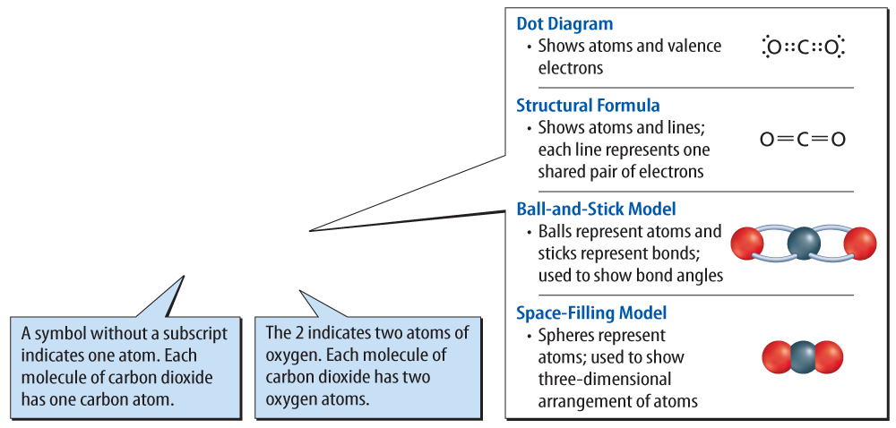
Lesson 2-4
Chemical formulas and molecular models provide information about molecules.

Slide 15

Lesson 2 - VS
A chemical formula is one way to show the elements that make up a compound.

Slide 16
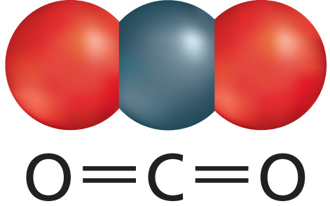
Lesson 2 - VS
A covalent bond forms when atoms share valence electrons. The smallest particle
of a covalent compound is a molecule.

Slide 17
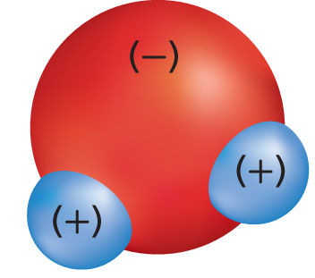
Lesson 2 - VS
Water is a polar molecule because the oxygen and hydrogen atoms unequally share electrons.

Slide 18

Lesson 2 – LR1
Which term refers to chemical combinations of different types
of atoms?
A. covalent bond
B. chemical formula
C. compound
D. polar molecule

Slide 19
Lesson 2 – LR2
When two atoms share one pair of valence electrons, which of the following exists?
A. single covalent bond
B. double covalent bond
C. triple covalent bond
D. none of these

Slide 20
Lesson 2 – LR3
Which term refers to a molecule that has a partial positive end and a partial negative end because of unequal sharing of electrons?
A. covalent bond
B. polar molecule
C. nonpolar molecule
D. covalent compound

