Slide 1


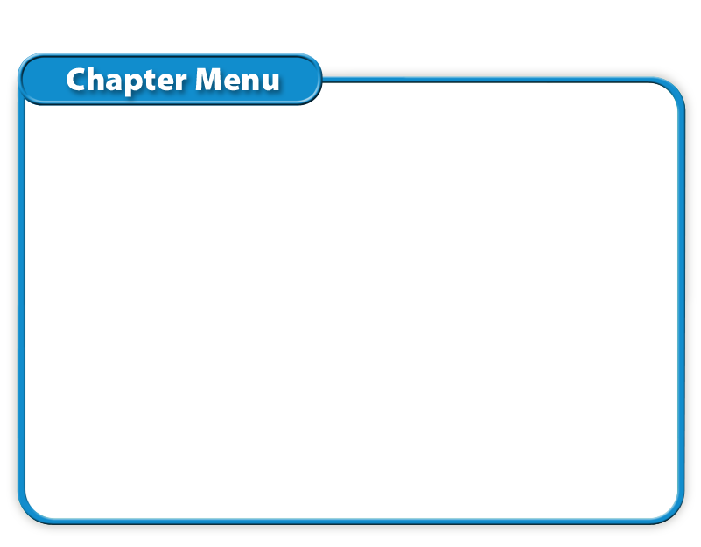
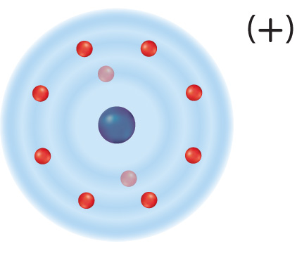




Chapter Menu
Chapter Introduction
Lesson 1 Electrons and
Energy Levels
Lesson 2 Compounds,
Chemical
Formulas, and
Covalent Bonds
Lesson 3 Ionic and Metallic Bonds
Chapter Wrap-Up

Slide 2



Lesson 3 Reading Guide - KC
Ionic and Metallic Bonds
What is an ionic compound?
How do metallic bonds differ from covalent and ionic bonds?

Slide 3
Lesson 3-1
Understanding Ions
An ion is an atom that is no longer electrically neutral because it has lost or gained valence electrons.
ion
from Greek ienai, means “to go”

Slide 4
Lesson 3-1
Understanding Ions (cont.)
Losing or gaining an electron changes the overall charge of an atom.
Atoms that lose valence electrons become ions with a positive charge.
Metal atoms tend to lose valence electrons.

Slide 5
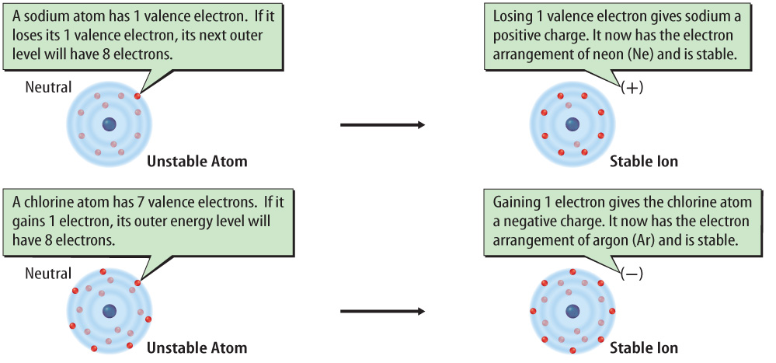

Lesson 3-1
Sodium atoms have a tendency to lose a valence electron. Chlorine atoms have a tendency to gain a valence electron.

Slide 6
Lesson 3-2
Ionic Bonds—Electron Transferring
When forming a compound, the nonmetal atoms gain the electrons lost by the metal atoms.
The attraction between positively and negatively charged ions in an ionic compound is an ionic bond.

Slide 7
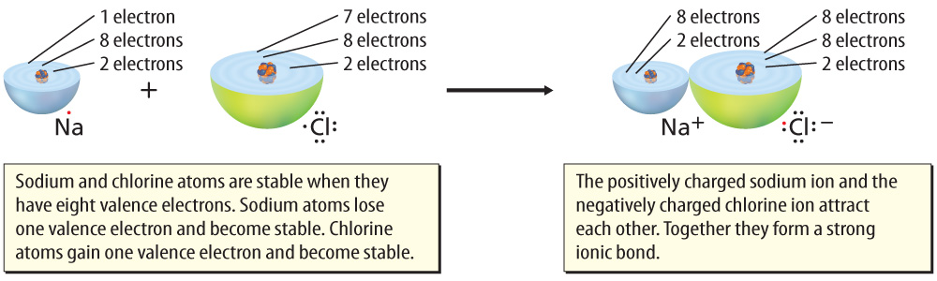
Lesson 3-2
An ionic bond forms between Na+ and Cl- when an Na atom transfers an electron to a Cl atom.

Slide 8
Lesson 3-3
Ionic Compounds
Individual ions in an ionic compound are strongly attracted to each other (opposites attract).
When nonmetal ions bond to metal ions in an ionic compound there is a large collection of oppositely charged ions and no molecules.

Slide 9
Lesson 3-4
Metallic Bonds—Electron Pooling
A metallic bond is a bond formed when many metal atoms share their pooled valence electrons.
Valence electrons in metals are not bonded to one atom.
Instead, a “sea of electrons” surrounds the positive ions.

Slide 10
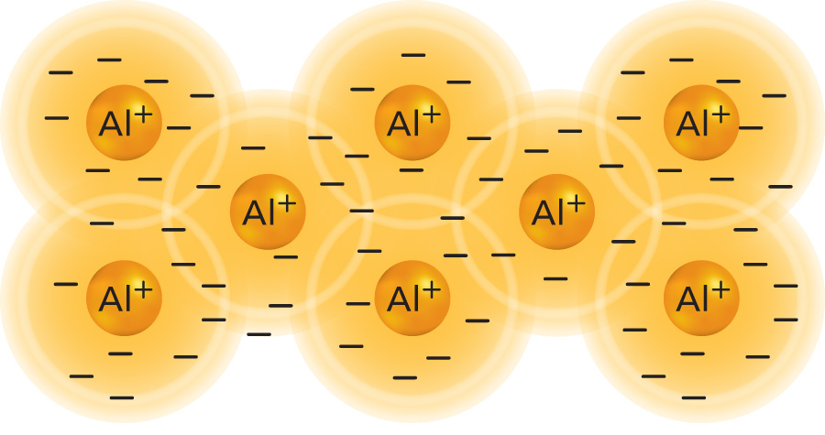
Lesson 3-4
Valence electrons are free to move among all the aluminum (Al) ions.

Slide 11
Lesson 3-4
Metallic Bonds—Electron Pooling (cont.)
Metals are good conductors of thermal energy and electricity.
Metals are shiny because the valence electrons at the surface of a metal interact with light.

Slide 12
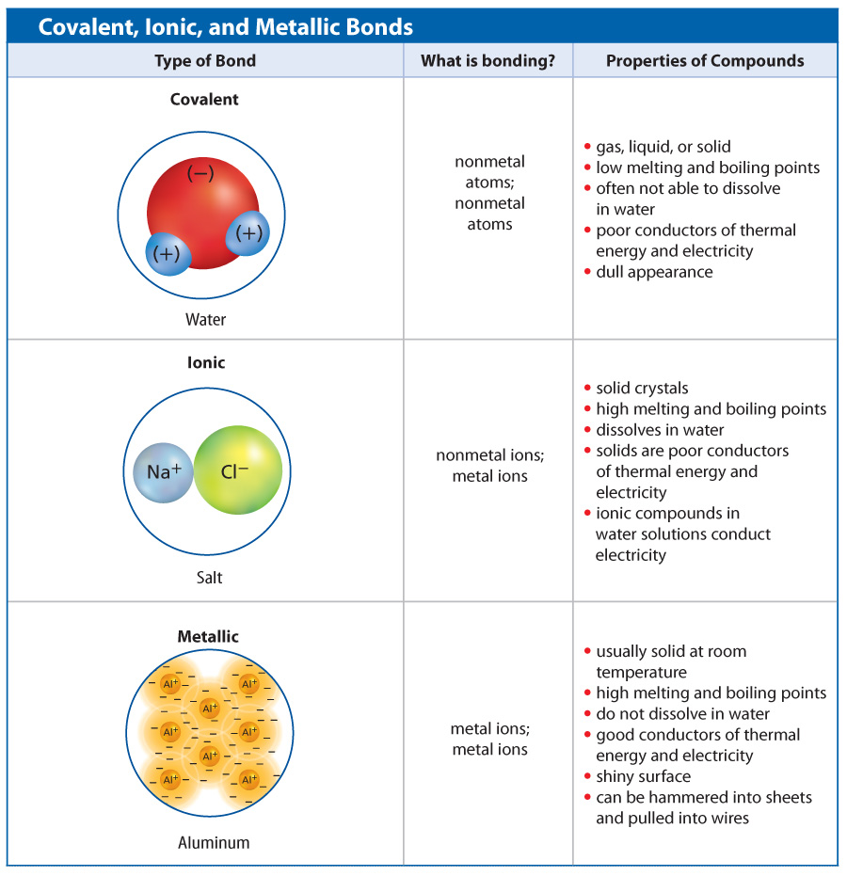
Lesson 3-4

Slide 13
Lesson 3-4

Slide 14
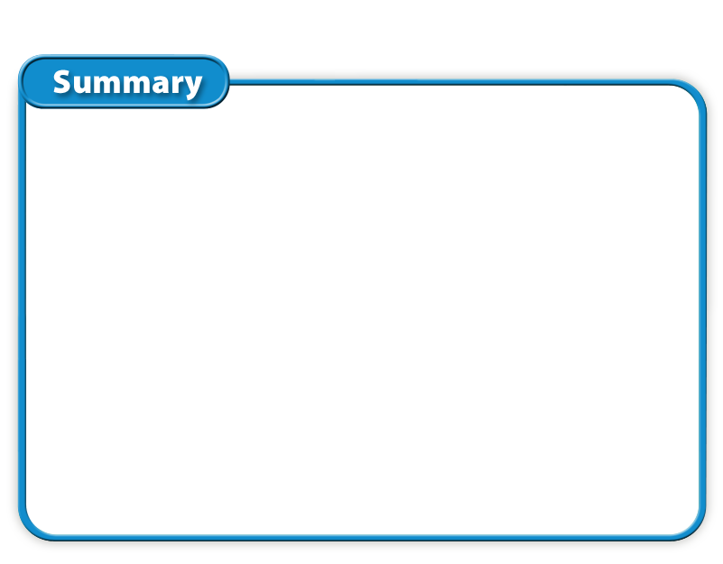
Lesson 3 - VS
Metal atoms lose electrons and nonmetal atoms gain electrons and form stable compounds. An atom that has gained or lost an electron is an ion.

Slide 15
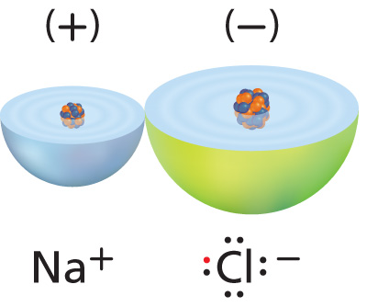
Lesson 3 - VS
An ionic bond forms between positively and negatively charged ions.

Slide 16
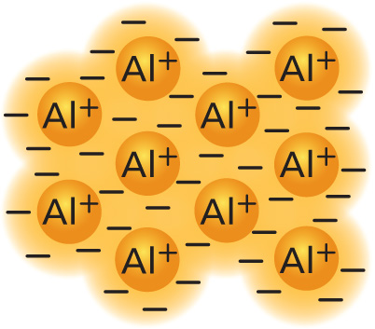
Lesson 3 - VS
A metallic bond forms when many metal atoms share their pooled valence electrons.

Slide 17
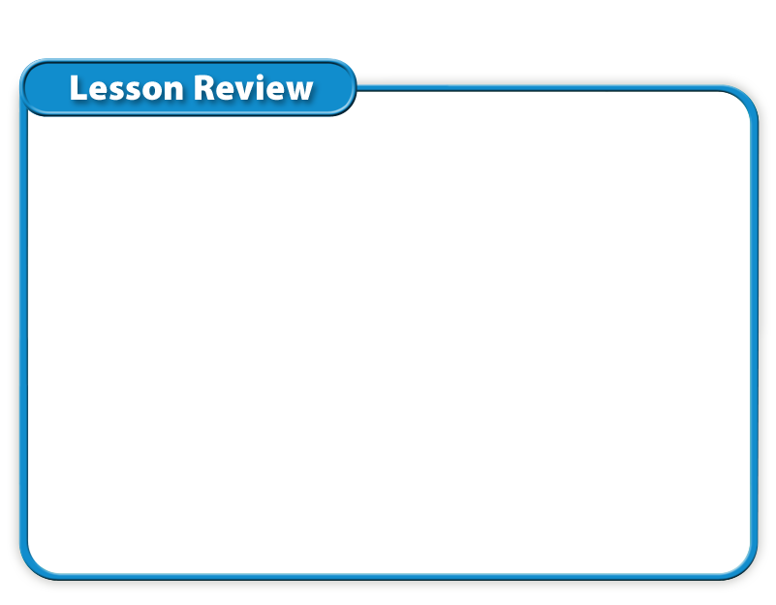
Lesson 3 – LR1
Which of these describes an atom that is no longer electrically neutral because it has lost or gained valence electrons ?
A. covalent compound
B. proton
C. ion
D. molecule

Slide 18
Lesson 3 – LR2
What is a bond formed when many metal atoms share their pooled valence electrons?
A. ionic bond
B. metallic bond
C. covalent compound
D. ionic compound

Slide 19
Lesson 3 – LR3
An ionic bond is the attraction between positively and negatively charged ions in which of these?
A. valence electrons
B. covalent compound
C. ionic compound
D. none of these

Slide 20

Lesson 3 - Now
Do you agree or disagree?
5. Losing valence electrons can make some atoms more chemically stable.
6. Metals are good electrical conductors because they tend to hold onto their valence electrons very tightly.

