Slide 1

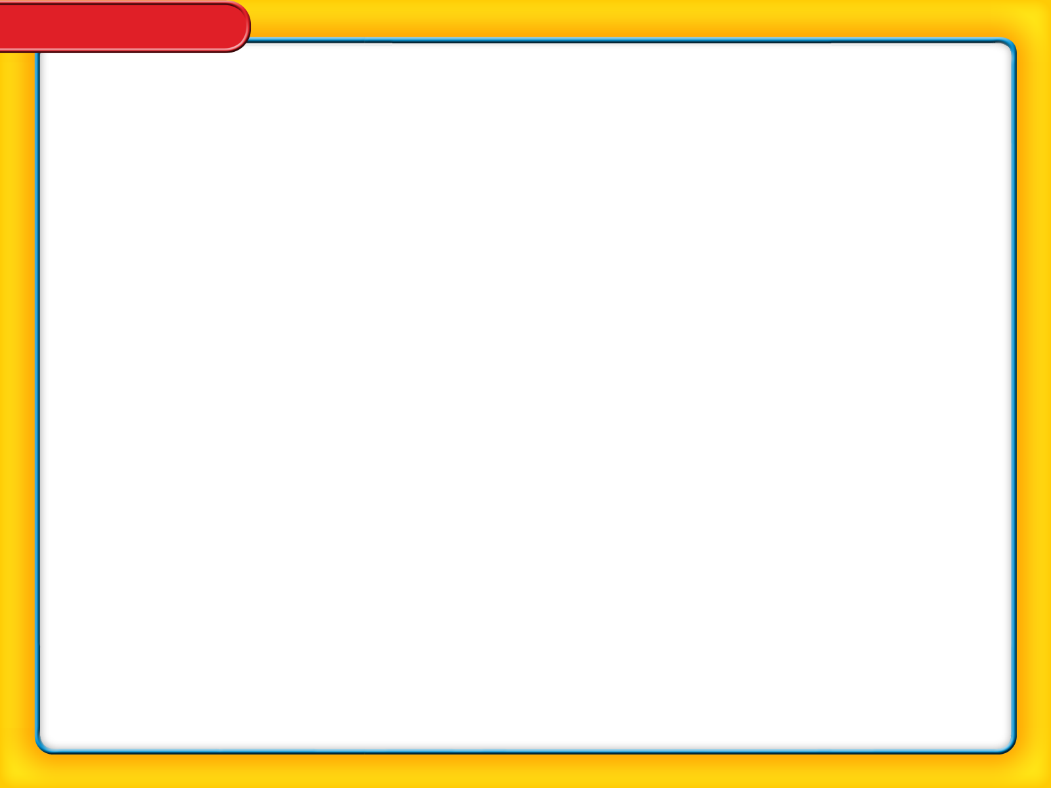
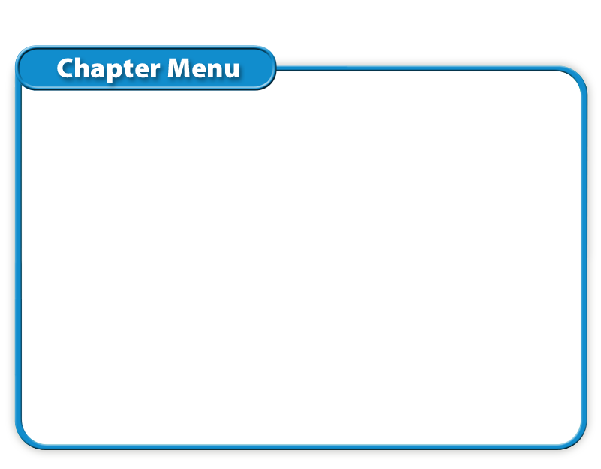
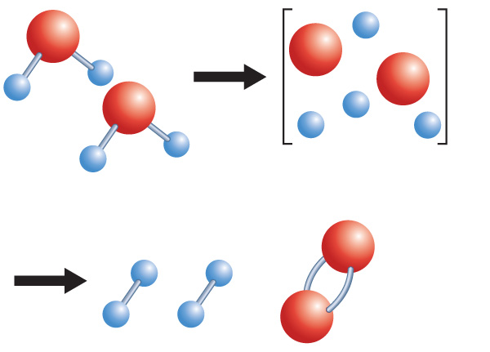




Chapter Menu
Chapter Introduction
Lesson 1 Understanding
Chemical Reactions
Lesson 2 Types of
Chemical Reactions
Lesson 3 Energy Changes and
Chemical Reactions
Chapter Wrap-Up

Slide 2
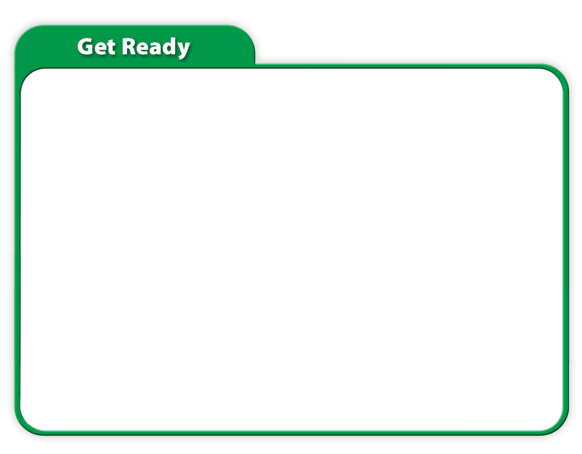
Chapter Introduction
Do you agree or disagree?
1. If a substance bubbles, you know a chemical reaction is occurring.
2. During a chemical reaction, some atoms are destroyed and new atoms are made.
3. Reactions always start with two or more substances that react with each other.

Slide 3
Chapter Introduction
Do you agree or disagree?
4. Water can be broken down into simpler substances.
5. Reactions that release energy require energy to get started.
6. Energy can be created in a chemical reaction.

Slide 4
Lesson 1-1
Changes in Matter
A physical change does not produce new substances.
For example, water is still water when it freezes.

Slide 5
Lesson 1-1
Changes in Matter (cont.)
During a chemical change, substances change into new substances.
A chemical reaction is a process
in which atoms of substances rearrange to form new substances.

Slide 6
Lesson 1-2
Signs of a Chemical Reaction
Changes in the physical properties of color, state of matter, and odor are all signs that a chemical reaction might have occurred.
If substances get warmer or cooler or if they give off light or sound, it is likely that a chemical reaction has occurred.

Slide 7
Lesson 1-3
What happens in a chemical reaction?
In a chemical reaction, atoms of elements or compounds rearrange and form different elements or compounds.
Atoms rearrange when chemical bonds between atoms break then re-form in different arrangement.

Slide 8
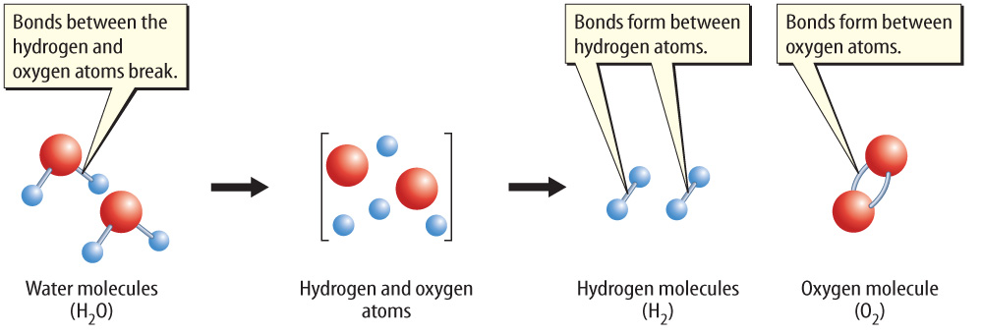
Lesson 1-3
No new atoms are created in a chemical reaction. The existing atoms rearrange and form new substances.

Slide 9
Lesson 1-4
Chemical Equations
A chemical equation is a description of a reaction using element symbols and chemical formulas.
In chemical equations, element symbols represent elements and chemical formulas represent compounds.

Slide 10
Lesson 1-4
Chemical Equations (cont.)
A subscript describes the number of atoms of an element in a compound.
If an element’s symbol does not have a subscript, the compound contains only one atom of that element.

Slide 11
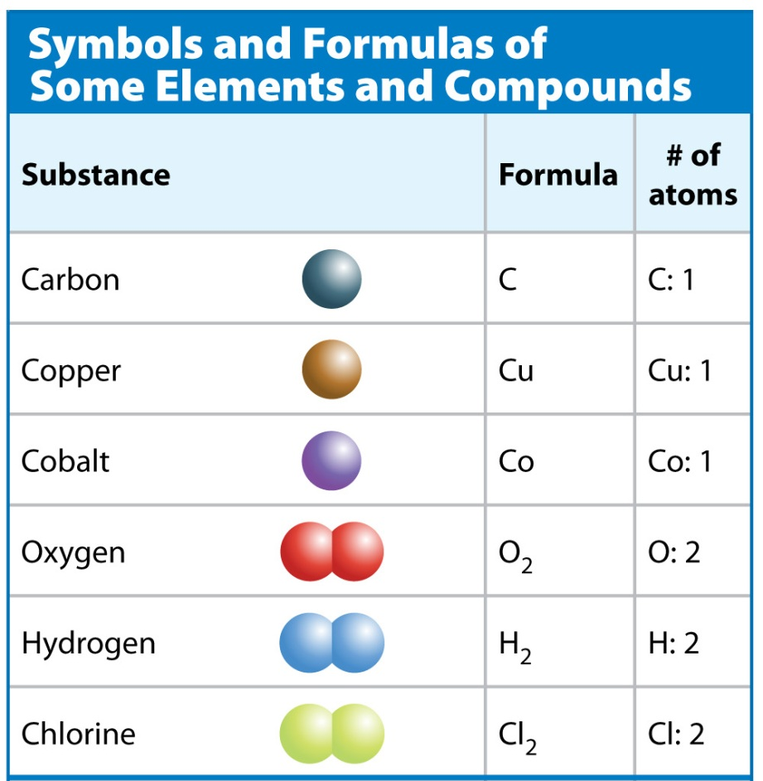

Lesson 1-4

Slide 12
Lesson 1-4
Chemical Equations (cont.)
A chemical equation includes both
the substances that react and the substances that are formed in a
chemical reaction.
The starting substances in a chemical reaction are reactants.
The substances produced by the chemical reaction are products.

Slide 13
Lesson 1-4
Chemical Equations (cont.)
The reactants are written to the left of
the arrow.
The products are written to the right of the arrow.
The general structure for a chemical equation is:
reactant + reactant product + product

Slide 14
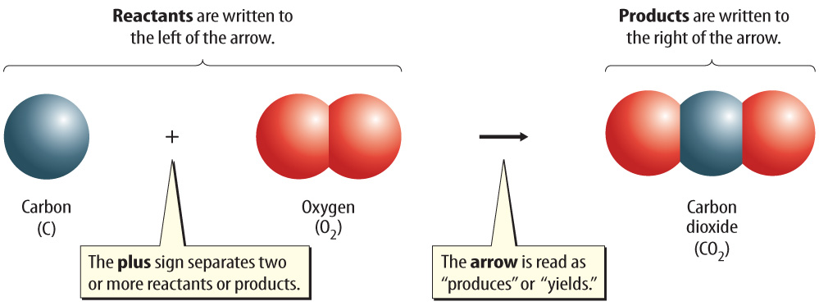
Lesson 1-4
An equation is read much like a sentence. This equation is read as “carbon reacts with oxygen to produce carbon dioxide.”

Slide 15
Lesson 1-5
Conservation of Mass
The law of conservation of mass –the total mass of the reactants before a chemical reaction is the same as the total mass of the products after the chemical reaction.
Mass is conserved in a reaction because atoms are conserved.
Atoms are not created or destroyed in a chemical reaction.

Slide 16
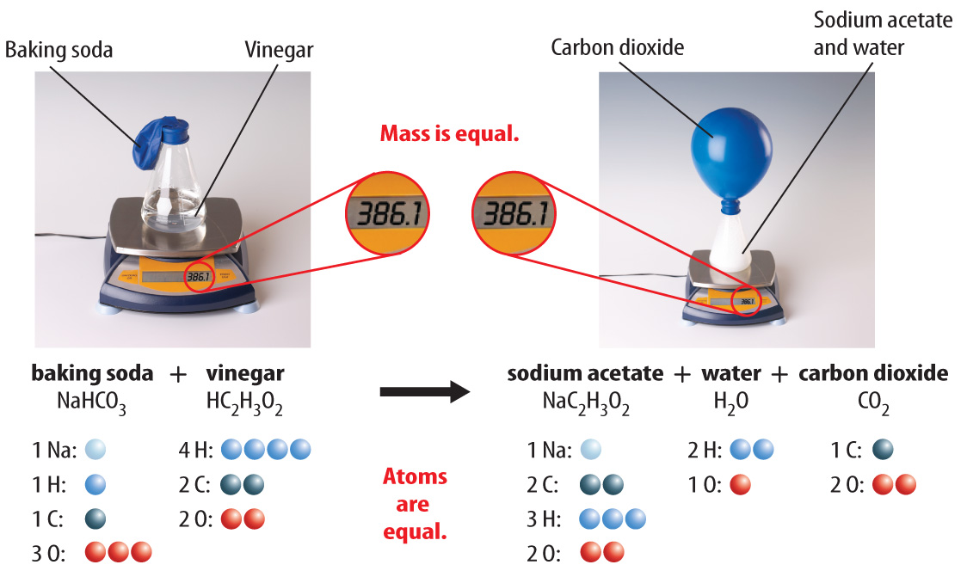
Lesson 1-5
Mass is conserved in the reaction between baking soda and vinegar.
Hutchings Photography/Digital Light Source
Hutchings Photography/Digital Light Source

Slide 17
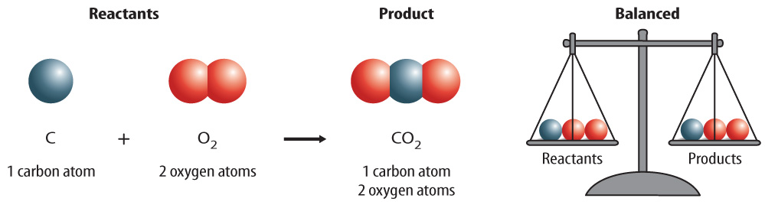
Lesson 1-5
Conservation of Mass (cont.)
A chemical equation is written so that the number of atoms of each element is the same, or balanced, on each side of the arrow.

Slide 18
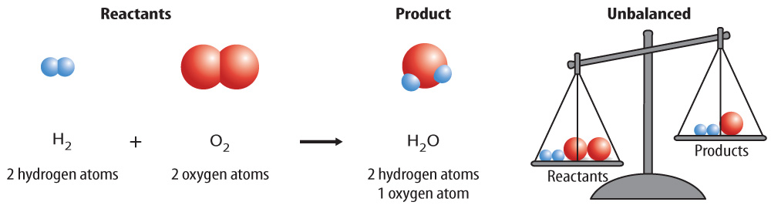
Lesson 1-5
Conservation of Mass (cont.)
A balanced equation often does not
happen automatically when the formulas
for reactants and products are written.

Slide 19
Lesson 1-5
Conservation of Mass (cont.)
A coefficient is a number placed in front of an element symbol or chemical formula in an equation.
Only coefficients can be changed when balancing an equation.

Slide 20
How to balance equations:
Write the formula for reactants and products correctly in the equation
Put boxes around each reactant and product to remind yourself that subscripts don’t change
Make a line dividing the reactant and product side
Count atoms of each element on both sides
Use coefficients as needed in front of boxes to have the same number of atoms of each element on product and reactant side

Slide 21
Example: hydrogen gas reacts with oxygen gas to produce water
Example: carbon dioxide reacts with water in photosynthesis to produce glucose and oxygen gas.

Slide 22
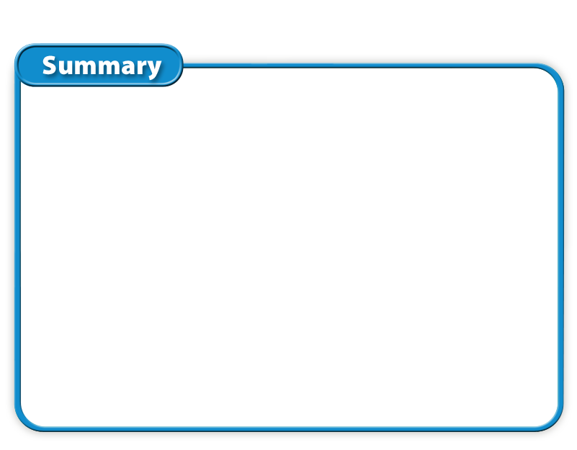
Lesson 1 - VS
A chemical reaction is a process
in which bonds break and atoms rearrange, forming new bonds.

Slide 23

Lesson 1 - VS
A chemical equation uses symbols
to show reactants and products of
a chemical reaction.

Slide 24
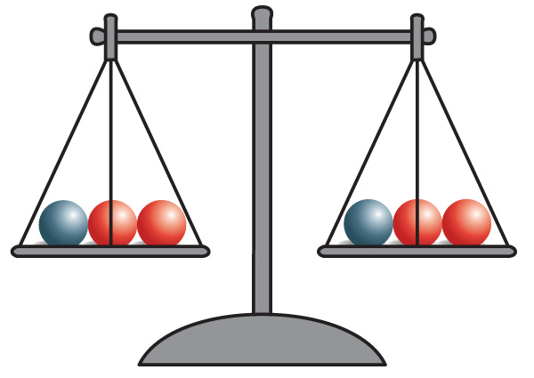
Lesson 1 - VS
The mass and the number of each
type of atom do not change during
a chemical reaction. This is the law
of conservation of mass.

Slide 25
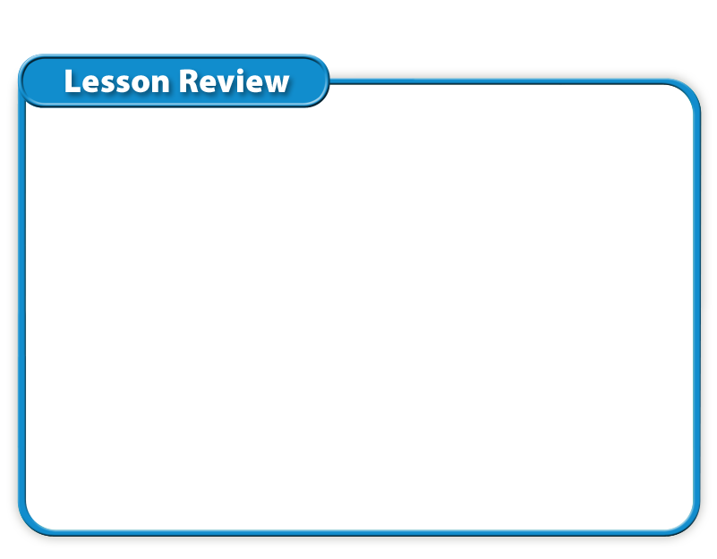
Lesson 1 – LR1
Which term refers to a description of a reaction using element symbols and chemical formulas?
A. chemical equation
B. chemical reaction
C. coefficient
D. subscript

Slide 26
Lesson 1 – LR2
What are substances produced by a chemical reaction called?
A. reactants
B. products
C. element
D. coefficient

Slide 27
Lesson 1 – LR3
What is conserved when mass is conserved in a reaction?
A. substances
B. products
C. coefficients
D. atoms

Slide 28

Lesson 1 - Now
Do you agree or disagree?
1. If a substance bubbles, you know
a chemical reaction is occurring.
2. During a chemical reaction, some atoms are destroyed and new atoms are made.

