Slide 1



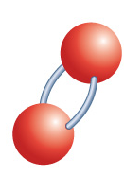




Chapter Menu
Chapter Introduction
Lesson 1 Understanding
Chemical Reactions
Lesson 2 Types of
Chemical Reactions
Lesson 3 Energy Changes and
Chemical Reactions
Chapter Wrap-Up

Slide 2



Lesson 2 Reading Guide - KC
Types of Chemical Reactions
How can you recognize the type of chemical reaction by the number or type of reactants and products?
What are the different types of chemical reactions?

Slide 3
Lesson 2-1
Patterns in Reactions
Each type of chemical reaction follows a unique pattern in the way atoms in reactants rearrange to form products.
There are 4 main kinds of reaction.

Slide 4
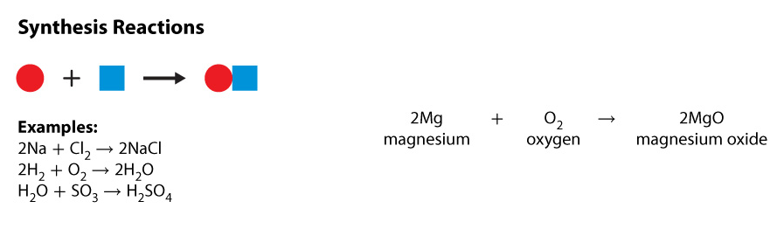

Lesson 2-2
Types of Chemical Reactions
A synthesis is a type of chemical reaction in which two or more substances combine and form one compound.

Slide 5
Lesson 2-2
Types of Chemical Reactions (cont.)
synthesis
from Greek syn–, means “together”; and tithenai, means “put”

Slide 6
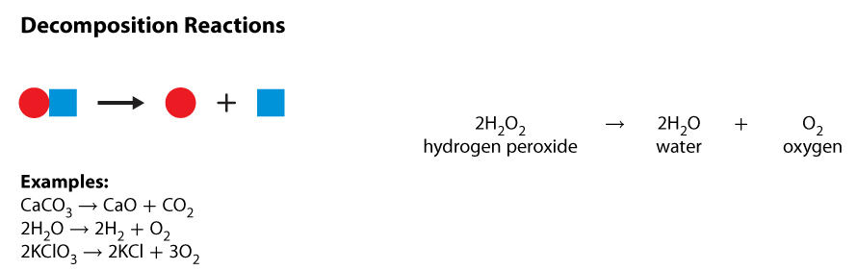
Lesson 2-2
Types of Chemical Reactions (cont.)
In a decomposition reaction, one compound breaks down and forms
two or more substances.

Slide 7
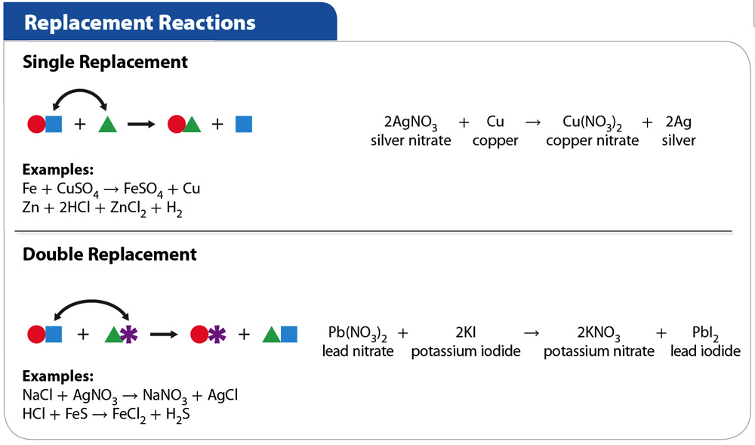
Lesson 2-2
Types of Chemical Reactions (cont.)
In a single-replacement reaction, one element replaces another element in a compound.

Slide 8
Lesson 2-2
Types of Chemical Reactions (cont.)
In a double-replacement reaction, the negative ions in two compounds switch places, forming two new compounds.

Slide 9
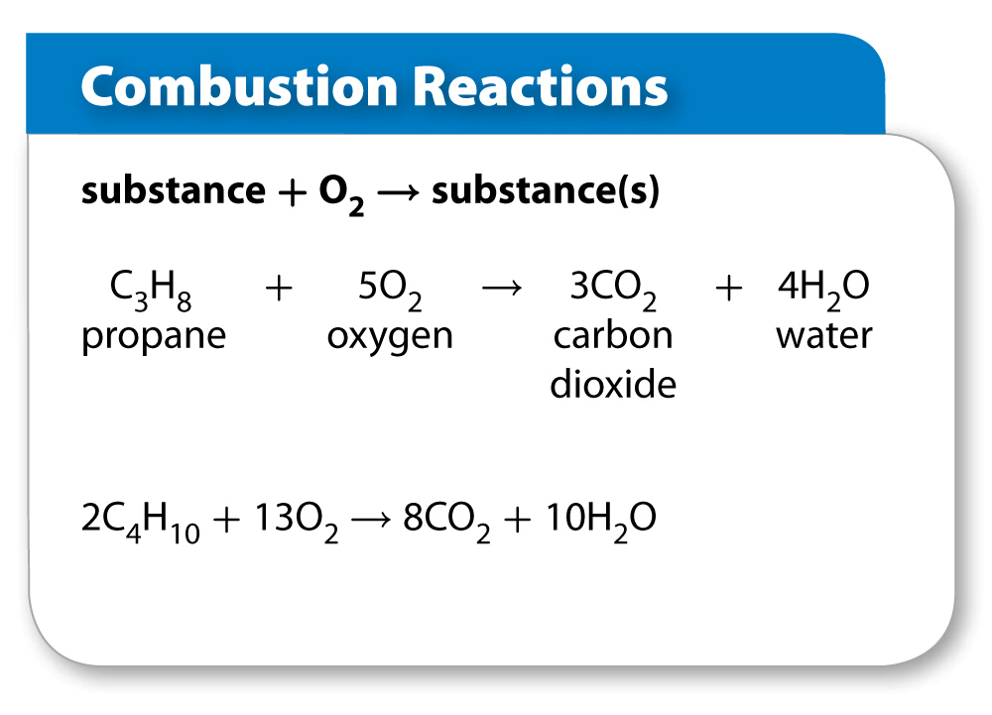
Lesson 2-2
Types of Chemical Reactions (cont.)
Combustion is a chemical reaction in which a substance combines with oxygen and releases
energy.

Slide 10

Lesson 2 - VS
Chemical reactions are classified according to patterns seen in their reactants and products.

Slide 11
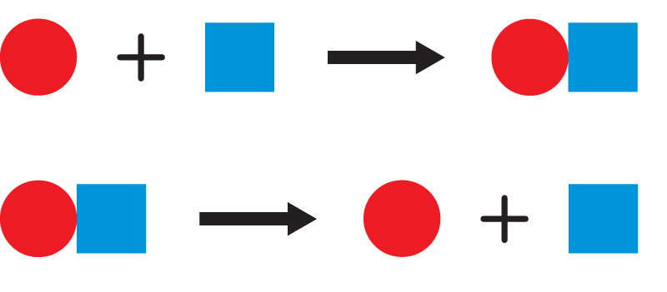
Lesson 2 - VS
In a synthesis reaction, there are two or more reactants and one product. A decomposition reaction is the opposite of a synthesis reaction.

Slide 12
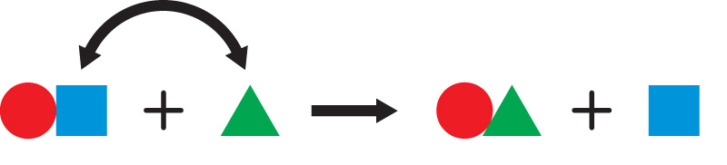
Lesson 2 - VS
In replacement reactions, an element, or elements, in a compound is replaced with another element or elements.

Slide 13

Lesson 2 – LR1
What term describes a type of chemical reaction in which two or more substances combine and form one compound?
A. single-replacement
B. double-replacement
C. combustion
D. synthesis

Slide 14
Lesson 2 – LR2
In which type of chemical reaction does a substance combine with oxygen and release energy?
A. synthesis
B. combustion
C. single-replacement
D. double-replacement

Slide 15
Lesson 2 – LR3
Which term refers to a chemical reaction in which the negative ions in two compounds switch places, forming two new compounds?
A. double-replacement
B. single-replacement
C. decomposition
D. synthesis

Slide 16

Lesson 2 - Now
Do you agree or disagree?
3. Reactions always start with two or more substances that react with each other.
4. Water can be broken down into simpler substances.

