Slide 1



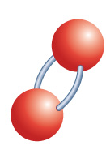




Chapter Menu
Chapter Introduction
Lesson 1 Understanding
Chemical Reactions
Lesson 2 Types of
Chemical Reactions
Lesson 3 Energy Changes and
Chemical Reactions
Chapter Wrap-Up

Slide 2



Lesson 3 Reading Guide - KC
Energy Changes and Chemical Reactions
Why do chemical reactions always involve a change in energy?
What is the difference between an endothermic reaction and an exothermic reaction?
What factors can affect the rate of a chemical reaction?

Slide 3
Lesson 3-1
Energy Changes
Chemical bonds contain a form of energy called chemical energy.
Breaking a bond absorbs energy from the surroundings.
The formation of a chemical bond releases energy to the surroundings.

Slide 4
Lesson 3-1
Energy Changes (cont.)
Some chemical reactions release more energy than they absorb.
Some chemical reactions absorb more energy than they release.
Energy is conserved in all chemical reactions.

Slide 5
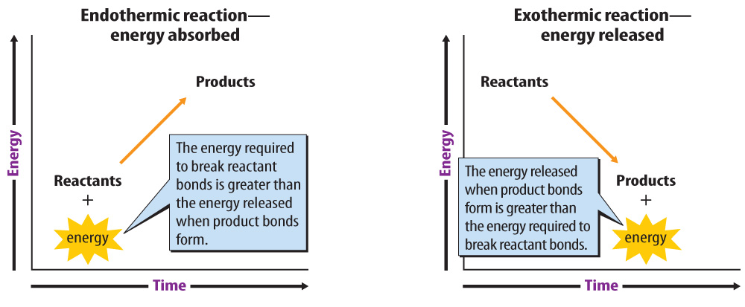
Lesson 3-1
Chemical reactions that absorb thermal energy are endothermic reactions.
In an endothermic
reaction, more
energy is required
to break the
bonds of the
reactants than
is released when
the products form.

Slide 6
Lesson 3-1
An exothermic reaction is a chemical reaction that releases thermal energy.
In an exothermic
reaction, more
energy is released
when the products
form than is
required to break
the bonds in the
reactants.

Slide 7
Lesson 3-1
Energy Changes (cont.)
exothermic
from Greek exo–, means “outside”; and therm, means “heat”

Slide 8
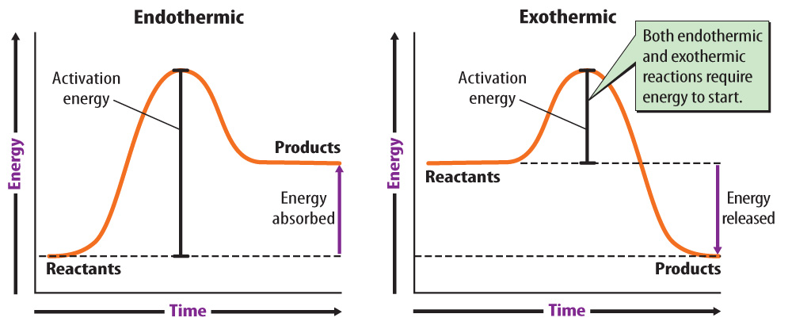
Lesson 3-1
Activation energy is the minimum amount of energy needed to start a chemical reaction.

Slide 9
Lesson 3-2
Reaction Rates
The rate of a reaction is the speed at which it occurs.
Chemical reactions occur faster if particles collide more often or move faster when they collide.

Slide 10
Lesson 3-2
Reaction Rates (cont.)
Increased surface area increases reaction rate because more particles on the surface of a solid come into contact with the particles of another substance.
At higher temperatures, the average speed of particles is greater, particles collide more often, and collisions with more energy are more likely to break chemical bonds.

Slide 11
Lesson 3-2
Reaction Rates (cont.)
Increasing the concentration of one or more reactants increases collisions between particles, resulting in a fast reaction rate.
In gases, an increase in pressure pushes gas particles closer together, resulting in more collisions.

Slide 12
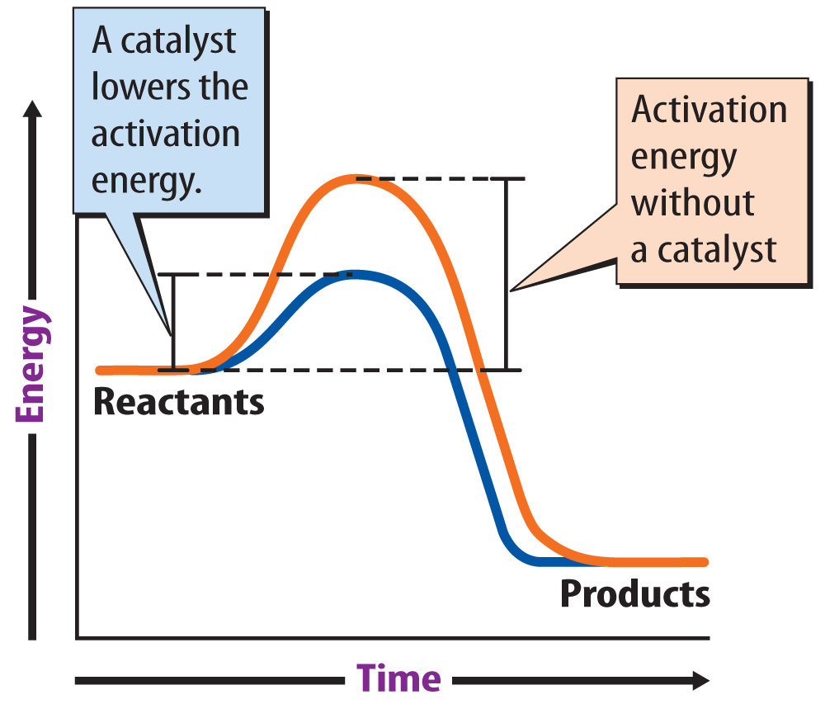
Lesson 3-2
A catalyst is a substance that increases reaction rate by lowering the activation energy of a reaction.
An enzyme is
a catalyst that
speeds up
chemical
reactions in
living cells.

Slide 13

Lesson 3-2
Reaction Rates (cont.)
An inhibitor is a substance that slows, or even stops, a chemical reaction.
What factors can affect the rate of a chemical reaction?

Slide 14

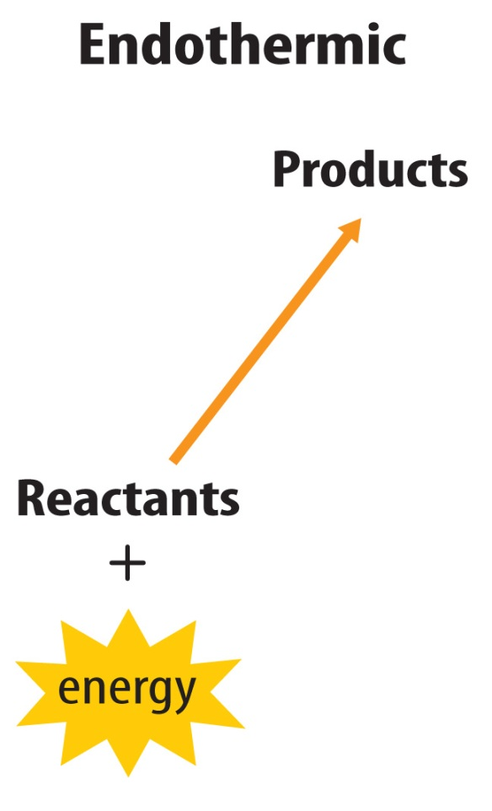
Lesson 3 - VS
Chemical reactions that release energy are exothermic, and those that absorb energy are endothermic.

Slide 15
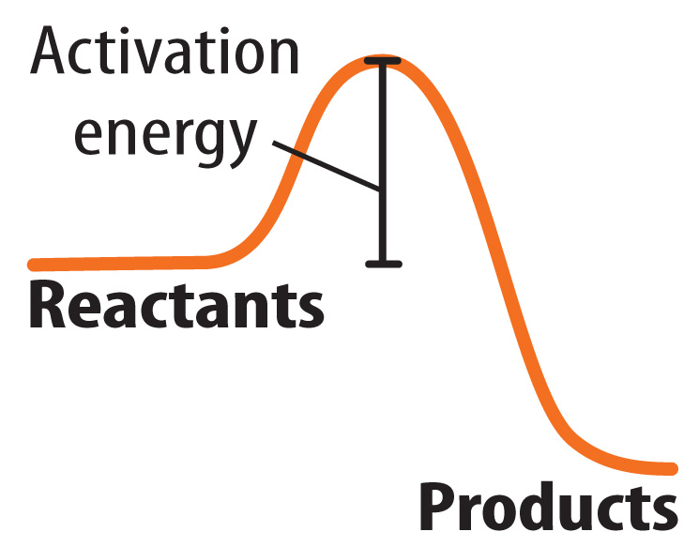
Lesson 3 - VS
Activation energy must be added to a chemical reaction for it to proceed.

Slide 16
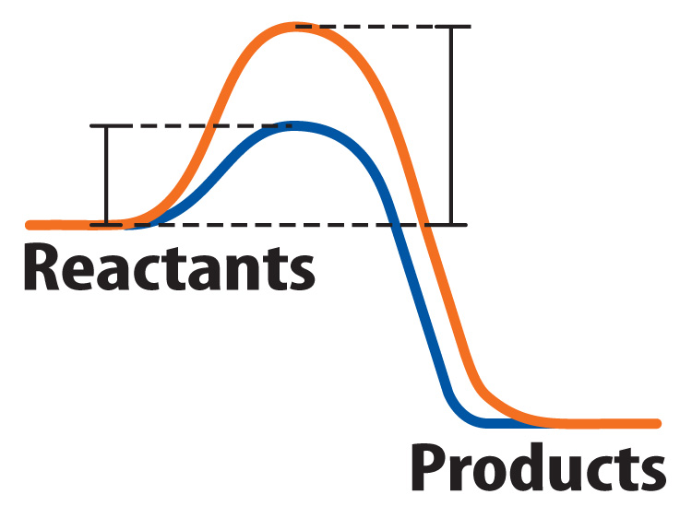
Lesson 3 - VS
Catalysts, including enzymes, speed up chemical reactions. Inhibitors slow them down.

Slide 17

Lesson 3 – LR1
What term refers to the minimum amount of energy needed to start a chemical reaction?
A. activation energy
B. catalyst
C. inhibitor
D. reactant

Slide 18
Lesson 3 – LR2
What is the name for a substance that slows, or even stops a chemical reaction?
A. reactant
B. inhibitor
C. enzyme
D. catalyst

Slide 19
Lesson 3 – LR3
In which type of reaction is more energy released when the products form than is required to break the bonds in the reactants?
A. endothermic
B. exothermic
C. single-replacement
D. double-replacement

Slide 20

Lesson 3 - Now
Do you agree or disagree?
5. Reactions that release energy require energy to get started.
6. Energy can be created in a chemical reaction.

