Slide 1



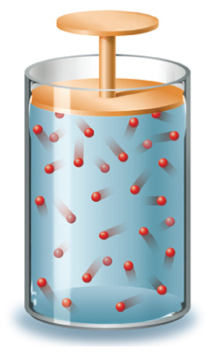




Chapter Menu
Chapter Introduction
Lesson 1 Scientific
Inquiry
Lesson 2 Measurement
and Scientific
Tools
Lesson 3 Case Study
Chapter Wrap-Up

Slide 2


Chapter Introduction
What is scientific inquiry?
Inquiry: a method of increasing knowledge or answering a question

Slide 3


Lesson 1 Reading Guide - KC
Scientific Inquiry
What are some steps used during scientific inquiry?
What are the results of scientific inquiry?
What is critical thinking?

Slide 4

Lesson 1 Reading Guide - Vocab
Scientific Inquiry
science
observation
inference
hypothesis
prediction
scientific theory
scientific law
technology
critical thinking

Slide 5
Lesson 1-1
Understanding Science
Science is the investigation and exploration of natural events and of the new information that results from those investigations.
science
Latin: scientia, means “knowledge” or “to know”

Slide 6
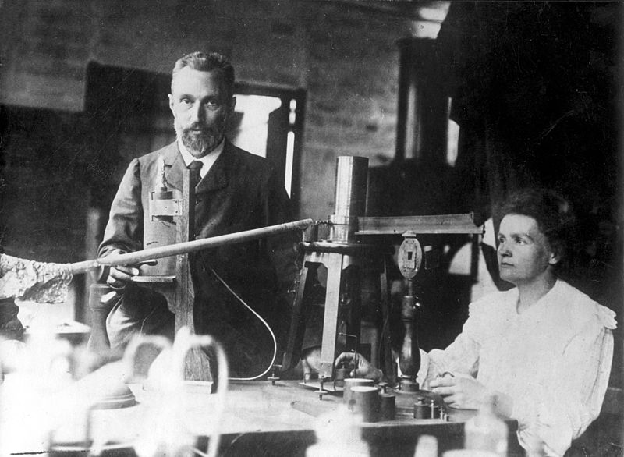
Lesson 1-1
Understanding Science (cont.)
Throughout history, people of many different backgrounds, interests, and talents have made scientific contributions.
Marie Curie—1867-1934
  Discovered 2 elements
  First woman to win Nobel Prize
  One of only 2 people to win Nobel Prize in 2 areas

Slide 7
Scientific study is organized into several branches, each of which focuses on a different part of the natural world.

Slide 8
Lesson 1-2
Branches of Science
Physical science is the study of matter and energy (physics and chemistry).
Earth scientists study the processes that occur in and on Earth and Earth’s place in the Universe.
Life scientists study organisms and the processes that occur in them.

Slide 9
The BIG Idea
Scientific inquiry is a collection of methods that scientists use in different combinations to perform scientific investigations.

Slide 10
Key Concepts 1
Lesson 1: Scientific Inquiry
Some steps used during scientific inquiry are making observations and inferences, developing a hypothesis, analyzing results, and drawing conclusions. These steps, among others, can be performed in any order.
There are many results of scientific inquiry. A few possible outcomes are the development of new materials and new technology, the discovery of new objects and events, and answers to basic questions.
Critical thinking is a way of deciding if an idea is always true, sometimes true, partly true, or false.

Slide 11
Make sure you have:
  Read and understood pages 4-5
  Tomorrow: pages 6-11

