Slide 1



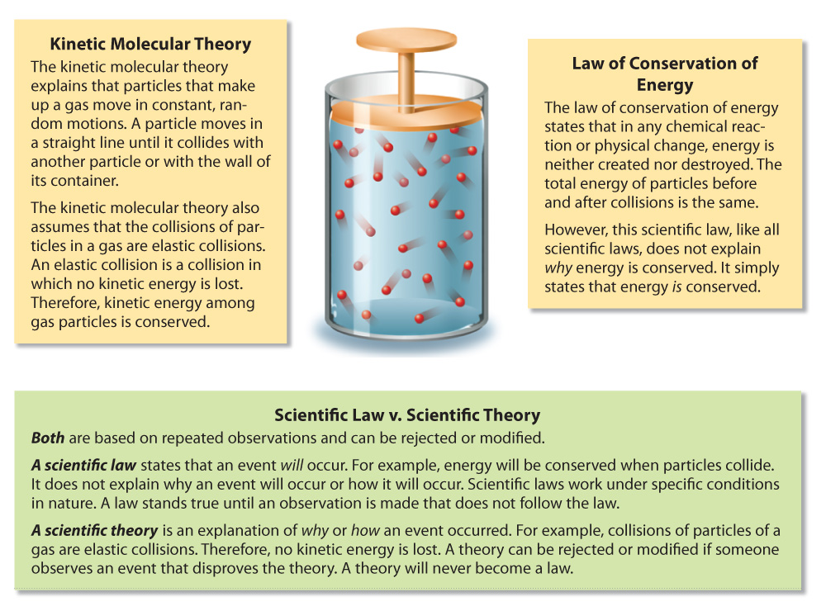




Chapter Menu
Chapter Introduction
Lesson 1 Scientific
Inquiry
Lesson 2 Measurement
and Scientific
Tools
Lesson 3 Case Study
Chapter Wrap-Up

Slide 2


Chapter Introduction
What is scientific inquiry?

Slide 3


Lesson 1 Reading Guide - KC
Scientific Inquiry
What are some steps used during scientific inquiry?
What are the results of scientific inquiry?
What is critical thinking?

Slide 4
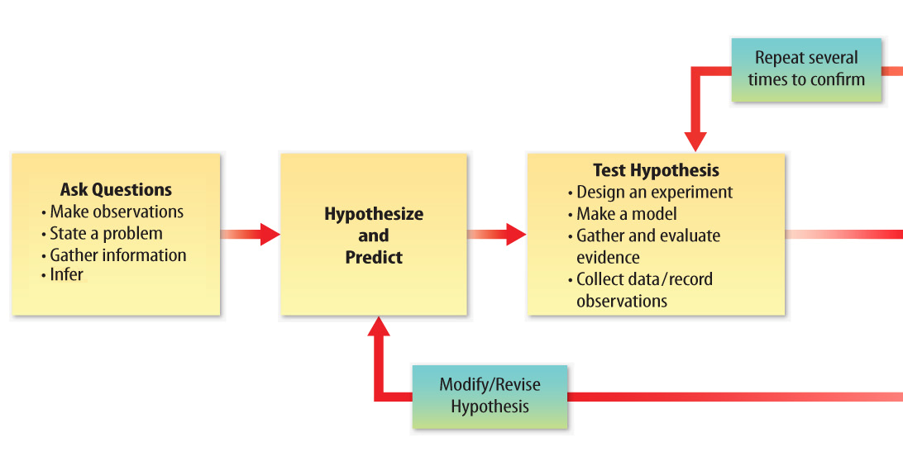
Lesson 1-3
What is Scientific Inquiry?
When scientists conduct investigations, they want to answer questions about a part of the Universe.

Slide 5
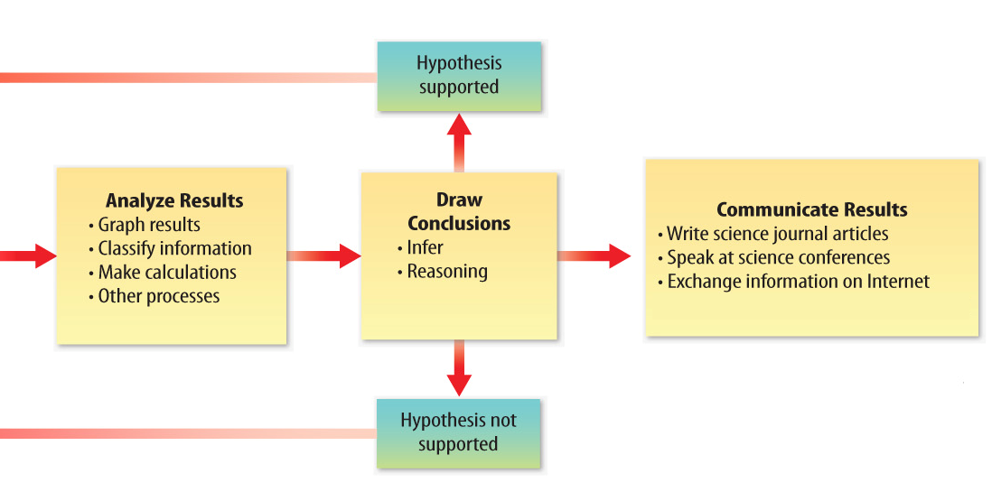
Lesson 1-3
What is Scientific Inquiry? (cont.)
When scientists conduct investigations, they want to answer questions about a part of the Universe.

Slide 6
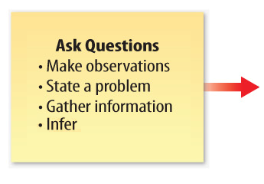
Lesson 1-3
What is Scientific Inquiry? (cont.)
Observations are the results of using one or more of your senses to gather information and taking note of what occurs.

Slide 7
Lesson 1-3
What is Scientific Inquiry? (cont.)
An inference is a logical explanation of an observation that is drawn from prior knowledge or experience.
A hypothesis is a possible explanation for an observation that can be tested by scientific investigations.

Slide 8
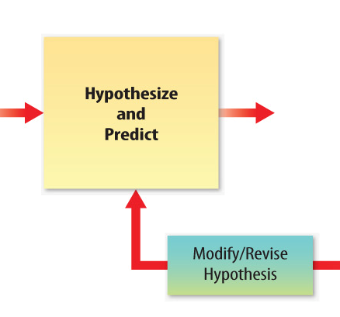
Lesson 1-3
What is Scientific Inquiry? (cont.)
A prediction is a statement of what will happen next in a sequence of events.

Slide 9
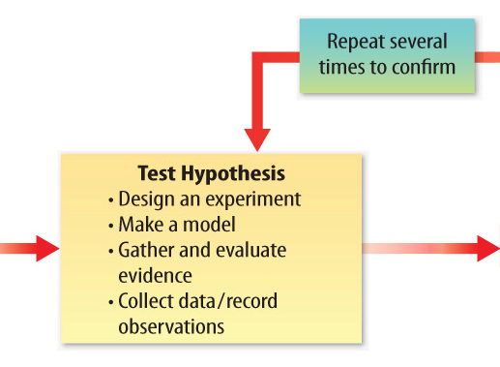
Lesson 1-3
What is Scientific Inquiry? (cont.)
To test your predictions and hypothesis, you design an experiment.

Slide 10
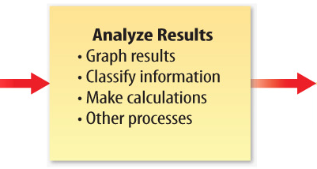
Lesson 1-3
What is Scientific Inquiry? (cont.)
After doing an experiment or research, you analyze your results and findings.

Slide 11
Lesson 1-3
What is Scientific Inquiry? (cont.)
If a prediction is confirmed, then it supports your hypothesis.
If a prediction is not confirmed, you might modify your hypothesis and retest it.

Slide 12
Lesson 1-3
What is Scientific Inquiry? (cont.)
A conclusion is a summary of the information gained from testing a hypothesis.

Slide 13
Lesson 1-3
What is Scientific Inquiry? (cont.)
By exchanging information, scientists evaluate and test others’ work and make progress in their own research.

Slide 14
Lesson 1-3
What is Scientific Inquiry? (cont.)
Each time you test a hypothesis, you learn more about the topic you are studying.
Even when a hypothesis is not supported, you gain valuable information.

Slide 15
Lesson 1-4
Scientific Theory
A scientific theory is an explanation of observations or events that is based on knowledge gained from many observations and investigations.
A scientific theory does not develop from just one hypothesis, but from many tested and not disproven hypotheses that are connected by a common idea.

Slide 16
Lesson 1-5
Scientific Law
A scientific law is a rule that describes a repeatable pattern in nature.
A scientific law does not explain why or how the pattern happens, it only states that it will happen.

Slide 17
Lesson 1-5

Slide 18
Lesson 1-6
Results of Scientific Inquiry
Most often, scientific investigation is used to develop new materials and technology, discover new objects, or find answers to questions.
Technology is the practical use of scientific knowledge.

Slide 19

Lesson 1-6
Results of Scientific Inquiry (cont.)
What are the results of scientific inquiry?

Slide 20
Lesson 1-6
Evaluating Scientific Information
Whether you are reading printed media or watching commercials on TV, it is important that you are skeptical, identify facts and opinions, and think critically about the information.
Critical thinking is a way of deciding if an idea is true, partially true, sometimes true, or false.

Slide 21
Lesson 1-6
Science cannot answer all questions.
There are some questions that science cannot answer.
Questions that deal with beliefs, values, personal opinions, and feelings cannot be answered scientifically.

Slide 22
Lesson 1-6
Safety in Science
When you begin scientific inquiry,
you should always wear protective equipment.
You also should learn the meaning of safety symbols, listen to your teacher’s instructions, and learn to recognize potential hazards.

Slide 23

Lesson 1 – LR1
Which describes an explanation that is based on knowledge gained from many observations and investigation?
A. inference
B. prediction
C. scientific law
D. scientific theory

Slide 24
Lesson 1 – LR2
Which term refers to a possible explanation for an observation that can be tested by scientific investigations?
A. hypothesis
B. prediction
C. scientific law
D. scientific theory

Slide 25
Lesson 1 – LR3
Which term refers to the practical use of scientific knowledge, especially for industrial or commercial use?
A. technology
B. scientific law
C. inference
D. critical thinking

Slide 26
Make sure you have:
  Read pages 6-11
  Tomorrow’s reading p 12-15

