Slide 1



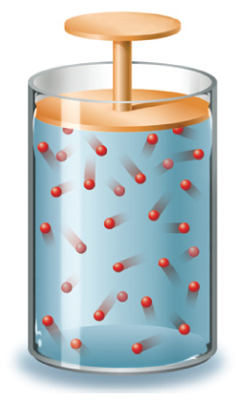




Chapter Menu
Chapter Introduction
Lesson 1 Scientific
Inquiry
Lesson 2 Measurement
and Scientific
Tools
Lesson 3 Case Study
Chapter Wrap-Up

Slide 2



Lesson 2 Reading Guide - KC
Measurement and Scientific Tools
Why did scientists create the International System of Units (SI)?
Why is scientific notation a useful tool for scientists?
How can tools, such as graduated cylinders and triple-beam balances, assist scientists?

Slide 3

Lesson 2 Reading Guide - Vocab
Measurement and Scientific Tools
description
explanation
International System of
Units (SI)
scientific notation
percent error

Slide 4
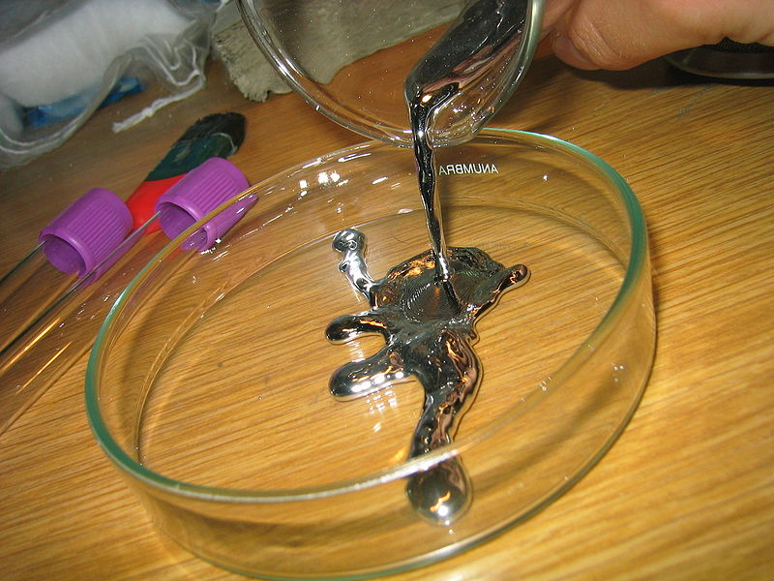
Lesson 2-1
Description and Explanation
Make observations: Video
A description is a summary of observations.
An explanation is an interpretation of observations.
When you describe something, you report your observations. When you explain something, you interpret your observations.

Slide 5
Lesson 2-2
The International System of Units
The International System of Units (SI) is the internationally accepted system of measurement.

Slide 6
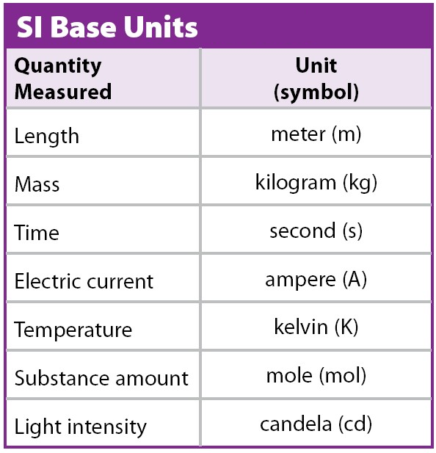
Lesson 2-2
The SI system uses standards of measurement, called base units.
Other units used in the SI system are derived from the base units.
Reference: http://physics.nist.gov/cuu/Units/units.html

Slide 7
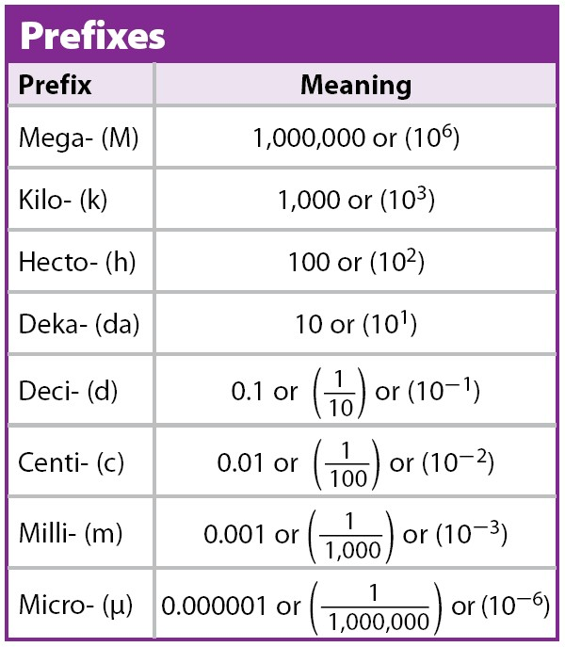
Lesson 2-2
The SI system is based on multiples of ten.
Factors of ten are represented by prefixes.
You either multiply or divide by a factor of ten to convert from one SI unit to another.

Slide 8
SI is used because it is easy to convert from one unit to another!
Prefixes are used to indicate units of different size.
Mr. Boal’s Handy Dandy Conversion line!

Slide 9
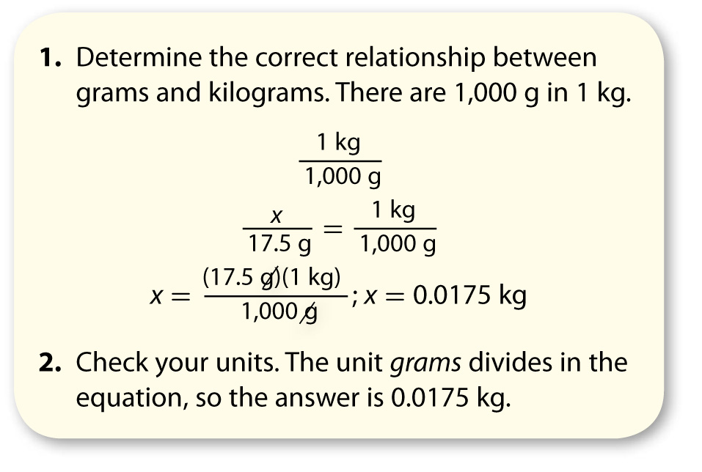
Lesson 2-2
A rock has a mass of 17.5 grams.
How many kilograms is that?

Slide 10
Lesson 2-3
Measurement and Uncertainty
Precision is a description of how similar or close repeated measurements are to each other.
Accuracy is a description of how close a measurement is to an accepted value.

Slide 11
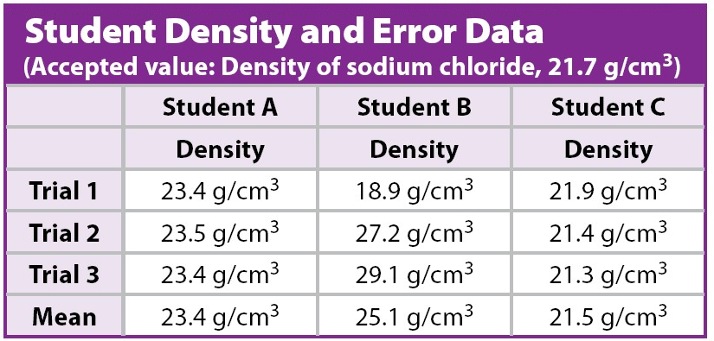
Lesson 2-3
Student A’s measurements are the most precise because they are closest to each other.

Slide 12
Lesson 2-3
Student C’s measurements are the most accurate because they are closest to the scientifically accepted value.

Slide 13
Lesson 2-3
Student B’s measurements are neither precise nor accurate. They are not close to each other or to the accepted value.

Slide 14
Lesson 2-3
Measurement and Uncertainty (cont.)
No measuring tool provides a perfect measurement.
All measurements have some degree
of uncertainty.

Slide 15
Lesson 2-3
Measurement and Uncertainty (cont.)
Scientific notation is a method of writing or displaying very small or very large numbers in a short form.
You would use scientific notation to report Earth’s distance from the Sun—149,600,000 km—and the density of the Sun’s lower atmosphere—0.000000028 g/cm³.

Slide 16

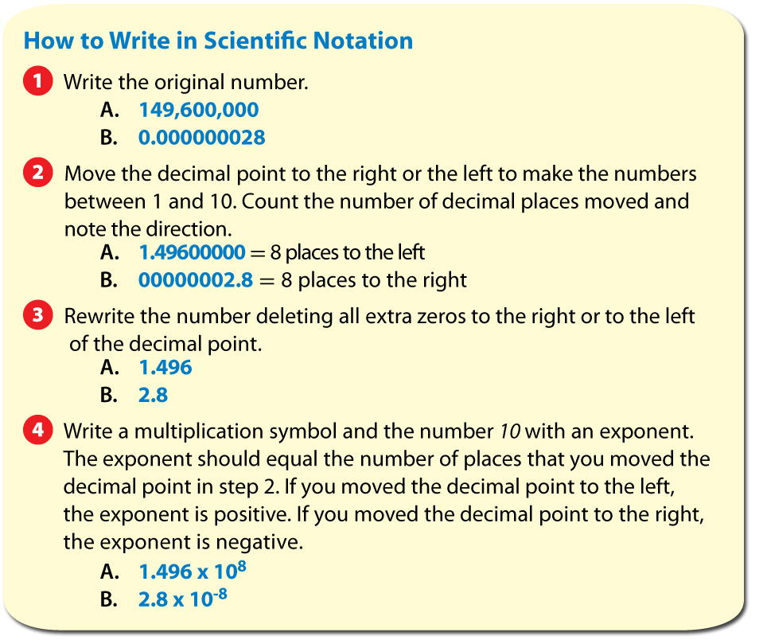
Lesson 2-3

Slide 17
Lesson 2-3
Measurement and Uncertainty (cont.)
Percent error can help you determine
the size of your experimental error.
Percent error is the expression of error as a percentage of the accepted value.

Slide 18
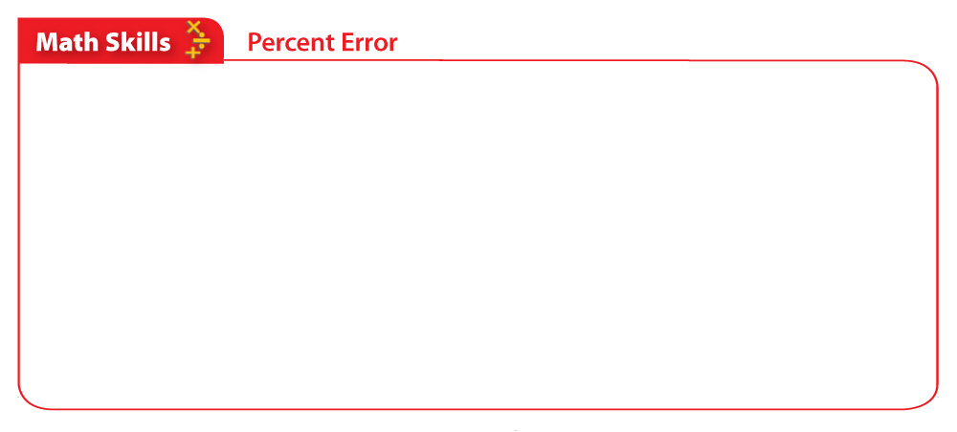
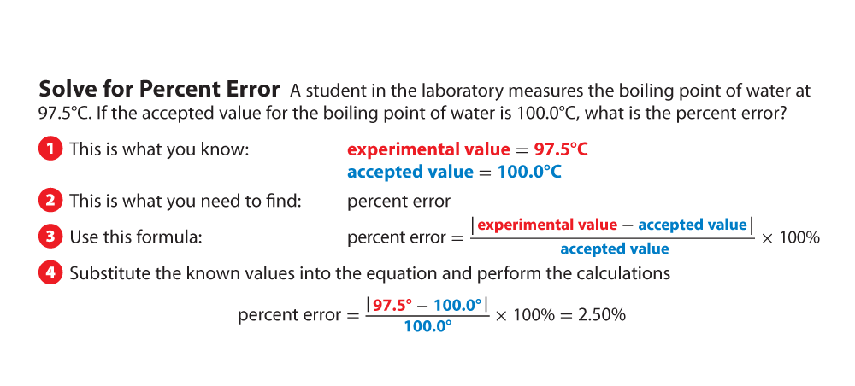
Lesson 2-3
Measurement and Uncertainty (cont.)

Slide 19
Make sure you have:
  Read pages 12—15
  Tomorrow: Quiz on conversion
  Tomorrow’s reading pages 16-18

