Slide 1



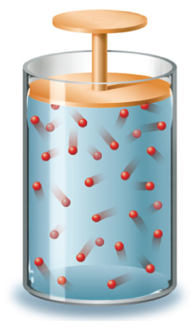




Chapter Menu
Chapter Introduction
Lesson 1 Scientific
Inquiry
Lesson 2 Measurement
and Scientific
Tools
Lesson 3 Case Study
Chapter Wrap-Up

Slide 2



Lesson 2 Reading Guide - KC
Measurement and Scientific Tools
Why did scientists create the International System of Units (SI)?
Why is scientific notation a useful tool for scientists?
How can tools, such as graduated cylinders and triple-beam balances, assist physical scientists?

Slide 3
Lesson 2-4
Scientific Tools
A science journal is used to record observations, write questions and hypotheses, collect data, and analyze the results of scientific inquiry.
A balance is used to measure the mass of an object.
Laboratory glassware, such as flasks, beakers, test tubes, and graduated cylinders, are used to hold or measure the volume of liquids.

Slide 4
Lesson 2-4
Scientific Tools (cont.)
A thermometer is used to measure the temperature of substances.
A hand-held calculator is a scientific tool that can be used in the lab and in the field to make quick calculations using your data.
Scientists can collect, compile, and analyze data more quickly using a computer.

Slide 5
Lesson 2-5
Additional Tools Used by Physical Scientists
pH paper is used to quickly estimate the acidity of a liquid substance.
Hot plates are used to heat substances in the laboratory.

Slide 6
Lesson 2-5
Additional Tools Used by Physical Scientists (cont.)
Scientists use stopwatches to measure the time it takes for an event to occur.
A spring scale is used to measure the weight or the amount of force applied to an object.

Slide 7

Lesson 2 – LR1
Which describes an interpretation of observations?
A. description
B. explanation
C. prefix
D. proportion calculation

Slide 8
Lesson 2 – LR2
What term refers to the standards of measurement used by the International System of Units?
A. base units
B. percent error
C. prefixes
D. scientific notation

Slide 9
Lesson 2 – LR3
Which is used to quickly estimate the acidity of a liquid substance?
A. hot plate
B. pH paper
C. spring scale
D. thermometer

