Slide 1



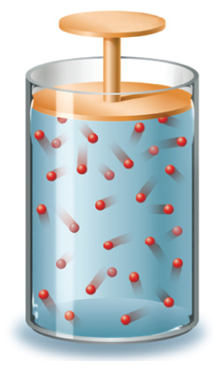




Chapter Menu
Chapter Introduction
Lesson 1 Scientific
Inquiry
Lesson 2 Measurement
and Scientific
Tools
Lesson 3 Case Study
Chapter Wrap-Up

Slide 2



Lesson 3 Reading Guide - KC
Case Study
Why are evaluation and testing important in the design process?
How is scientific inquiry used in a real-life scientific investigation?

Slide 3

Lesson 3 Reading Guide - Vocab
Case Study
variable
constant
independent variable
dependent variable
experimental group
control group
qualitative data
quantitative data

Slide 4
Lesson 3-1
The Minneapolis Bridge Failure
On August 1, 2007, the center section of the Interstate-35W bridge in Minneapolis, Minnesota, suddenly collapsed.
The design and engineering processes that bridges undergo are supposed to ensure that bridge failures do not happen.

Slide 5
Lesson 3-2
Controlled Experiments
After the 2007 bridge collapse, investigators needed to use scientific inquiry to determine why the bridge failed.
The investigators designed controlled experiments to help them answer questions and test their hypotheses.
A controlled experiment is a scientific investigation that tests how one factor affects another.

Slide 6
Lesson 3-2
Controlled Experiments (cont.)
A variable is any factor that can have more than one value.
The independent variable is the factor that you want to test. It is changed by the investigator to observe how it affects a dependent variable.

Slide 7
Lesson 3-2
Controlled Experiments (cont.)
The dependent variable is the factor you observe or measure during an experiment.
Constants are the factors in an experiment that do not change.

Slide 8
Lesson 3-2
Controlled Experiments (cont.)
A controlled experiment usually has at least two groups: the experimental group and the control group.
The experimental group is used to study how a change in the independent variable changes the dependent variable.
The control group contains the same factors as the experimental group, but the independent variable is not changed.

Slide 9
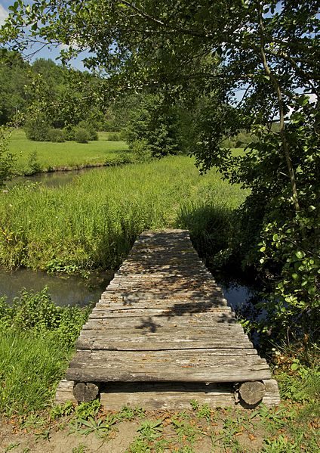
Lesson 3-3
Simple Beam Bridges
The simplest type of bridge is a beam bridge, which has one horizontal beam across two supports.
A disadvantage of beam bridges is that they tend to sag in the middle if they are too long.

Slide 10
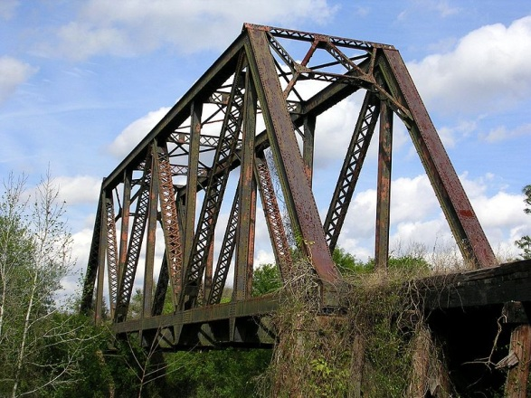
Lesson 3-4
Truss Bridges
A truss bridge often spans long distances.
This type of bridge is supported only at its two ends, but an assembly of interconnected triangles, or trusses, strengthens it.
The I-35W bridge was a truss bridge designed in the early 1960s.

Slide 11
Lesson 3-5
Bridge Failure Observations
After recovering all the pieces of the collapsed bridge, investigators found physical evidence they needed to determine where the breaks in each section of the bridge occurred.
Investigators also used video footage of the bridge collapse to help pinpoint where the collapse began.

Slide 12
Lesson 3-6
Asking Questions
Investigators reviewed the modifications made to the bridge since it opened.
Investigators recorded qualitative and quantitative data.

Slide 13
Lesson 3-6
Asking Questions (cont.)
Qualitative data use words to describe what is observed.
Quantitative data use numbers to describe what is observed.

Slide 14
Lesson 3-6
Asking Questions (cont.)
The analysis of the bridge was conducted using computer-modeling software.
After evaluating the evidence, the accident investigators formulated a hypothesis and then tested their hypothesis and analyzed the results.

Slide 15
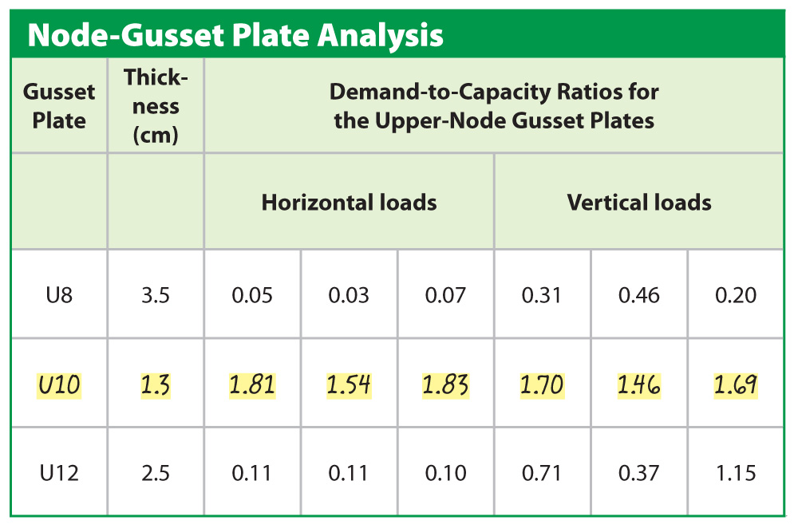
Lesson 3-6
A demand-to-capacity value greater than
1 means the structure is unsafe. Notice how high the ratios are for the U10 gusset plate compared to the other plates.

Slide 16
Lesson 3-6
Asking Questions (cont.)
Investigators concluded that if the gusset plates were properly designed, they would have supported the added load, which led to the bridge collapse.
Reports published by the Federal Highway Administration and the National Transportation Safety Board now provide scientists and engineers with valuable information they can use in future bridge designs.

