Slide 1
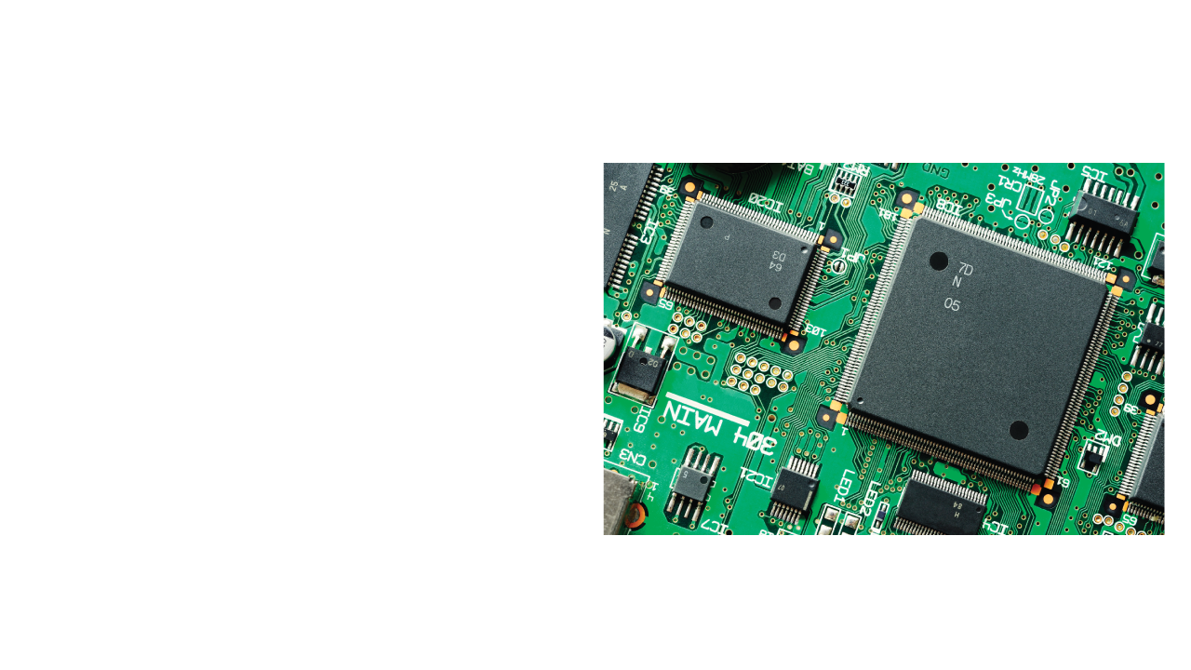

Electricity and circuits
Notes:
This lesson introduces the topic of electricity in general, and its practical applications. It includes the concepts of electric current and its unit, electric circuits, and schematic diagrams for circuit elements, and distinguishes between open circuits, closed circuits, and short circuits.

Slide 2
Objectives
Define electric current.
Identify the electric symbols for basic circuit elements.
Use a multimeter to test continuity.
Identify and construct open, closed, and short circuits.
Notes:
Tell students they will be learning some of the basic, practical information that is used by real electricians and electrical engineers.

Slide 3
Physics terms
electric current
ampere (A)
electric circuit
open circuit
closed circuit
short circuit
Notes:
The ampere is the unit of electric current. The students will be using the ampere throughout this unit. You might prompt the students to think of what other units they expect to encounter. Perhaps they will mention volts, ohms, or watts.

Slide 4

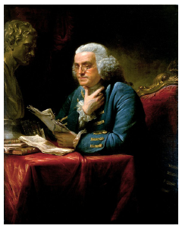
Ben Franklin and his kite
Legend has it that Benjamin Franklin flew his metal key on his kite in a lightning storm.
Do you think the story is true? Why or why not?
Notes:
Benjamin Franklin suggested this experiment, but it is unclear from his notes whether he ever attempted some version of it. To try this in an actual lightning storm would be to risk death by electrocution. If he performed this experiment, he was lucky to survive it.

Slide 5
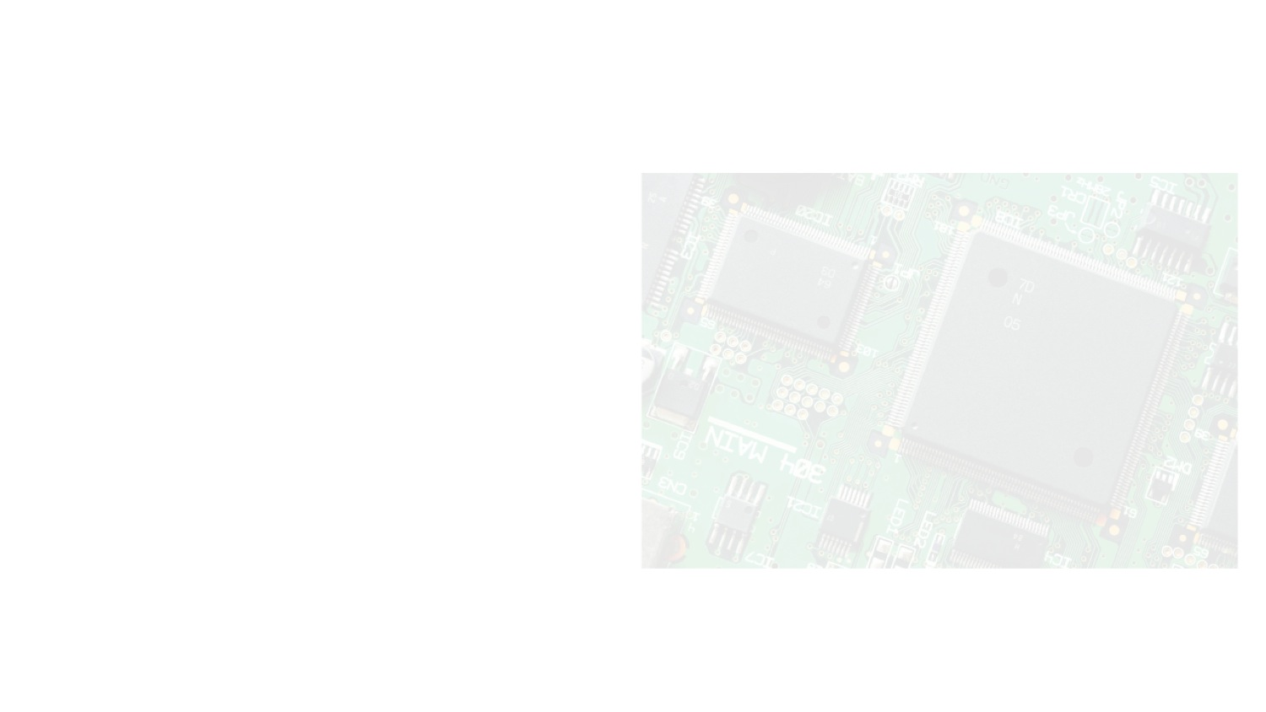
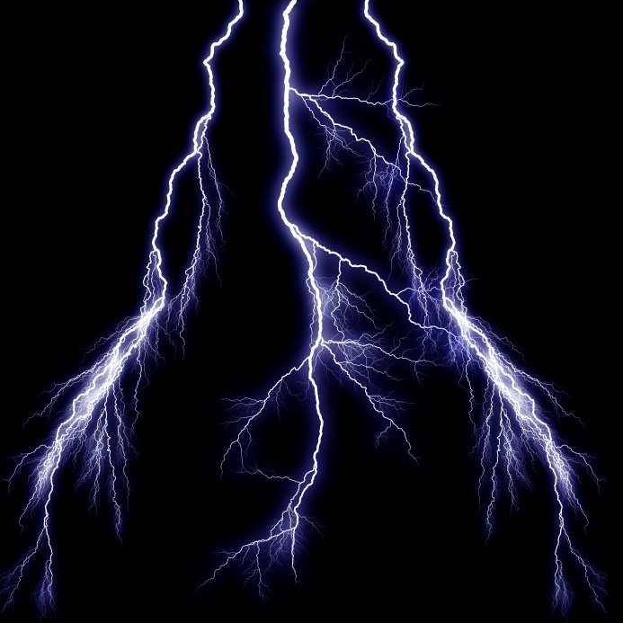
What is electricity?
Electricity is the flow of electric charges, typically through wires, conductors, and electrical devices.
Sometimes we can see the effects of electricity in nature.
Notes:
Ask the students for a couple of examples of static electricity in their everyday lives. When scientists first started learning about electricity, they did not know how to create currents in the laboratory. They could only create static charges.

Slide 6
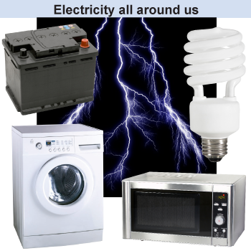
How do we use electricity?
Many household appliances and personal devices use electricity.
The room you are in right now is probably full of devices that use electricity.
Notes:
Ask the students for examples of electricity use in the room where you are working. This will help students appreciate the ways that this topic is relevant to their lives.

Slide 7
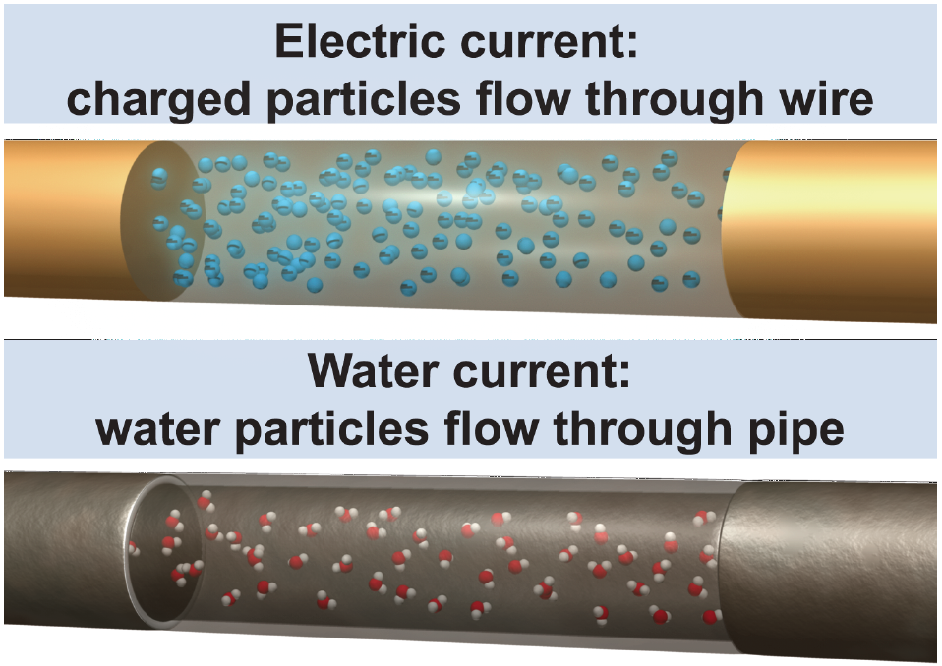
What is electric current?
Electric current is the flow of charged particles, usually through wires and circuits.
Current is measured in amperes (A), also called amps.
Animated illustration, page 472
Notes:
See page 472 for this mouse-over animated illustration. Water current can be measured as the amount of water that flows past a certain point in a pipe every second. Electric current is a measure of the amount of electric charge that flows through a certain point in a wire every second. The charges are always in the wires, but there is only a current if the charges flow along the wire.

Slide 8
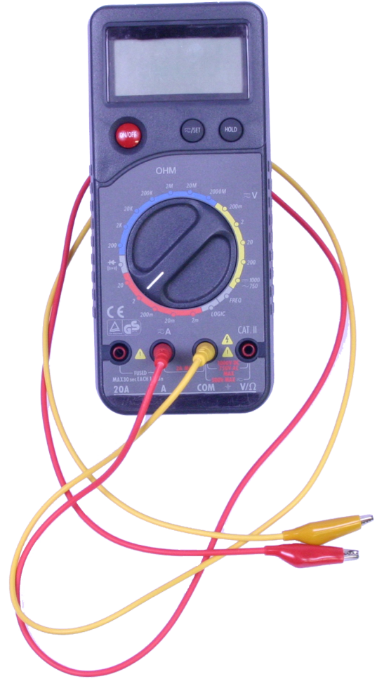
How do we measure electric current?
Electric current is measured using an ammeter or, more commonly, a digital multimeter.
In order to properly measure current, all the current must flow into the meter and back out again, into the circuit being tested.
Notes:
In other words, the multimeter must be connected in series.

Slide 9
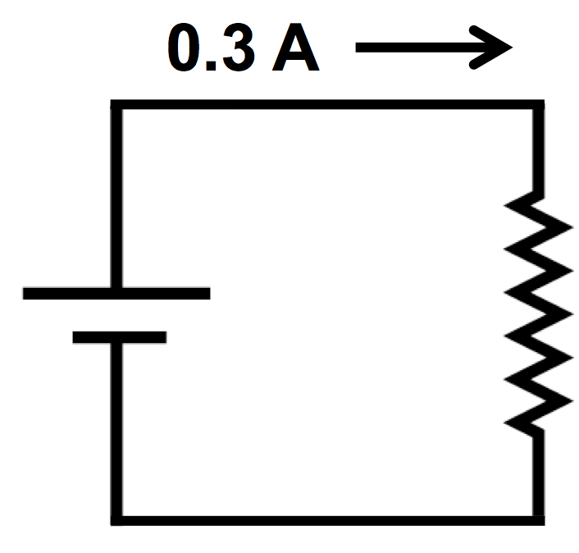
What is an electric circuit?
An electric circuit is a conducting path through which electric current can flow.
The symbol for electric current is I.
In this circuit, I = 0.3 amps.

Slide 10
Charge is conserved
Electric current I must be the same at all points in a simple, single-loop circuit.
Charge can never be created or destroyed. All the charge that flows through one point in the circuit must flow through the next point also.
I
I
Notes:
To get them ready for the next slide, ask “What kinds of parts might we need to have to build a circuit in the classroom?”

Slide 11
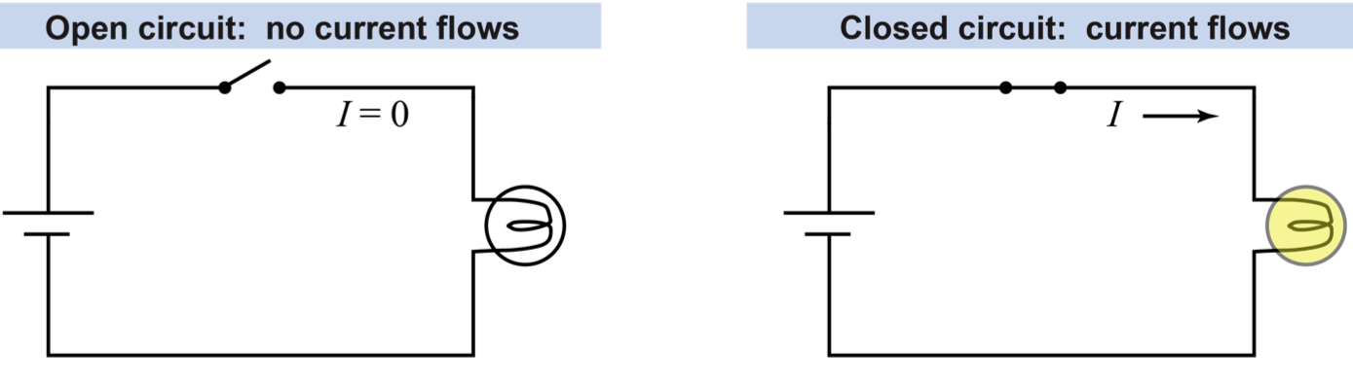
Open and closed circuits
An open circuit does not have a complete path so no current flows.
A closed circuit has a complete path, allowing current to flow.
Notes:
Point out the direction of the current arrow in the closed circuit, which shows current flowing from the positive battery terminal toward the negative terminal. This is called the “conventional current” direction, and is the direction that positive charges would flow through the circuit. Students will use this convention throughout the unit. (In fact, it is actually the electrons that flow, and they flow in the opposite direction)

Slide 12
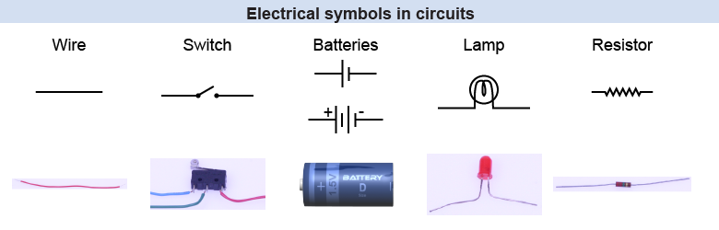
Common circuit elements
Notes:
Draw the students’ attention to the electrical symbol for each component. Point out the long and short slashes on the battery symbol, representing the + and – terminals. A battery can be represented by one or more sets of these slashes. Reassure them that they will be learning about resistors soon, but not in this lesson.

Slide 13
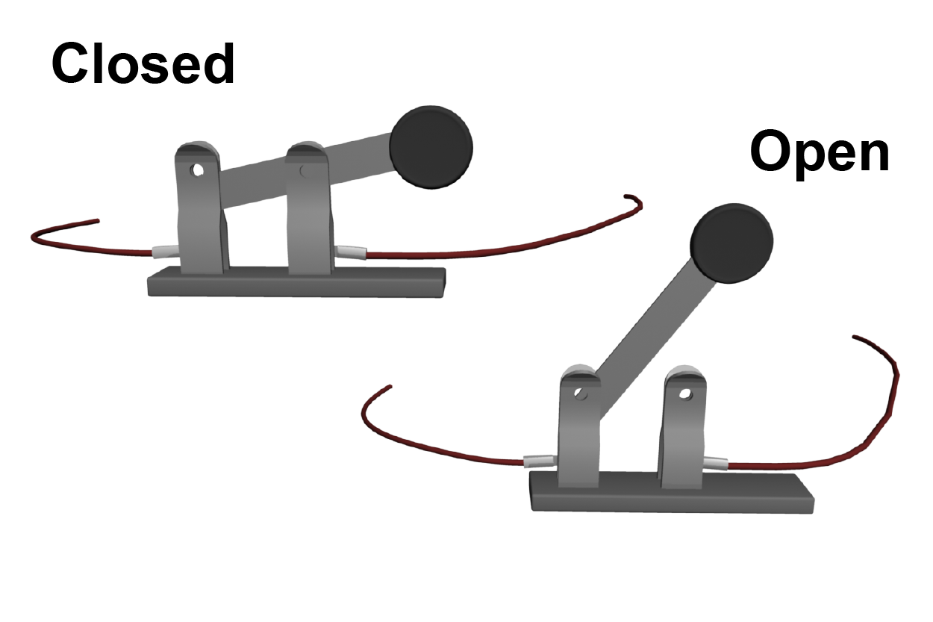
Knife blade switches
A knife blade switch uses a mechanical lever to open/close a circuit connection.
The handle is an insulator, so you won’t get a shock when you touch it!
When attaching a knife blade switch to a circuit, do so with it in the open position.
Notes:
The current flows much more easily through a simple wire than it does through the bulb and resistors. So when the switch is closed the current takes the easy way around and almost no current at all will flow through the other three paths.

Slide 14
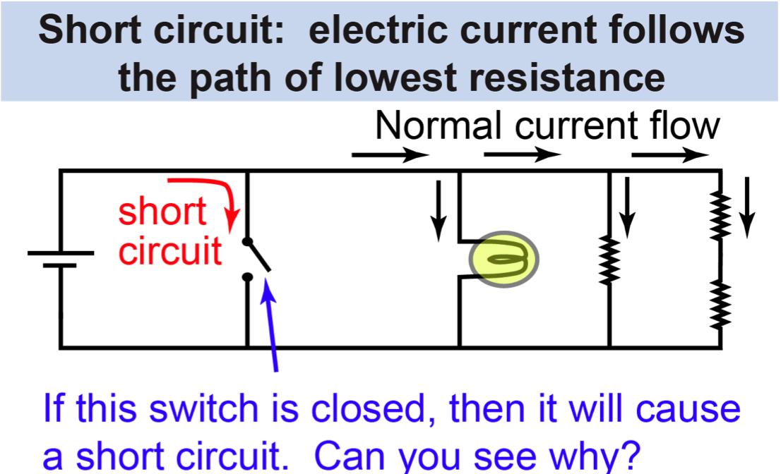
What is a short circuit?
Notes:
The current flows much more easily through a simple wire than it does through the bulb and resistors. So when the switch is closed the current takes the easy way around and almost no current at all will flow through the other three paths.

Slide 15
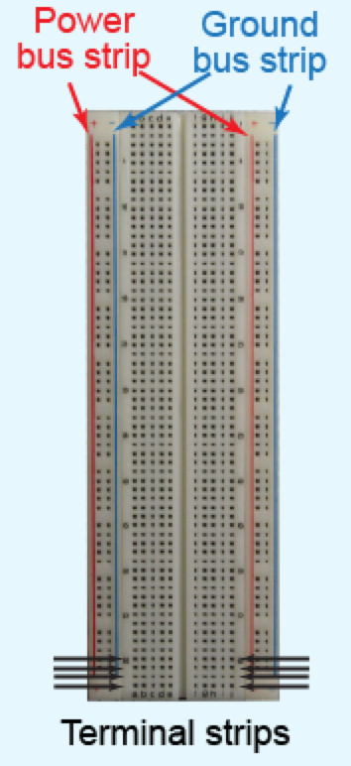
What is a breadboard?
A circuit breadboard is a device used for mounting and prototyping electric circuits.
Power and ground are connected from an external source to strips on the edge of the breadboard.
Notes:
Many years ago, before these breadboards were invented and made commonly available, people needed an easy way to create and test their prototype electric circuits without having to solder all the connections. They solved the problem by hammering rows of nails into an actual piece of wood such as a breadboard, and connected their circuit elements via these nails. These solderless breadboards are now also referred to as prototyping boards, or protoboards.

Slide 16
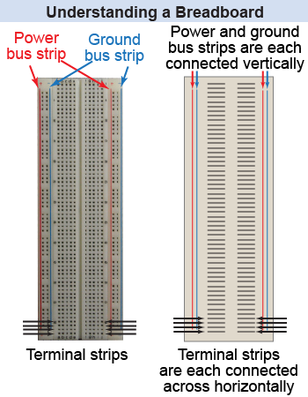
Breadboards
All the holes along the vertical power bus strip are connected to each other.
All holes along the horizontal terminal strips are connected to each other.
Adjacent terminal strips do not connect across the center.
Notes:
Overview of a typical breadboard showing the conducting strips under the plastic.

