Slide 1
Compound problems

Slide 2
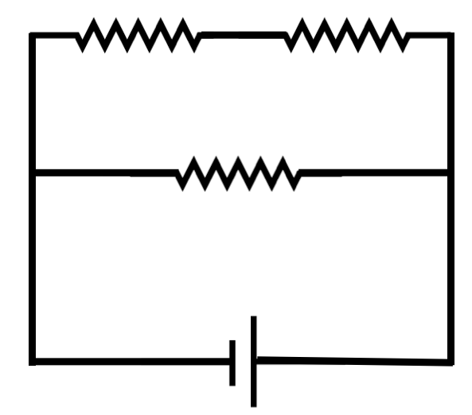
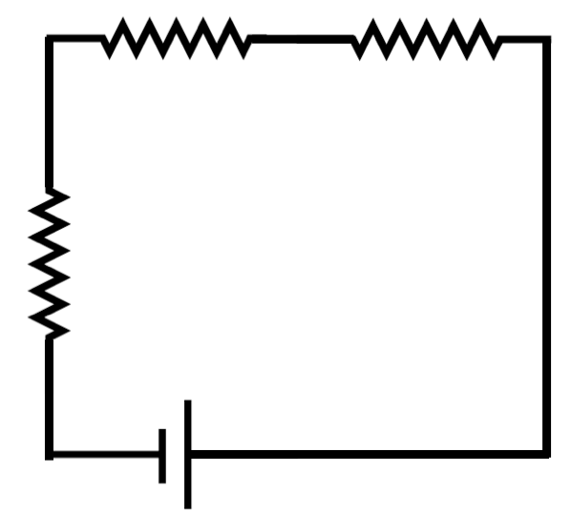
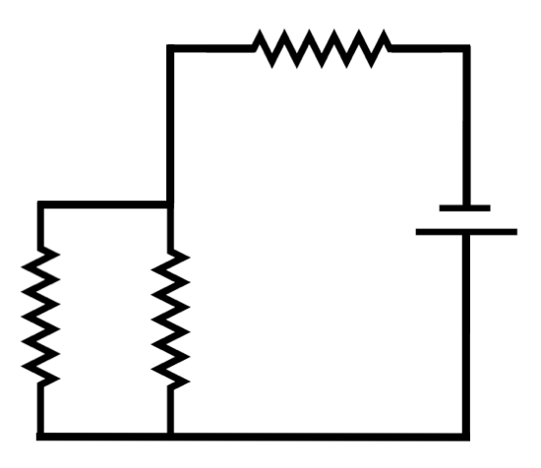
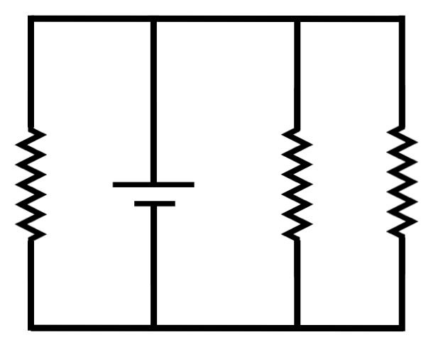
Assessment
1. Identify each circuit as a series, parallel, or compound arrangement.
A. B.
C. D.

Slide 3
Assessment
1. Identify each circuit as a series, parallel, or compound arrangement.
A. B.
compound series
C. D.
parallel
compound

Slide 4
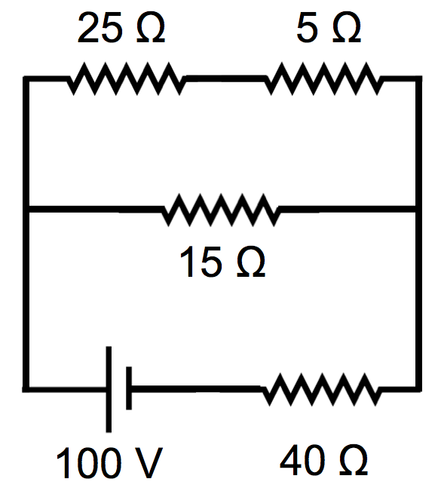
Assessment
For the circuit shown, calculate the equivalent resistance and the current through the battery.

Slide 5

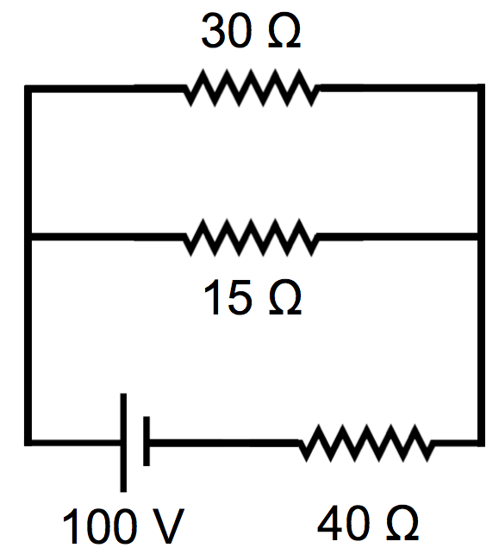
Assessment
For the circuit shown, calculate the equivalent resistance and the current through the battery.

Slide 6
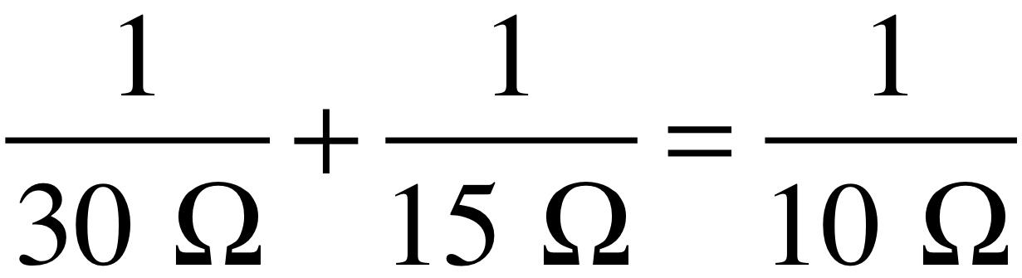
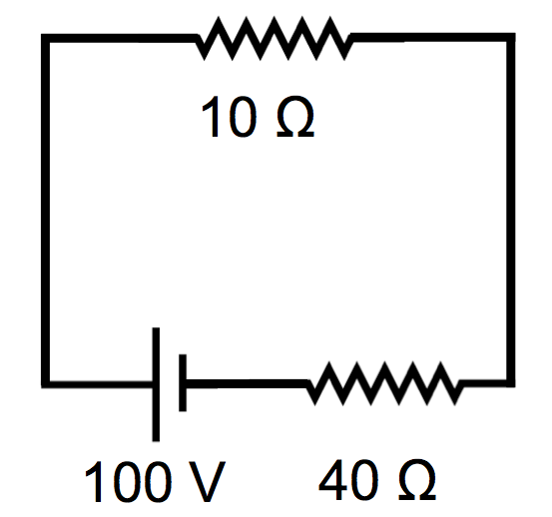
Assessment
For the circuit shown, calculate the equivalent resistance and the current through the battery.

Slide 7

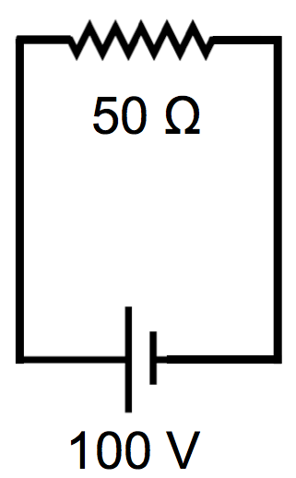
Assessment
For the circuit shown, calculate the equivalent resistance and the current through the battery. R_{eq} = 50 Ω

Slide 8
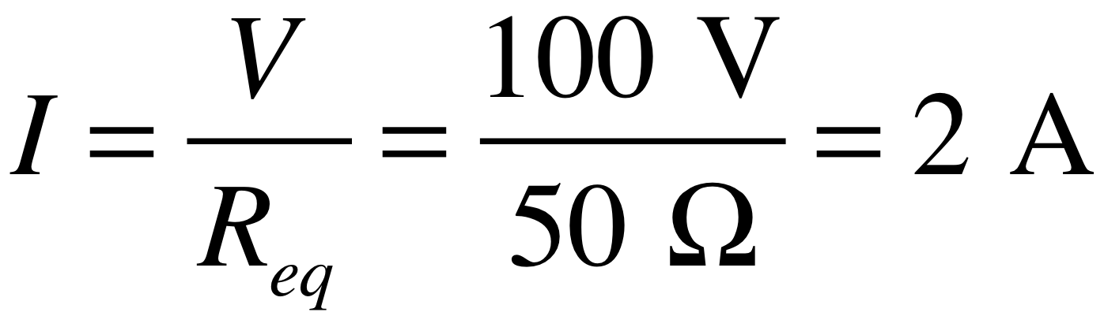
Assessment
For the circuit shown, calculate the equivalent resistance and the current through the battery. R_{eq} = 50 Ω
The current through the battery is 2 amps.

Slide 9
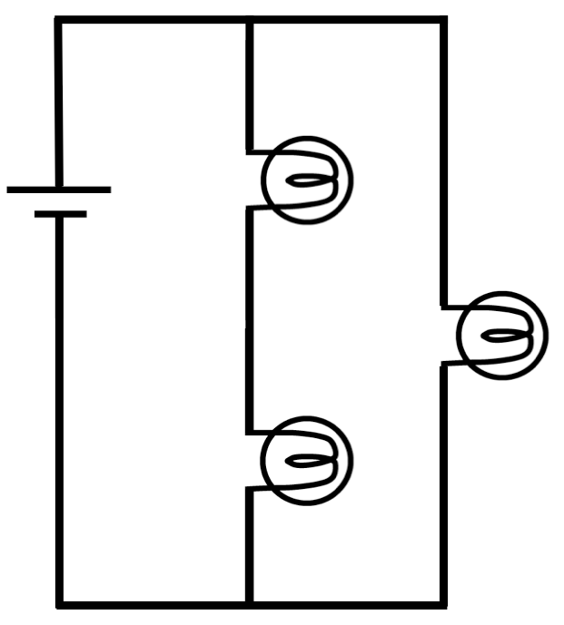
Assessment
The bulbs in this circuit are identical. Rank the bulbs in order of brightness, from brightest to dimmest. Explain.
A
B
C

Slide 10
Assessment
The bulbs in this circuit are identical. Rank the bulbs in order of brightness, from brightest to dimmest. Explain.
B is brightest. A and C are the same.
Brightness is power: P = I²R
The resistances are equal, so the bulb with more current is brighter.
A and C have equal current.
B has twice as much.
A
B
C

