Slide 1
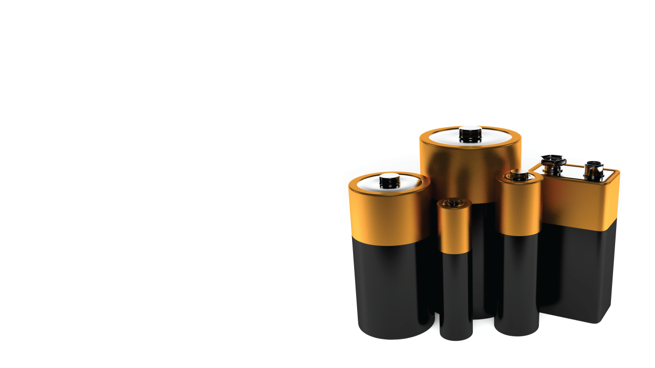

Voltage and batteries

Slide 2
Objectives
Define voltage source.
Distinguish between parallel and series arrangements of batteries.
Construct electric circuits with batteries connected in series and in parallel.
Calculate the combined voltage of batteries connected in series and in parallel.
Notes:
Assessments for the first, second and fourth objectives appear on the next two slides. Assessment of the construction of electric circuits will be included within the hands-on investigation contained in this lesson.

Slide 3
Physics terms
voltage
volt (V)
battery
voltmeter
Notes:
Voltage, the quantity, is measured in volts, the unit. Both are represented by the letter V.

Slide 4
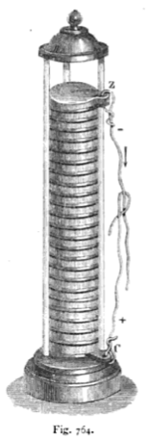
A reliable source of current
Prior to 1800, no one knew how to create a steady supply of electric current.
Alessandro Volta was the first to succeed.
He discovered that placing two different metals in an acid or salt solution produced an electric current between the terminals.
He connected multiple voltaic piles together to create a battery of them.
Adolphe Ganot, Elementary Treatise on Physics, 1893
Notes:
The volt was named in honor of Alessandro Volta, the first person to create an electric current! Think of all the devices that were created as a result of his work.

Slide 5
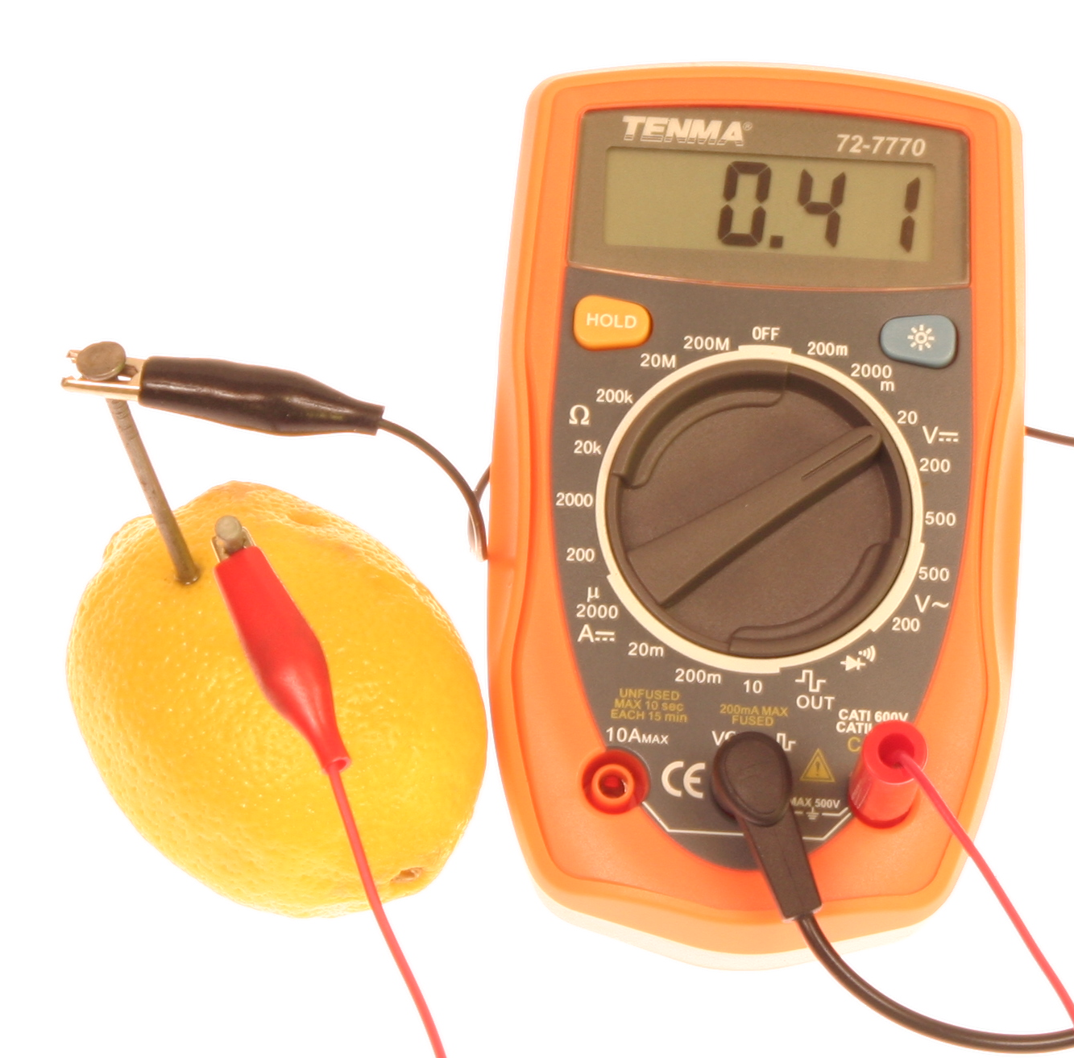
What is a battery?
A battery is a device that converts stored chemical energy into electrical energy.
chemical energy
electrical
energy
Notes:
The multimeter in this figure is reading 0.41 Volts. But the lemon by itself is not creating this voltage. The juice inside a lemon is being used in place of Volta’s acid or salt solution. Point out to the students that the nails in the lemon must be made of two different metals.

Slide 6

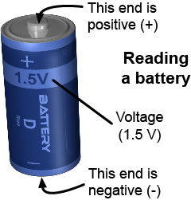
Reading a battery
The voltage of a battery is the difference in electric potential between the battery terminals.
The unit of voltage is the volt (V), named after Volta, the inventor of the battery.
Batteries come in many voltages: 1.5 V, 6V, 9V, and 12 V, for example.
Notes:
Ask the students the voltage of a typical car battery (12 V). The voltage of a wall socket? (120 V).

Slide 7
Voltage versus current
Voltage and current are the two most important physical quantities for understanding electric circuits.
Current measures the flow of charge through a wire—in amps, or amperes.
Voltage measures the change in electrical potential energy per unit of charge—in volts.
Notes:
Voltage is one of the most difficult concepts for students to grasp. It is the difference in electric potential energy per coulomb of charge between two points. But for students, it is important for them to grasp that current is the actual amount of “stuff” (charges) that flows through the wires, and voltage is a measure of the energy of those charges.

Slide 8
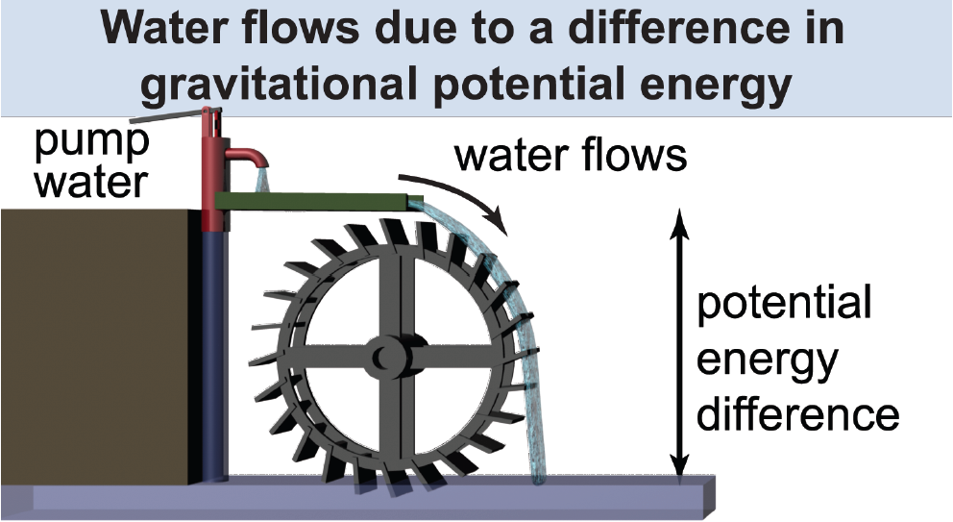
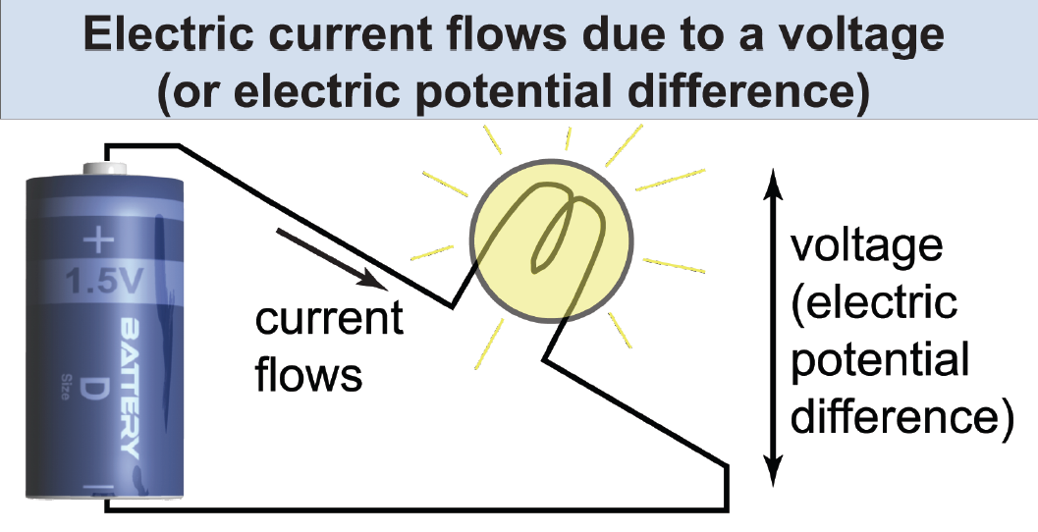
A useful analogy
Charges in a wire are analogous to water in a pipe:
Electric current is analogous to the flow of the water.
Voltage is analogous to the change in gravitational E_{p}.
The battery is analogous to the water pump.

Slide 9
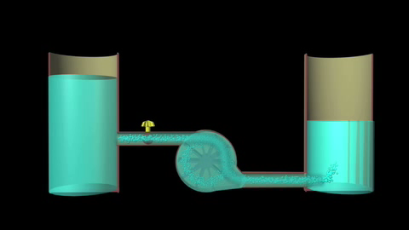
A useful analogy
Water flows because there is an energy difference, measured in height.
Current flows because there is an energy (potential) difference, measured in volts.
animated illustration, page 475
Notes:
Mouse over this slide to make the animation bar visible. If this animation does not function on your setup, use the one in the e-Book.
Water always flows from a position of high gravitational potential energy to a position of lower potential energy.
Charges always flow from a position of high electric potential to a position of lower electric potential.

Slide 10
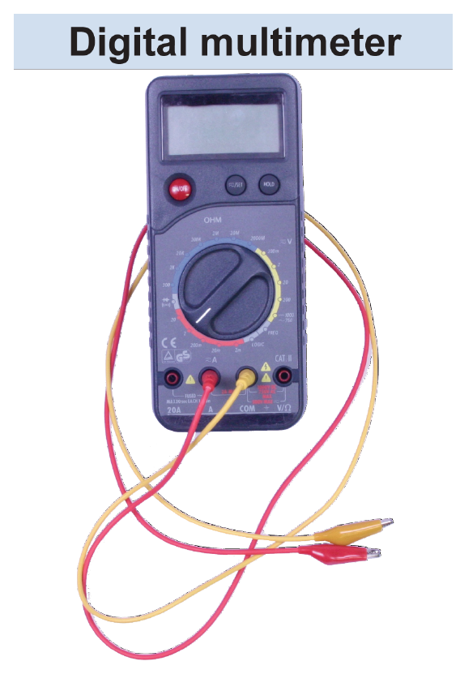
How is voltage measured?
Voltage is measured using a voltmeter or a digital multimeter.
To measure voltage, the two leads (wires) must touch the opposite ends of the battery or other circuit element.
Notes:
A digital multimeter is a very handy device because it can read voltage, current, and resistance (and may have additional functions, such as the ability to read capacitance).

Slide 11
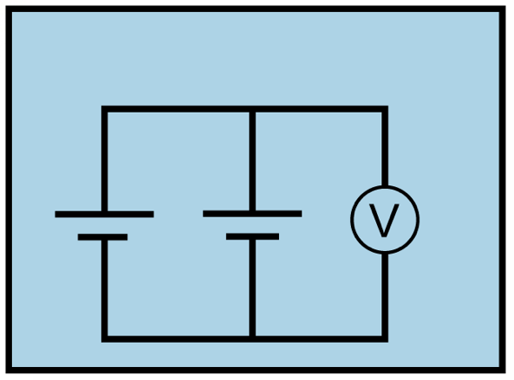
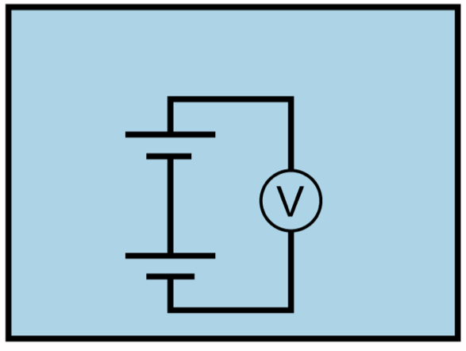
Draw a conclusion
How do you connect batteries together to create a larger voltage than either battery alone?
Explain why this is the case by referring to the circuit diagrams.
Explain why this is the case by using an analogy to water.
Notes:
Two voltage sources in series acts like a set of pumps in a water circuit. The first pump raises the water through some initial height. The second pump raises that water through an additional height, giving it even greater gravitational potential energy

Slide 12
Summarizing the results
To calculate the voltage across batteries connected in series or in parallel:
When batteries are connected in series, the voltages add together.
When identical batteries are connected in parallel, the total voltage remains the same.

Slide 13
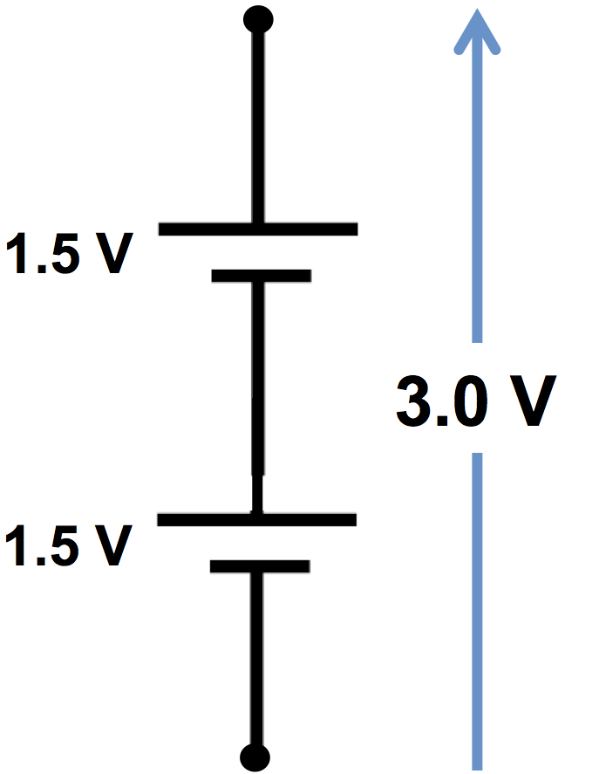
Why does it work this way?
When the batteries are connected in series, the voltages add together.
Electric charge (1 coulomb) passing through a 1.5 volt battery gains 1.5 joules of E_{p}.
Passing through a second 1.5 volt battery gains another 1.5 joules of E_{p}.
It’s like climbing a stairway to the second floor, then another stairway to the third floor.

Slide 14
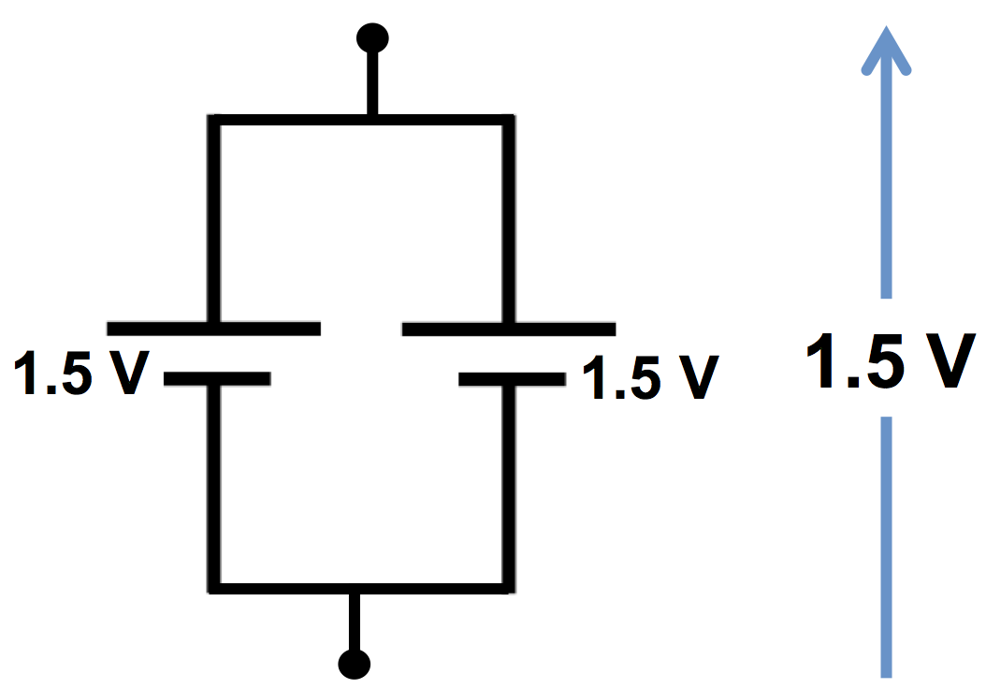
Why does it work this way?
When the batteries are connected in parallel, the total voltage remains the same.
Electric charge passes through one battery OR the other.
It ONLY gains 1.5 joules of E_{p} because each charge ONLY passes through one battery.
It’s like climbing either of two stairways from the first to second floor.
Notes:
There is still one advantage to adding batteries in parallel: the batteries last twice as long because each is supplying only half of the energy used by the circuit.

Slide 15
Disposing of used batteries
Did you only use as many batteries as needed for your investigation?
Batteries last for a long time, but what do you do when they are used up?
Alkaline batteries: These batteries used to contain mercury, and so would have to be disposed with hazardous waste. Today, most alkaline batteries have no mercury and can be disposed in the trash. Do not pile many batteries together, however, because they can connect with each other and become hot!
Rechargeable batteries: (nickel cadmium, lithium, car batteries, etc.) These must be recycled directly at a waste management center or through an auto dealer or home hardware store.

Slide 16
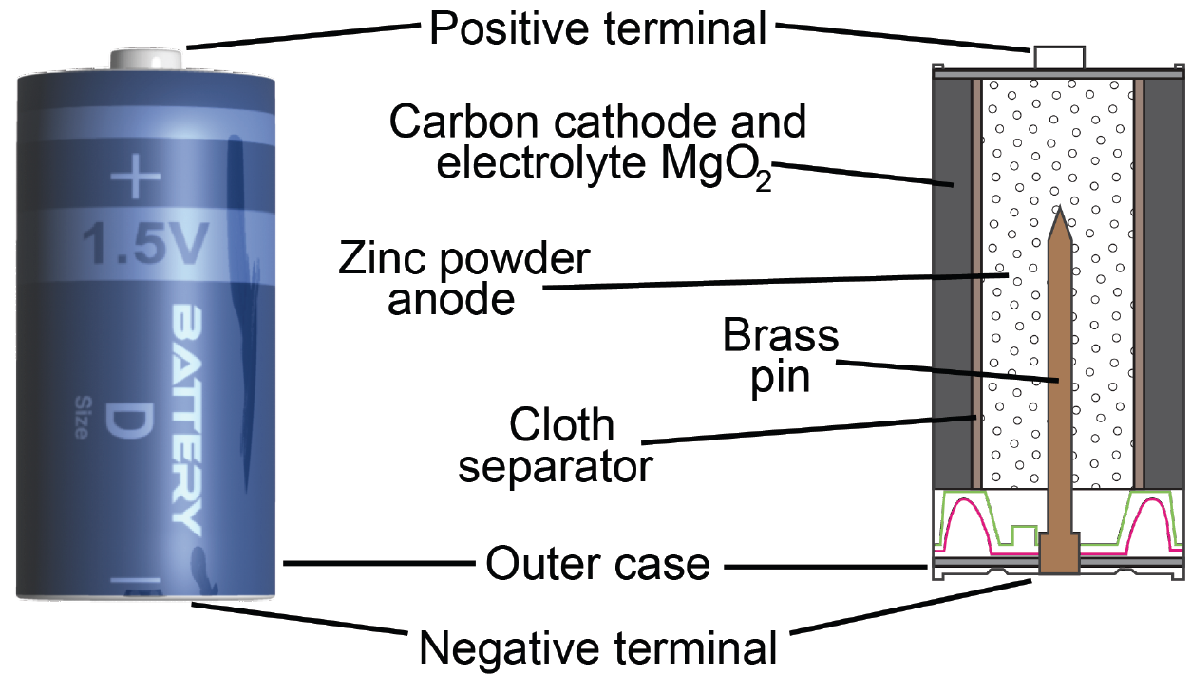
Going further: What’s inside a battery
Notes:
Advanced students may be curious about how the battery works. Refer them to their e-Book, which provides additional information.

